Slide 1
What we learned in financial education
By,
Josh, Sierra, Lea, Bryce and Dmitri.

Slide 2
In Financial Education we have learned lots of things and we are going to show you what topics stood out the most to us.

Slide 3
Assets and Liabilities
A Asset is something that puts money in your pocket, for example a rental house, or a company.
A Liability is something that takes money out of your pocket , for example, a new car, family (in a good way) or putting yourself through school (books, tuition, etc)

Slide 4
Debt and Loan
Debt is when you owe money to someone or the bank. For example you borrow money from the bank to buy a awesome sports car and you can’t pay back your money you borrowed.
A Loan is when an arrangement in which a lender (bank) gives money to a person, but this person has to agree to repay the money back to the lender.

Slide 5
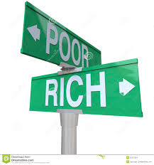
The Difference Between The Rich And The Wealthy.
We learned that the rich have money at the Moment but cannot sustain themselves for very long without a job.
But the wealthy buys assets first rather than liabilities, then when there out of a job or retired they can still are acquiring positive cash flow.

Slide 6
What's the difference between positive and negative Cash Flow.
Positive Cash Flow: Is when you are getting a decent amount of money coming into your account, being made by assets you bought in the past, for example rental houses.
Negative Cash Flow: Is when more money is coming out of your bank account, then coming in, we learned that that going into debt to buy liabilities can cause this for sure.

Slide 7
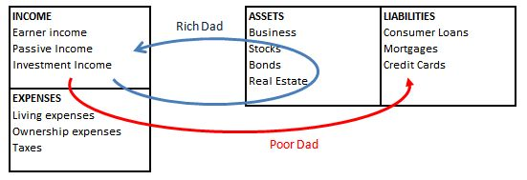
Here is a more simple way of explaining positive cash flow and negative cash flow
Blue is positive and Red is negative
Cash flow.

Slide 8
R.O.I (Return on investment)
A R.O.I means the money you get back after your initial investment. For example you will get a R.O.I from stocks, or shares in a company.
invest
Start to break even from debt
Money in your pocket

Slide 9
What is Passive Income?
We learned that cash flow and passive income actually goes hand In hand because passive income is the money that is made after expenses from a asset. So its kind of the same as cash flow.

Slide 10
Budgets
We learned that budgeting is actually important to peoples lives because if they didn’t have spending budgets people would be spending until they are broke and in debt.

Slide 11
What Is The Rat Race.
Well we learned that the Rat Race is actually a very big problem for the majority of the population (Middle Class) because lots of people decide to buy liabilities instead of assets that would make them money in the future therefore becoming stuck in the Rat Race, and even sometimes people never do get enough money in their savings to escape the Rat Race. And mostly the reason for this problem is because these people never really got taught about money and buying assets in school, and this is why Financial Ed is so beneficial for our future.

Slide 12
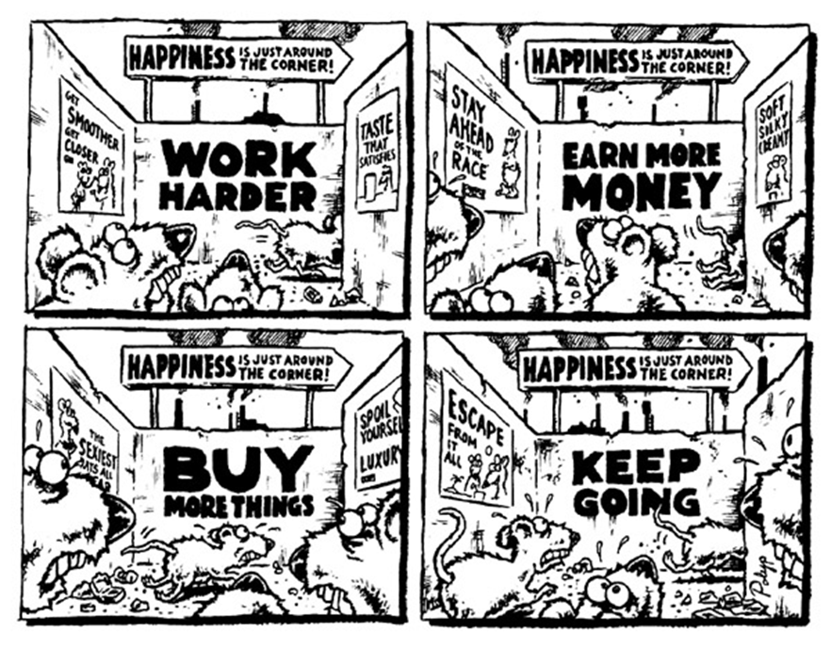

Slide 13
The End And thanks for watching!
For More info visit:
https://www.richdadcoaching.com

