Slide 1
Section 3.3
Triangulation, Parallax and Doppler effect

Slide 2
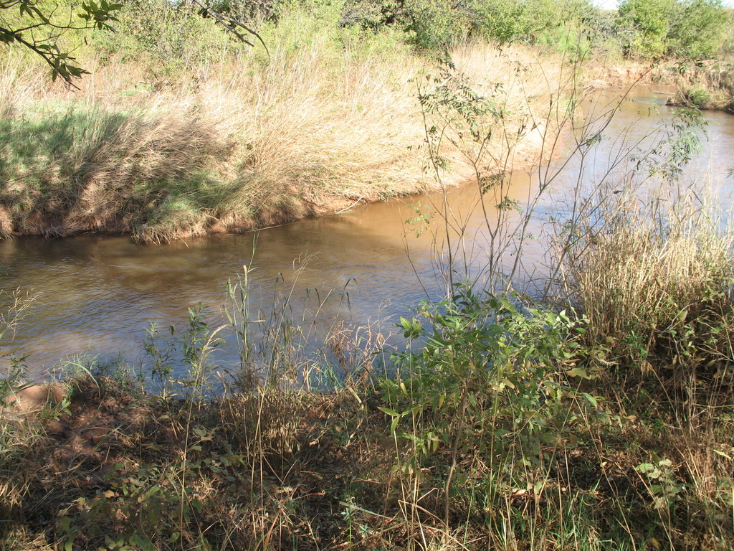
Using triangulation to measure the distance across a river without actually crossing the river…
Point on the distance object
Angles to be measured
BASELINE

Slide 3
Steps for triangulation:
Measure a baseline
Stand at one end of the baseline and measure the angle with a protractor to determine the angle between the end of your baseline and the object.
Go to the other end of the baseline and measure the angle between the end of your baseline and the object
Make a scale drawing using the length of the baseline and the two angles
On your drawing, mark a perpendicular line from the baseline to the object. Measure this line and use the scale to convert it to actual length. This will give you the distance across the river.

Slide 4
Example 1
You’re trying to cross a river and you would like to know what the distance is from where you’re standing to a tree on the other side. You measure out a baseline of 100m. Angle A is 75° and angle B is 65°. What is the distance across?
Step one: What scale of drawing will you use?
1 cm = ?
Step two: measure your angles
Step three: draw straight lines using your angles
Step four: draw a perpendicular line from the baseline to your object.
Step four: measure this final line, and convert it into actual distance.

Slide 5
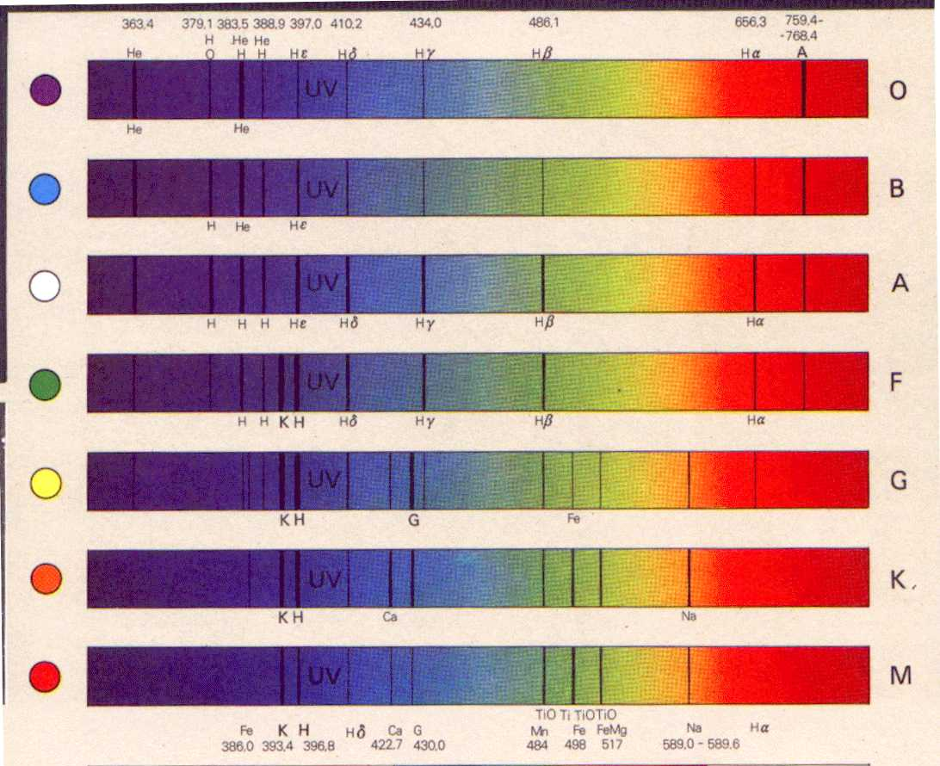
Star’s composition – using a spectrometer

Slide 6
Doppler Effect
http://www.wwnorton.com/college/geo/egeo/animations/ch1.htm
http://galileoandeinstein.physics.virginia.edu/more_stuff/flashlets/doppler.htm
Big Bang Theory…
http://www.youtube.com/watch?v=Y5KaeCZ_AaY
http://www.youtube.com/watch?v=J43lAESftPs&NR=1

Slide 7
Red shift, Blue shift
The dark bands move in response to the light waves of a moving star.
BLUE SHIFT – toward the blue end, means the star is approaching earth
RED SHIFT – toward the red end, means the star is moving away from the earth
NO SHIFT – star and earth are moving in the same direction (star is stationary).

Slide 9
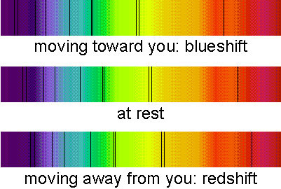

Slide 10
RED BLUE SHIFT animations
http://www.wwnorton.com/college/geo/egeo/animations/ch1.htm

Slide 11
Complete the following:
Rest of the white practice booklet.
Use your notes and textbook section 3.0 to complete the questions.

