Slide 1
Section 3.0
Optical telescopes, radio telescopes, and other technologies advance our understanding of space.

Slide 2
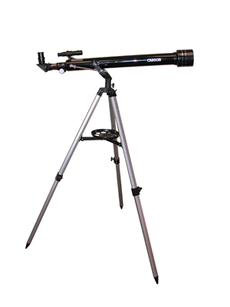
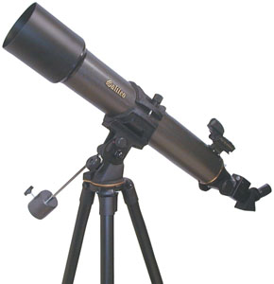
Using Technology to See the Visible
Optical Telescopes:

Slide 3
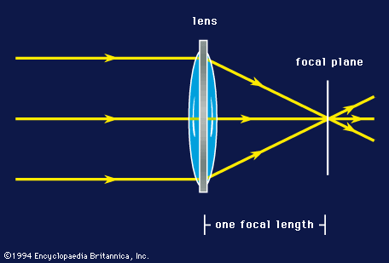
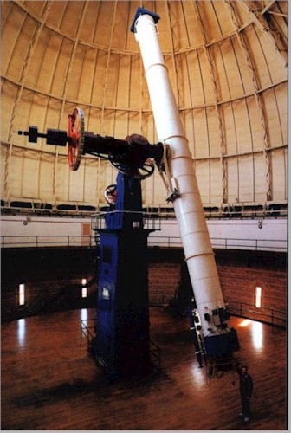
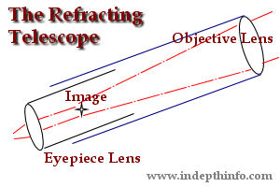
Refracting Telescopes

Slide 4
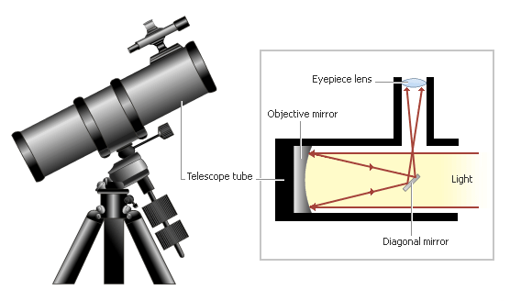
Reflecting Telescopes:

Slide 5
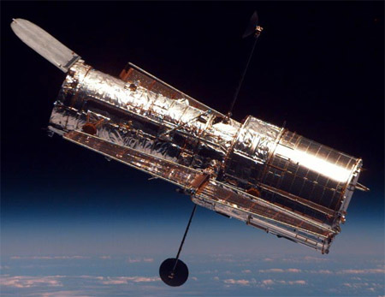
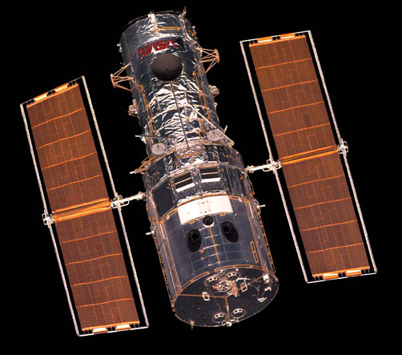
Hubble Space Telescope

Slide 6
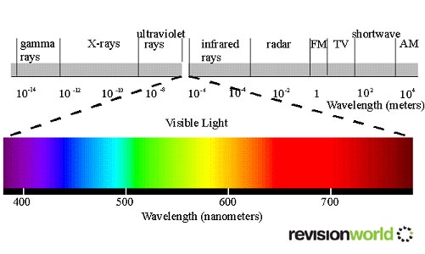
3.2 Using technology to see beyond the Visible
Electromagnetic spectrum

Slide 7
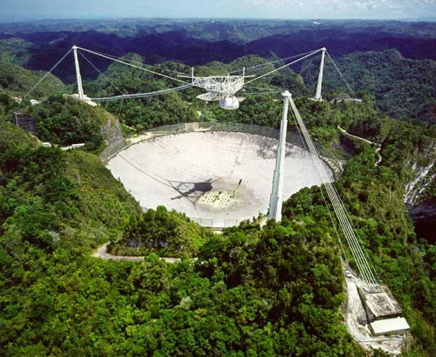
Radio Telescopes
Because the wavelengths of radio waves are so large, the antenna of a radio telescope must be large. This telescope in Puerto Rico, has a diameter of more than 300m.

Slide 8
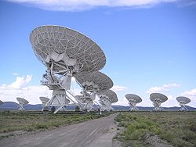
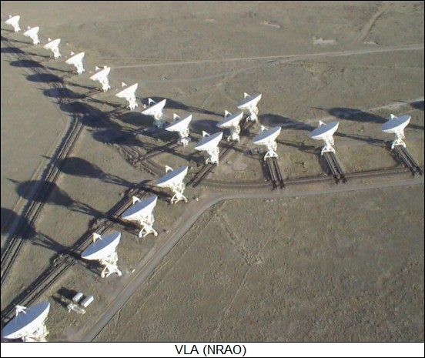
Radio Interferometry

Slide 9
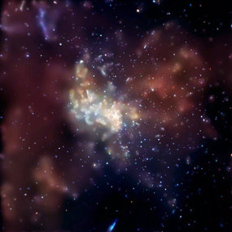
Viewing More Than What The Eye Can See
Gamma ray burst
X-rays from a black hole

Slide 10
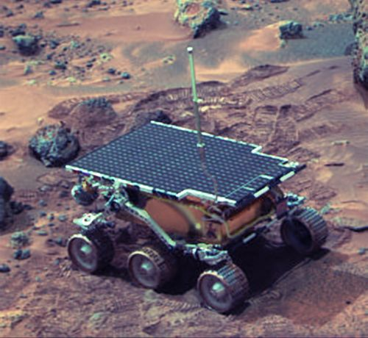
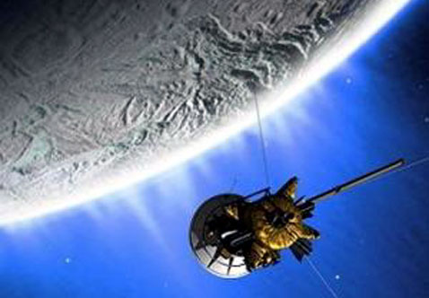
Space Probes
Cassini – 2004 – Flyby of Saturn
Mars Pathfinder – 2000 – Mars landing

Slide 11
White Practice Booklet
Using your textbook and notes:
Complete numbers 1-11

