Slide 1
Section 2.0
Pgs 408 - 432

Slide 2
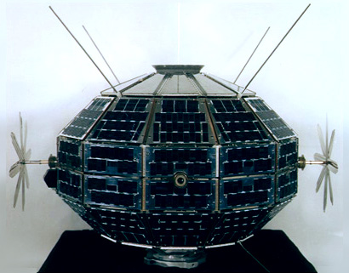
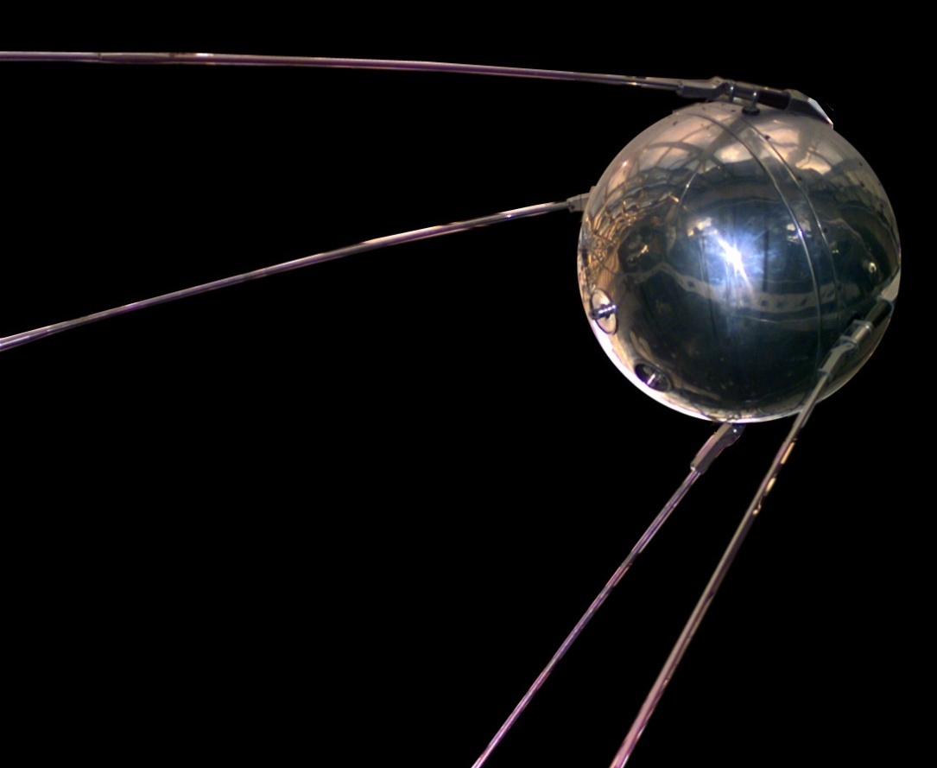
2.0 Technological developments are making space exploration possible and offer benefits on Earth.
Sputnik, 1957
Alouette, 1962

Slide 3
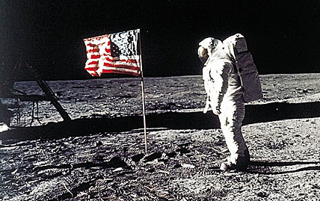
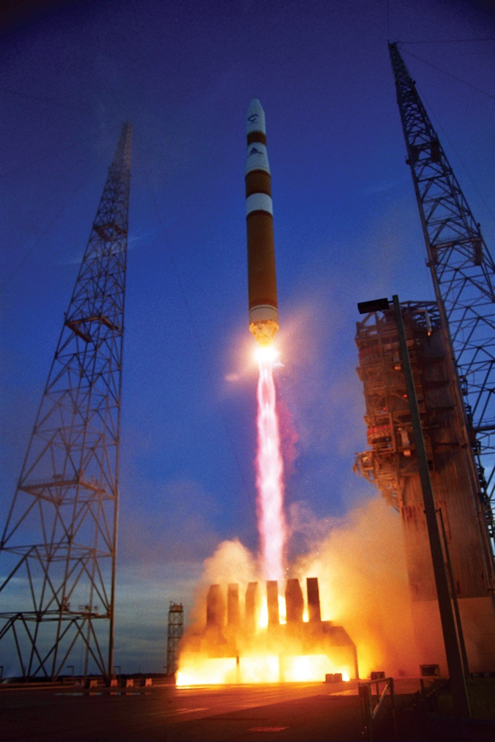
First man on the moon, 1969
For every action, there is an equal and opposite reaction.

Slide 4
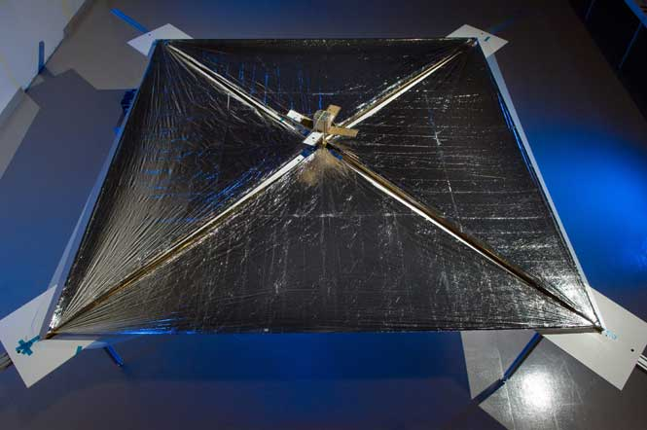
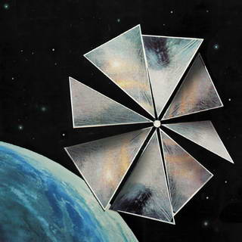
Solar sails spacecraft
NASA’s first solar sail
powered craft

Slide 5
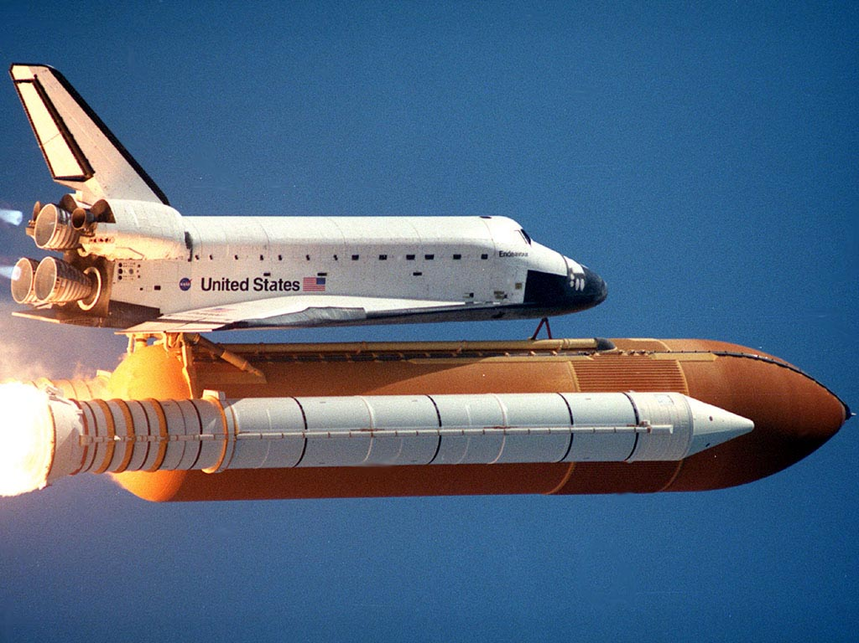
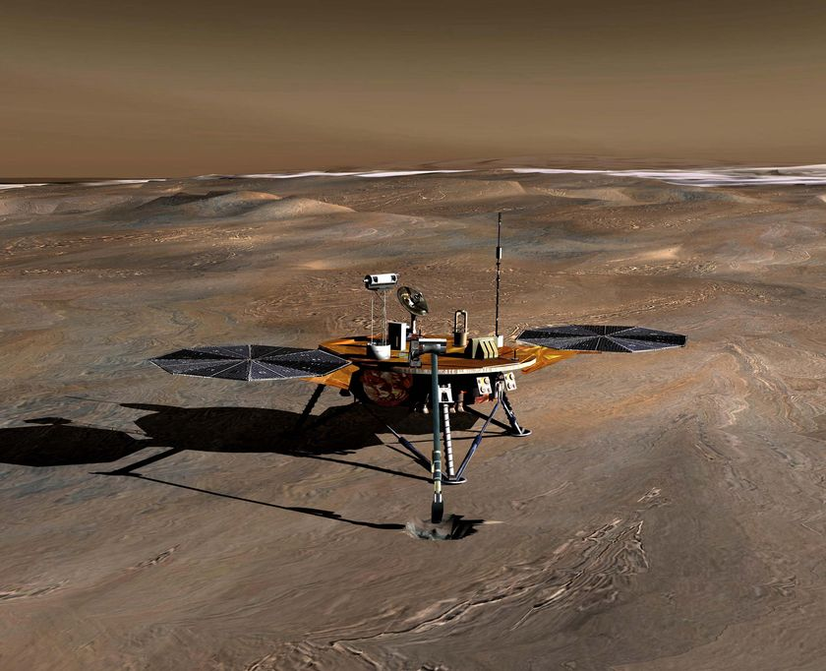
Space probe
Shuttle

Slide 6
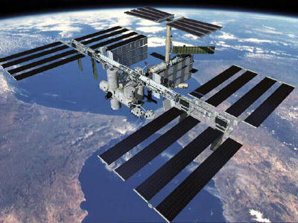
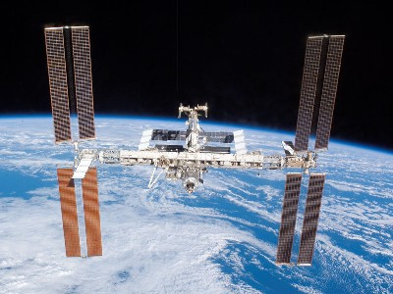
Space station
http://www.youtube.com/watch?v=kw5-n5Js6DM&feature=related

Slide 7
Check and reflect p 417
Numbers 3 - 8

Slide 8
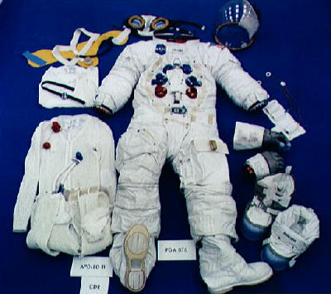
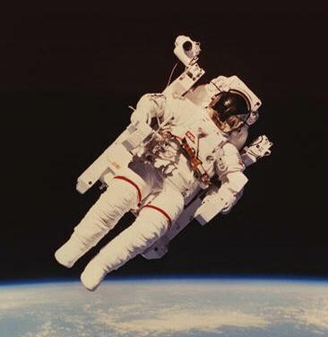
2.2 Surviving There: Technologies for Living in Space (pages 418 – 422)

Slide 9
Space suit clip
http://www.youtube.com/watch?v=yEwvMlKzz_o

Slide 10
Check and Reflect p 425
Numbers 1 - 7

Slide 11
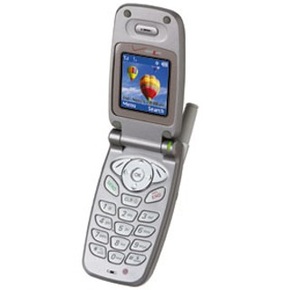
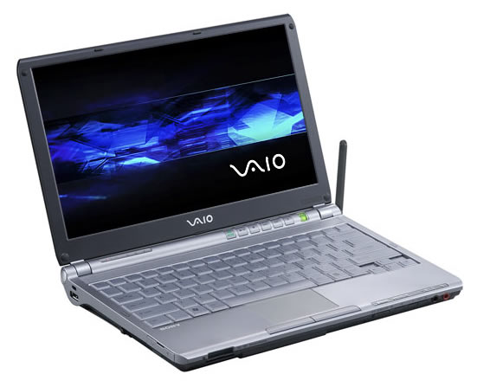
2.3 Using Space Technology To Meet Human Needs (pages 427 – 429)
Communication satellites

Slide 12
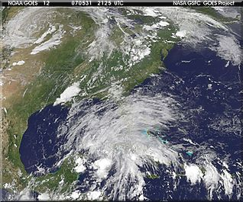
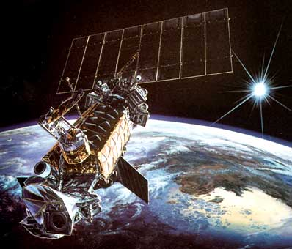
Weather satellites
Google earth

Slide 13
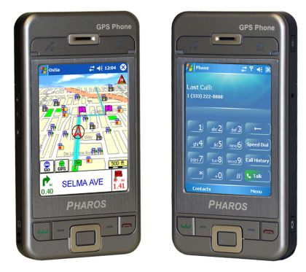
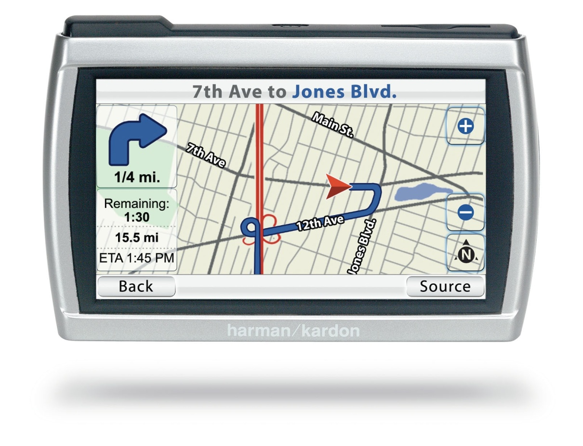
GPS
24 satellites in orbit

Slide 14
Read p. 431
“Space age” inspired materials and systems
Numbers 2-8
Assess your Learning p. 433

