Slide 1
What does this mean for us, today?
How do we follow Jesus?

Slide 2
We know Jesus wants us to follow Him,
but sometimes it can be difficult to know
How He wants us to follow Him.
That’s why we have
DISCERNMENT

Slide 3
Discernment is how we hear God, how we can find out where He is calling us to. There are some things we can do to help us Discern; hear God’s call, understand His will.
DISCERNMENT

Slide 5
Prayerfully How do we pray?
Formal prayer: prayers established by the Church and saints.
Spontaneous prayer: prayers made up on the spot with your own words.
Ask for help from God.
Read the Bible.
Listen for response from God.
Pay attention to the feelings you have when you pray.
Thanksgiving for the time God has given you in prayer.
Read something written by or about a saint/pope/priest/sister/brother.

Slide 6
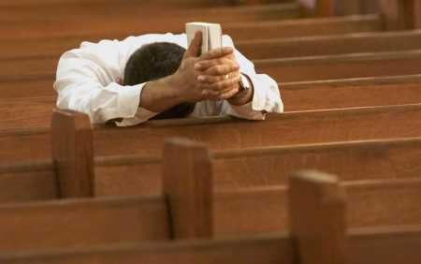
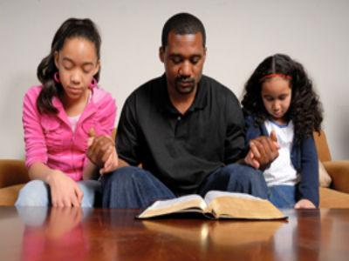
Prayerfully Where can we pray?
In Church: before the Mass begins quietly; with the congregation during Mass.
In School: to yourself or as a class.
At Home: in the morning as you start your day; at meals with your family at night before you go to bed.
ANYWHERE!!!

Slide 7
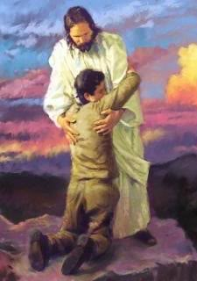
Prayerfully Why do we pray?
God knows us better than we know ourselves: He made us
God always wants what is best for us and wants to tell us what that is.
Praying gives us peace of mind

Slide 8
PRAYER
Usually asking God to make clear the path He wants you to take.
Time: take time to allow God to speak to your heart.
Quiet: plants grow in silence, so does your vocation; listen in the quiet of your room or some other place where you can be alone.
Ask for the saints to intercede on your behalf; the more people praying for you; the better.
Receive the sacrament of reconciliation often; it gives you more grace each time you go, thus you can have more vocational clarity.

Slide 9
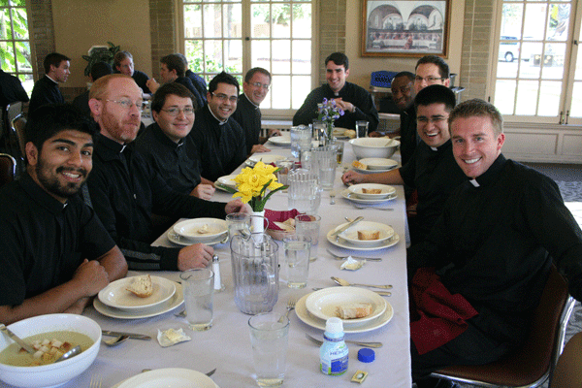
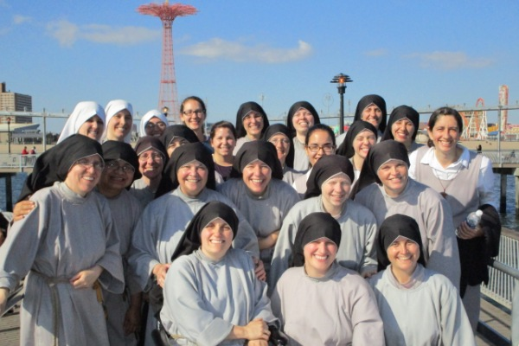
Constant Learning!
Learn about the seminary/religious community.

Slide 10
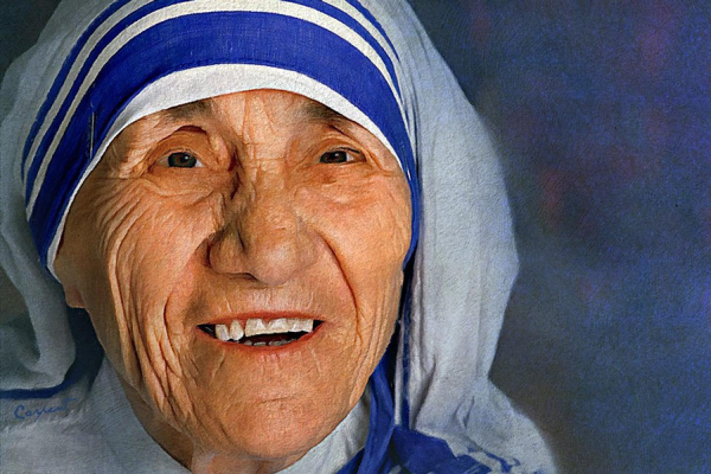
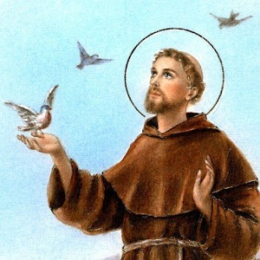
Learn about saints who have lived different vocations.

Slide 11
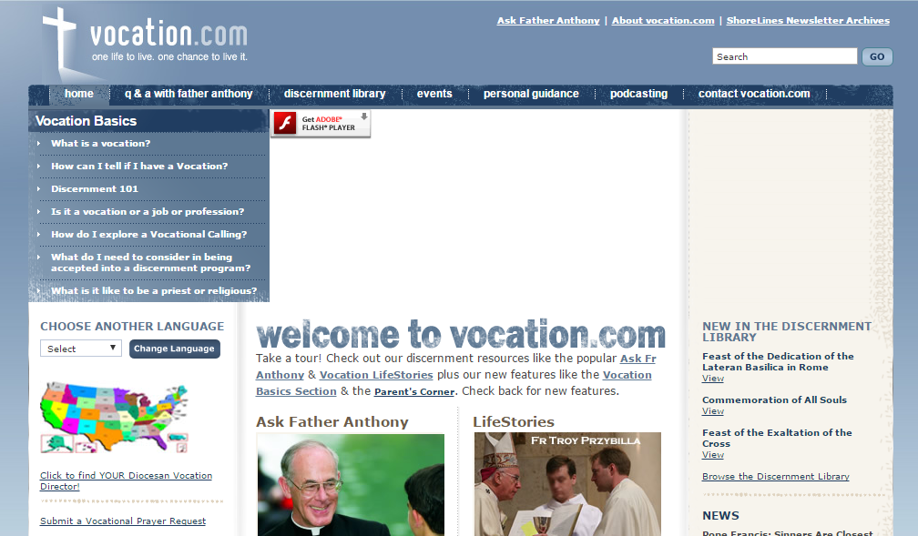
Learn that you are not alone: check out vocations websites.

Slide 12
SPIRITUAL MENTOR
Someone who will guide you along your path and answer any questions you might have; also will be a good example of how to live a vocation
Who Could be a Spiritual Mentor?

Slide 13
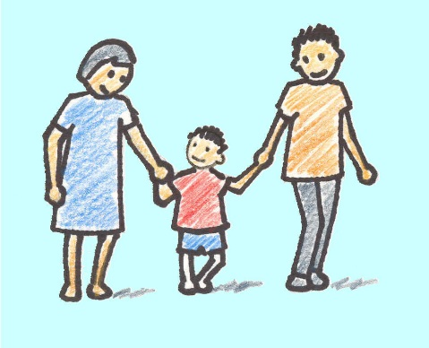
Spiritual Mentor: Could be your parents
Ask their thoughts on vocations (especially marriage).
Do they feel like they are doing what God is asking of them?
What do they want you to do when you grow up?
Will they help you figure out what God is asking of you?
How is God a part of their marriage?
What talents do they see in you? (Make a list)

Slide 14
Spiritual Mentor : Could be a big brother/sister, close family relative
Ask them how they think about God

Slide 15
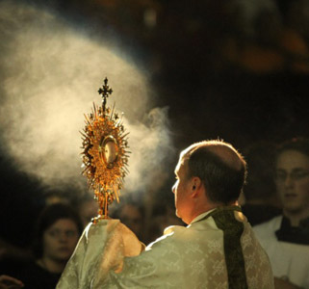
Spiritual Mentor : Could be a Priest/Deacon/Religious Sister/Brother
What are good prayers for discernment?
How do I know what God wants?
What if I think it is God but it is really me?
What if I don’t think I can do what I think God wants me to do?
What talents do they have that make it possible to do what they do? (Make a list and compare it to yours)

Slide 16
And one other way to Discern is to ….
THINK OF YOUR
GIFTS & TALENTS!

Slide 17
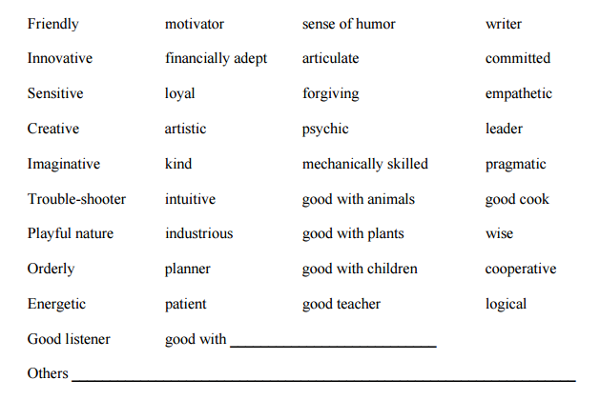
The Gifts and Talents you have were given to you by God for a reason. They can give us insight into how God wants us to follow Him.
Look at the following small list of gifts and talents, do any of these describe you?
Can you think of other gifts and talents that are not listed here, but describe you?

