Slide 1
Poor dad vs Rich dad
By: Jada,Dani,sarah,trinity,brianna k ☺

Slide 2
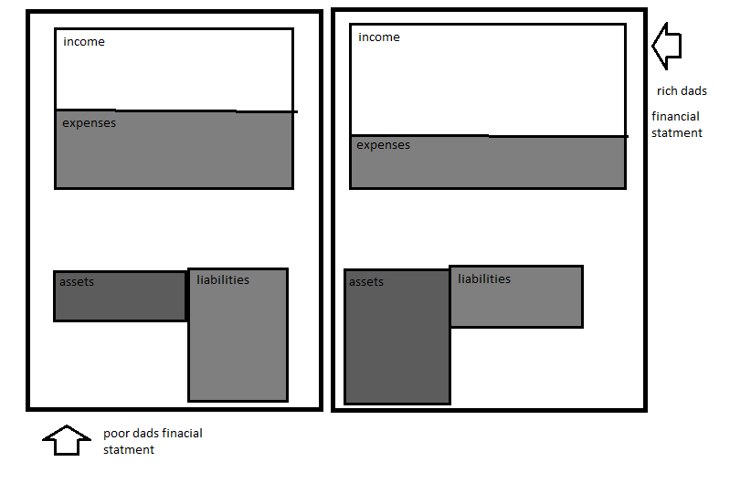

Slide 3
Rat Race
The rat race is when people are caught up with wanting to buy everything when they know the cant afford it, or being stuck in the middle class\lower class trying to get wealthy the wrong way. Ex. “always going for the cheese”

Slide 4
How to get out of the rat race
You could make up a budget every month
Change your life style( not spending, keeping track of your money)
Get a lot more assets than liabilities
Pay off all the money you owe over time.

