Slide 1
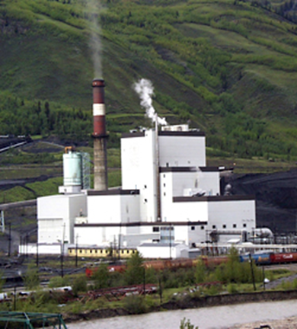

Environmental Protection
Neil Calder, P. Eng.
Alberta Environment and Parks
Industrial Approvals Engineer
March 16, 2016
www.maximpowercorp.com

Slide 2

What do I do?
  I am an Industrial Approvals Engineer for the Government of Alberta.
  I set the rules for industrial facilities to protect your environment.
www.pixgood.com

Slide 3
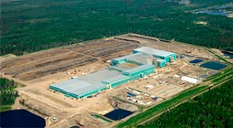
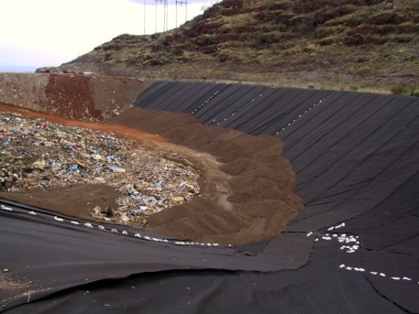
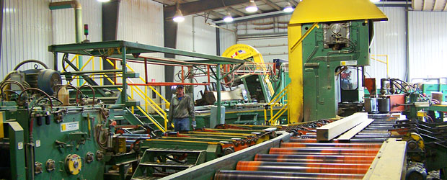
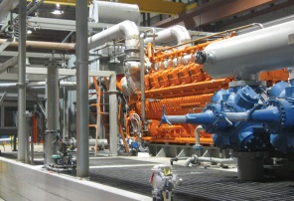
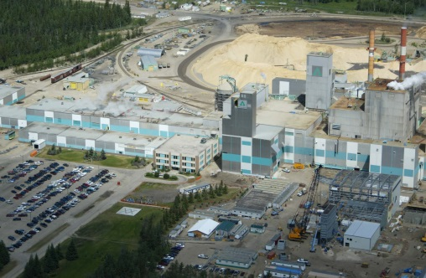
Industrial Facilities include:
    Landfills
    Oil and Gas Facilities
    Pulp Mills
    Sawmills
    Chemical Manufacturing Facilities
    Hazardous Recyclable Storage Facilities
    Power Plants
www.ainsworth engineered.com
www.wasteline.wordpress.com
www.mascus.com
www.wartsila.com
www.jvdriver.com
Notes:
Do any of your parents work at Aquatera, Canfor, Ainsworth, Weyerhaeuser, or in Oil and Gas?

Slide 4
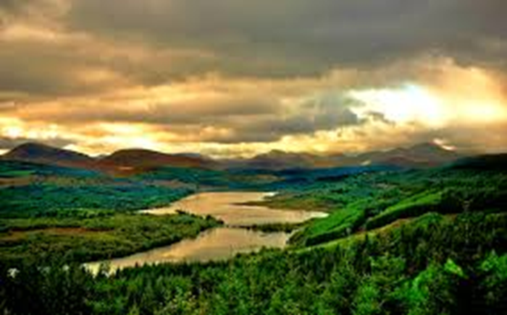
What is Our Environment Made Of?
  Air
  Land
  Water
Do you care about our environment? Why?
What if you didn’t?

Slide 5
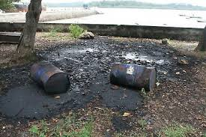


Environmental Protection and Enhancement Act
Legal requirements to protect the environment
Recycling programs
Spill reporting and clean up
Enforcement, including up to a $1,000,000 fine and
2 years in jail

Slide 6

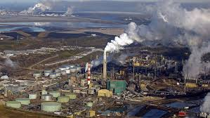


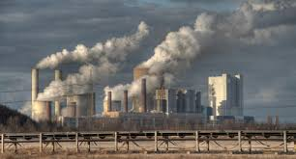
Air
Where does air pollution come from?
Natural
Industry
Transportation
Municipalities
Electricity

Slide 7
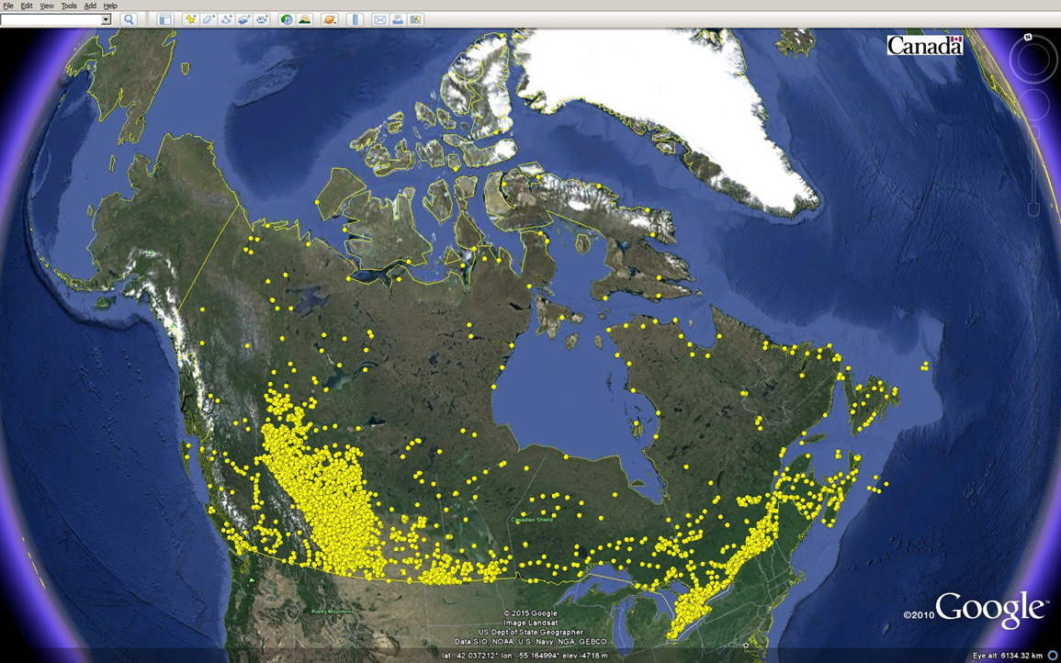
Industrial Sources of Air Pollution in Canada
Source: NPRI

Slide 8
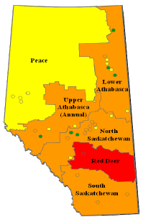
Current Status of Alberta Air Quality
2015: Particulate Matter 2.5
http://esrd.alberta.ca/air/management-frameworks/canadian-ambient-air-quality-standards-for-particulate-matter-and-ozone/documents/AlbertaAirZonesReport-2011-13-Sep2015.pdf
Notes:
Alberta Environment and Parks completed and published the results of the 2011-2013 CAAQS PM_{2.5} and ozone assessment.
The results for PM_{2.5} indicate five out of the six provincial air zones are stressed meaning they are approaching or exceeding the CAAQS limits.
As indicated on the map for PM_{2.5}, all the air zones highlighted in orange must develop management plans to prevent CAAQS exceedances.
The Red Deer air zone highlighted in red has exceeded the CAAQS and must take action to meet the CAAQS.
The results of the ozone assessment identify the North Saskatchewan air zone approaching the ozone CAAQS and must take action to prevent an exceedance of the ozone CAQQS.

Slide 9
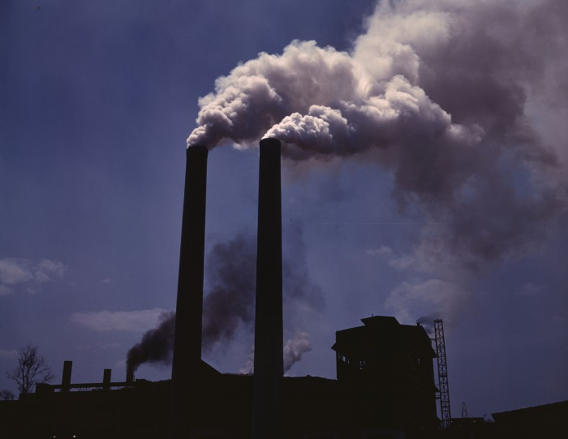
Air Quality
http://en.wikipedia.org/wiki/Air_pollution
  What contaminants affect our air quality?
    Nitrogen Oxides (NOx)
    Sulphur Dioxide
    Carbon Monoxide
    Carbon Dioxide
    Particulate Matter (Dust)

Slide 10
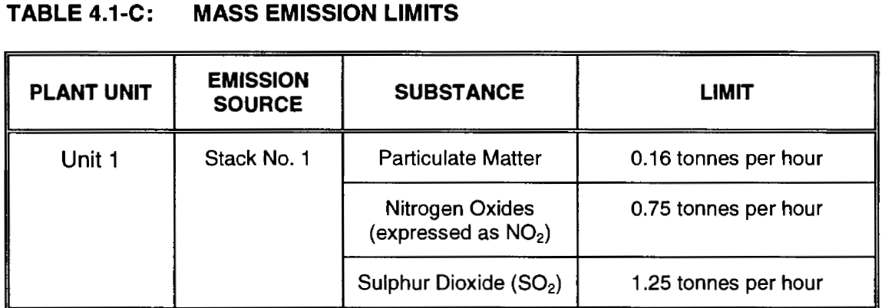
Industrial Approval
Air Quality Limits
http://en.wikipedia.org/wiki/Air_pollution

Slide 11
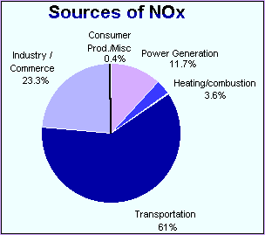
Where Do Nitrogen Oxides Come From?
environmentaljournalismcanada.wikispaces.com
High temperature combustion

Slide 12
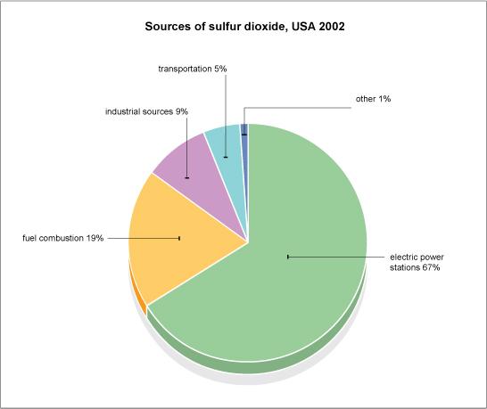
Where Does Sulphur Dioxide Come From?
www.bbc.co.uk
Coal Fired Power Plants
Sour Gas Plants

Slide 13
How Do We Determine What Level of Air Quality is OK?

Slide 14
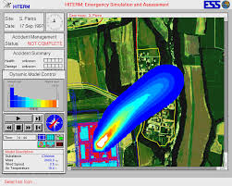
How can we predict the impact that a facility will have on Air Quality?
  Air Dispersion Modelling
www.ess.co.at
www.ess.co.at

Slide 15
Air Dispersion Modelling
www.ess.co.at
  What information is required for the model?
    Meteorological Information (Wind, weather)
    Terrain (Hills and Valleys)
    Emission rates
    Other emission sources
  How do I determine if the predicted air quality is acceptable?

Slide 16
Environment Canada 3D Modelling Video
http://www.cbc.ca/news/canada/edmonton/computer-generated-video-shows-pollution-spread-across-the-prairies-1.3261783

Slide 17
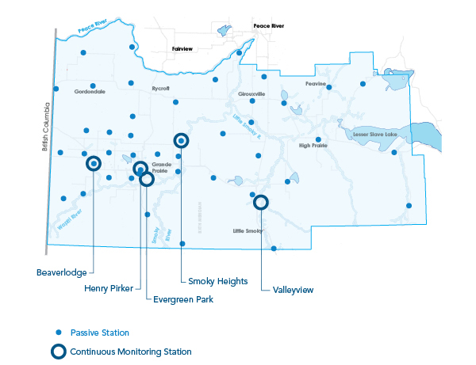
Peace Airshed Zone Association
Monitoring Stations
  http://www.paza.ca/
  PHOTO CONTEST – entries due March 31, 2016

Slide 18
Air Quality Health Index
( AQHI)
Community
Air Quality Health Index
1
2
3
4
5
6
7
8
9
10
+
Risk:
Low Moderate High Very High
(1 - 3) (4 - 6) (7 - 10) (Above 10)
Current
2
Low Risk

Slide 19
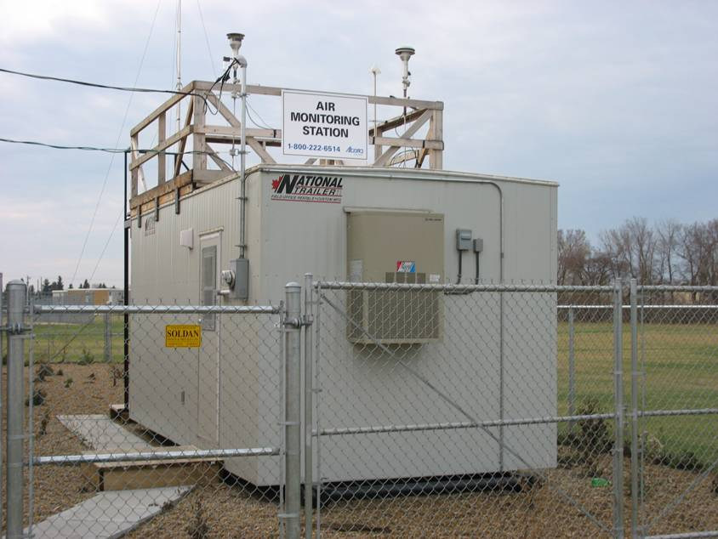
Air Monitoring Station
6

Slide 20
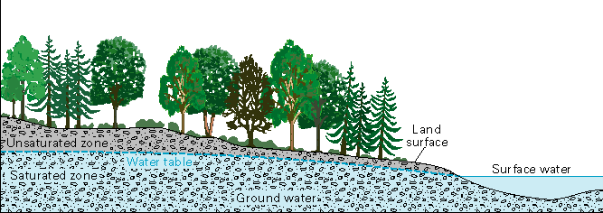
Water
What is the difference between Surface Water and Groundwater?
Why is Surface Water important?
Why is Groundwater important?
Image Credit: United States Geological Survey

Slide 21
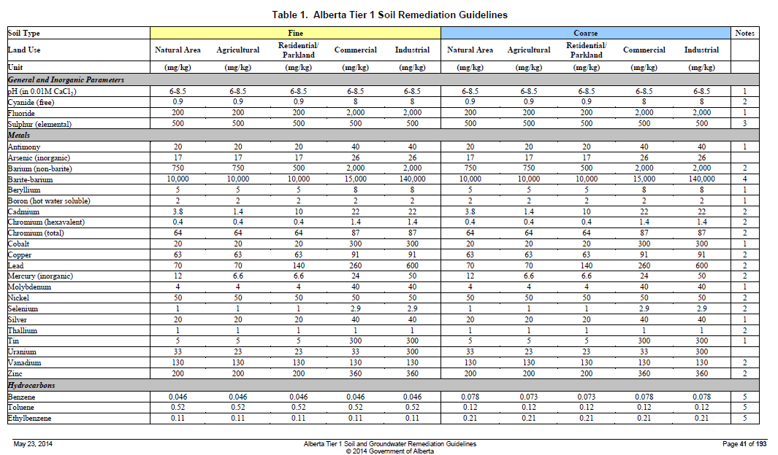
Soil and Groundwater Guidelines
Source Pathway Receptor
Land Use
  Natural Area
  Agricultural
  Residential
  Commercial
  Industrial

Slide 22
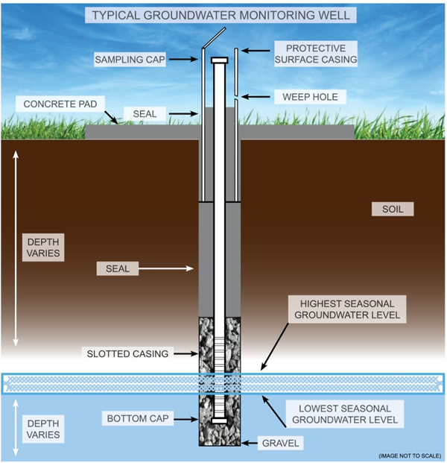
Groundwater Monitoring
www.aacounty.org

Slide 23
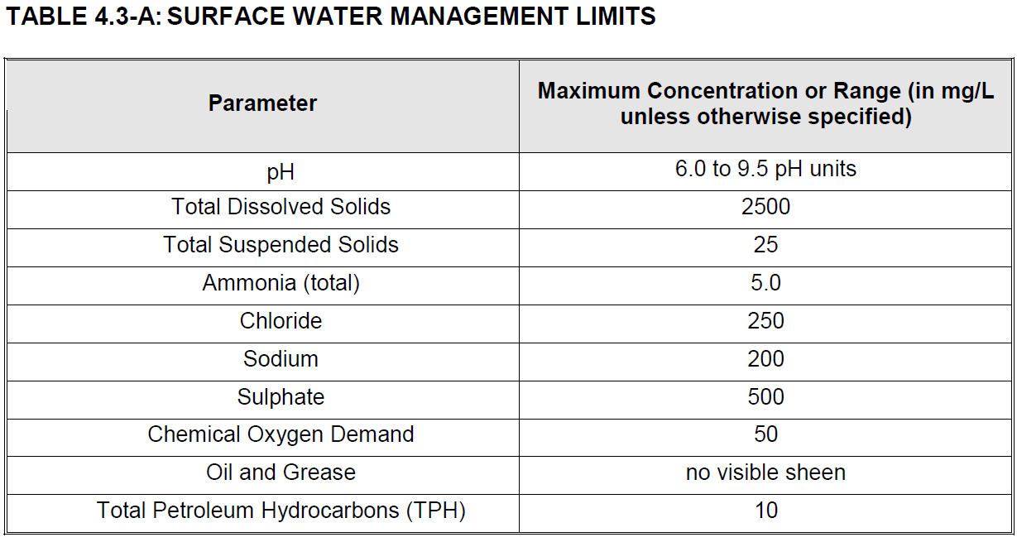
Industrial Approval
Run-off Water Release Limits

Slide 24
What is a Landfill?
www.wasteline.wordpress.com
A facility designed to dispose of waste

Slide 25
What is a Landfill?
www.wasteline.wordpress.com
What are the risks to the environment?
How can we manage these risks?

Slide 26
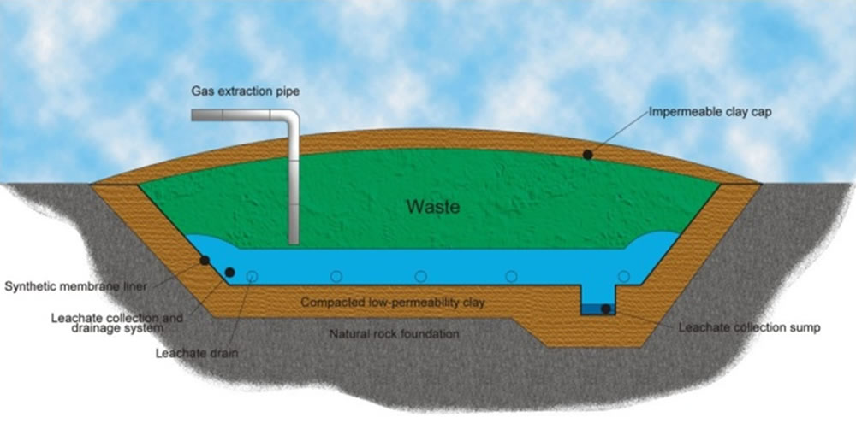
Landfills
What are the risks to the environment?
How can we manage these risks?
Risks | Safeguards
Contamination of the Soil and Groundwater | A liner provides a barrier to the environment
 | Leachate is removed and disposed
 | Surface run-off is collected and tested before it is released
Odours and pests | The waste is covered daily
www.ukhydrogeologist.co.uk

Slide 27
Aquatera Landfill Gas to Energy Project
https://www.youtube.com/watch?v=0DxXm19qQvg

Slide 28




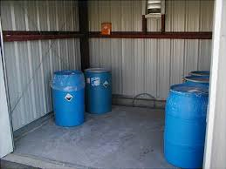
Hazardous Waste and Recyclables Storage
Ensure safe storage of nasty chemicals that can harm the environment
Toxic, corrosive, flammable, chemically reactive
Examples include:
  Used car batteries
  Used oil
  Leftover paint
  Cleaning products
  Contaminated soil

Slide 29
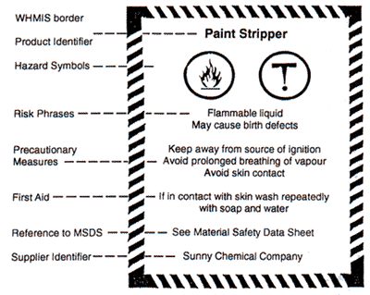

Hazardous Waste and Recyclables Storage
How should we safely store these chemicals?
  Containment
  Emergency procedures
  Controlled access
  Labelling

Slide 30
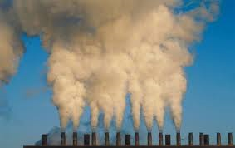
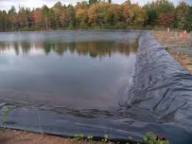
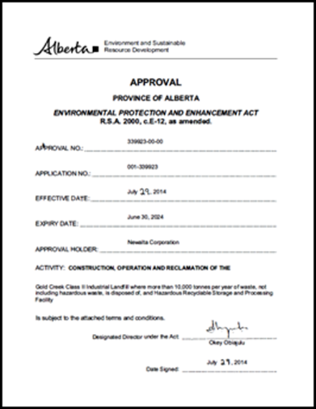
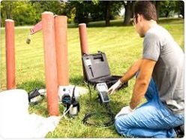
Environmental Approvals Include:
Soil Conservation
Air Emissions
  Pollution Controls, Emission Limits, Monitoring
Surface Water Management
  Run-off Release Limits, Monitoring, and Reporting
Wastewater Treatment and Disposal
Waste Management
  Hazardous Waste Storage
  Disposal or Recycling
Soil and Groundwater Monitoring
Remediation (clean up)
Reclamation (revegetation)

Slide 31
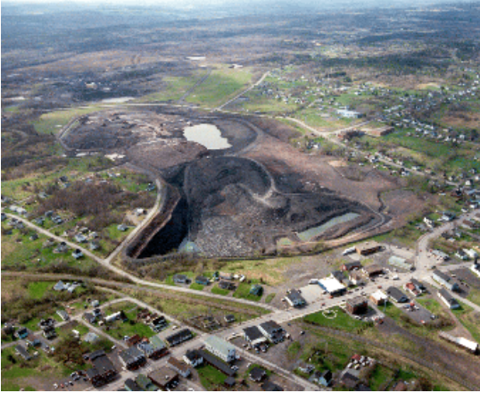
What is Reclamation?

Slide 32
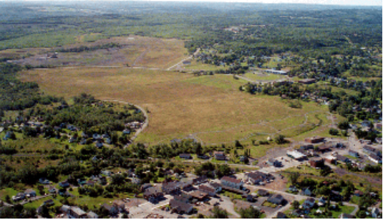
What is Reclamation?

Slide 33
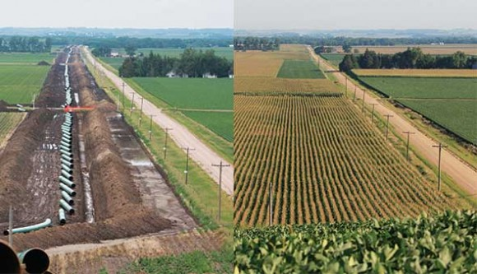
Reclaimed Pipeline

Slide 34

What can you do to minimize your environmental impact?

