Slide 1
MT Staff Meeting
Gr.1 & 2 Teacher
Feb.4, 2019

Slide 3
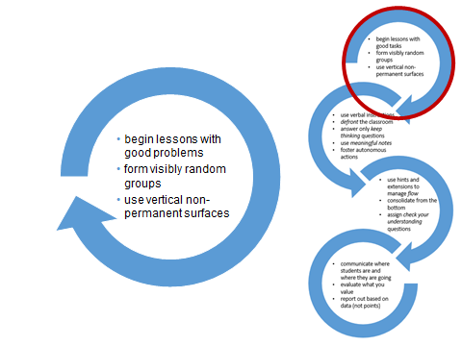

Slide 4
Resources
http://www.peterliljedahl.com/teachers/numeracy-tasks
www.mathforlove.com
www.aliciaburdess.com
www. https://www.stevewyborney.com/
Able Pupils- google docs
Super Source books

