Slide 1
Morning at Mother Teresa
Conversations about Math.
Oct. 19, 2018

Slide 2
Random Groups & Vertical Surfaces
The word “fun” has a vowel-to-consonant ratio of 1:2
Can someone explain that to the class?
Find 3 words with a vowel-to-consonant ratio of 2:3. How did you figure it out?
Extension:
Choose a vowel-to consonant ratio and have your group find 3 words for it.
Notes:
Put in random groups using cards. Vertical surfaces. Question is from the gr.6 textbook.

Slide 3
Thinking Classroom
Random Groups- cards, popsicle sticks, random group generator,etc. - Takes away stigmas, learn to work with anyone.
Vertical Non-Permanent Surfaces-Whiteboard, windows, etc. -Quick easy formative assessment. -Risk taking - Everyone has access to learning space.
Problem Solving - low floor, high ceiling tasks- so all students can be engaged. -all learner can have a voice -take risks, persevere, collaborate
http://www.peterliljedahl.com/publications/building-thinking-classrooms

Slide 4
Dot Collection
Notes:
How many dots do you see? How do you see it?

Slide 6
How did you see the Dots?
How MAny Dots did you See?
Did you See the number Dots in Another Way?

Slide 7
Dot Collection

Slide 9
How did you see the Dots?
How MAny Dots did you See?
Did you See the number Dots in Another Way?

Slide 10
Dot Pattern in Higher Grades
http://www.datapointed.net/visualizations/math/factorization/animated-diagrams/

Slide 12
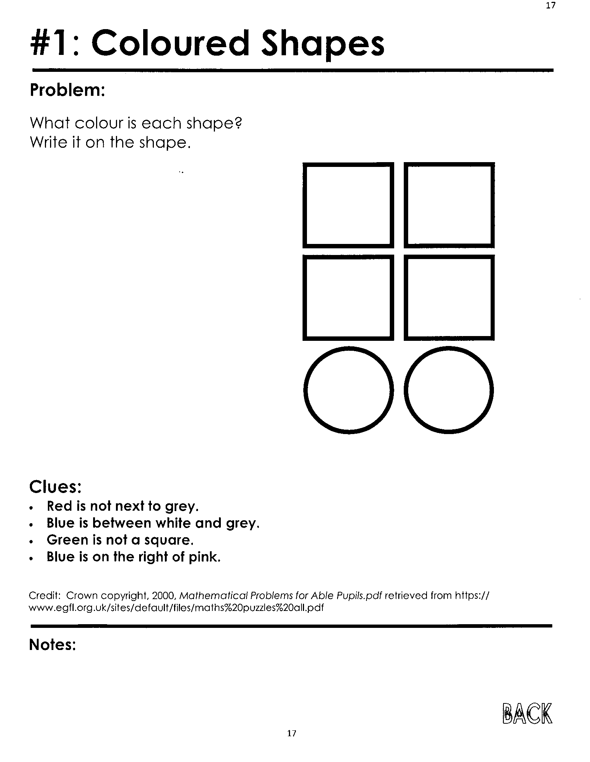
Grab some math manipulatives (snap cubes, cuisenaire rods, etc.) to solve the problem.
Or use markers, crayons, pencil crayons, etc.
Make sure to record your findings.
Extension:
Make your own clues and have your group figure out the coloured shape.
Notes:
K-2

Slide 13
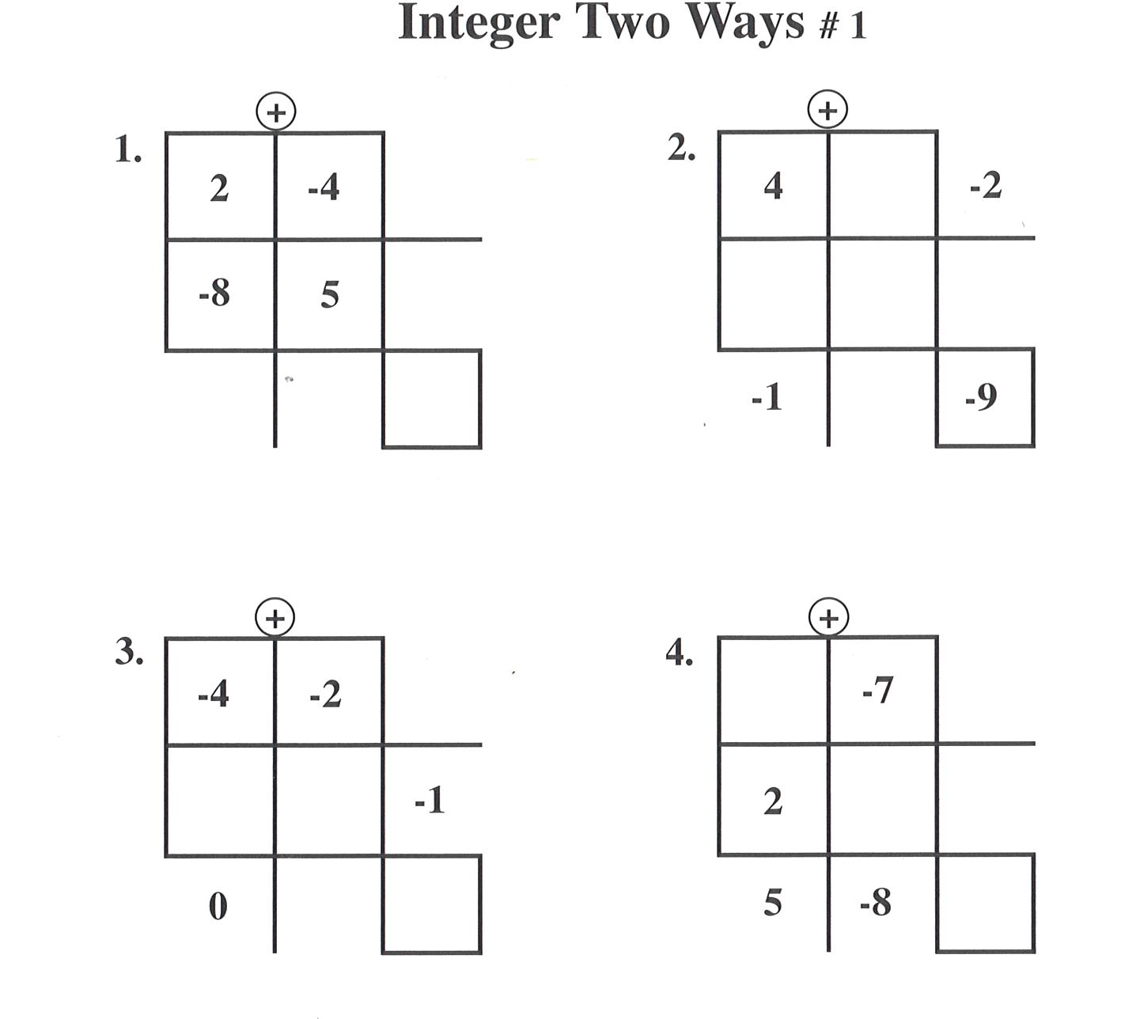
Random groups
Vertical surfaces
Manipulatives (red/yellow tiles)
How can you change it to fit your grade?
Notes:
Gr.3-6 group

Slide 14
Collaboration Time
In grade level groups, explore and investigate the Developing Math Fluency, Textbook and Super Source resources and, with the help of your program of studies, find three problems that link to you curriculum.
Try them out with your students. Use random groups, vertical surfaces, one pen!

Slide 15
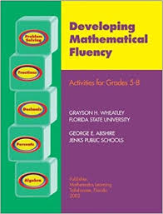
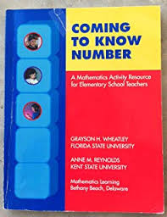

Slide 16
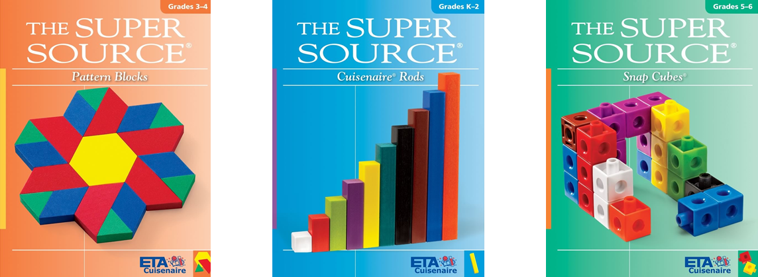
Using Math Manipulatives
Super Source Books
Cuisenaire rods
Snap cubes
Pattern Blocks
Play

Slide 18
CApture the Flag, Cuisenaire Rods, page 26-28
- Rules to Play Capture the Flag
1)This game is for 2 player. The object is to cover the last square on the Flag board game with Cuisenaire Rods.
2) Decide who goes first.
3) Players take turns placing a rod anywhere on the board according to these rules: - The rod must be horizontal or vertical. - The rod must lie within the grid lines. - The rod must completely cover a whole number of squares.
4) Play continues until all the squares are covered. The player who covers the last empty square is the winner. - Play 3 games of Capture the Flag! - Be Ready to talk about the good moves and the bad moves.

Slide 19
Math Resources- Cuisenaire Rods
K-2
Super Source- “Alike and Differences”- pg.18- Discuss and record their findings on the vertical surfaces.
Super Source- “Make a Match” - pg.54- record information on vertical surfaces. (Shapes)
Super Source- “Mystery Trains”- pg.62- record information on vertical surfaces.
Super Source- “Rod Toys”- pr.74- record the information on vertical surfaces.
Super Source- “Sides of Triangle”- pg.78- record the information on vertical surfaces.

Slide 20
Math Resources- Cuisenaire Rods
3&4
Super Source- “Building to Spec”- pg.18- record their information on the Vertical surface- “Alike and Differences”
Super Source- “Fraction Pairs”- pg. 26-27. Record their findings on the vertical surface.
Super Source- “Just too Big”- pg.34. Record their findings.

Slide 21
Math Resources- Cuisenaire Rods
5&6
Super Source- “Capture the Flag”- pg.26. Record their findings on the vertical surfaces.
Super Source- ”Hidden Rods”-pg.50. Record their findings on the vertical surfaces.
Super Source- “Naming Rods”- pg.58. Record their findings on the vertical surfaces.
Super Source- “Planning the Playground”-pg.66. Record their findings on the vertical surfaces.

Slide 22
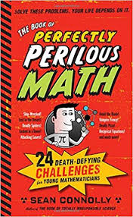
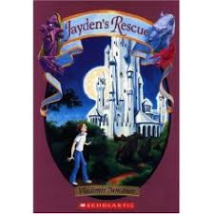
Literacy and MAth
Anno’s Mysterious Multiplying Jar
https://www.youtube.com/watch?v=86i4eP3Ipi4
Perfectly Perilous Math
7 8 9 Picture Book
Lemonade Wars
Jayden’s Rescue
Zero the Hero

Slide 23
MAth Starters
You can start math class with a starter; Ideas; - Quick Draw
- Daily Starter http://www.transum.org/Software/SW/Starter_of_the_day/index.htm
-Riddles: https://www.youtube.com/watch?v=lLOALyWls2k
-Puzzles https://www.youcubed.org/week-inspirational-math/
-Books- (Chicka Chicka 1-2-3, Pete the Cat and the groovy buttons, Equal Shmequal, Zero the Hero, Bear Counts).

Slide 24
Assessment
Teachers are the professionals in the classroom all day. You know your students the best.
If parents need proof, record student work once they are ready. (Video, math journal, pictures, etc)
“Choose 4 problems and calculate, write a story and draw 2 visual solutions”. - Jo Boaler

Slide 25
