Slide 1
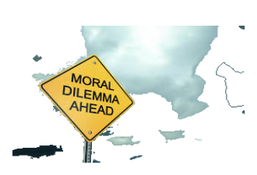
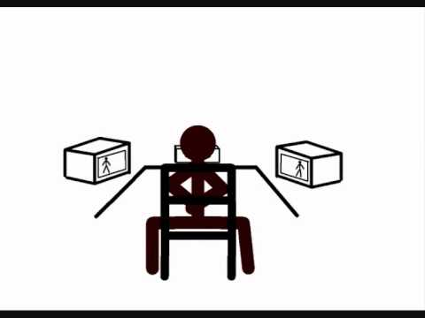
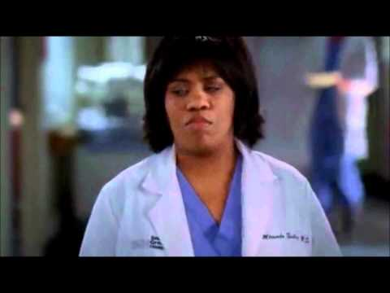
Morality--derived from Latin work moralitas -having to do with the customs, habits and manners shaping human life.
The goodness or evil of human acts (deciding between Good and Evil)

Slide 2
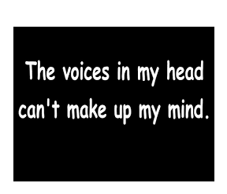
Who decides what is Moral?
Using free-will one must discern all the voices they hear that suggest different perspectives.
As a catholic (universal Christian) we must discern and understand how God wants us to live before making our final choice?
-we look to the Church and Tradition
We also, need to reflect on all humanities natural goodness and dignity-as we all are created in Gods image and likeness (from the start we are all essentially good)

Slide 3
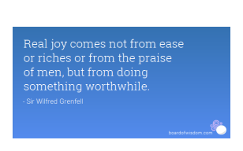
The result of a moral decision that matches your inner voice is Joy and well-being. ( note: true joy is not equal to physical sensations of no pain)
Does the ability to choose mean we have the right to choose whatever we want????
(think of one right you have and the responsibility
that is attached to that right.)

Slide 4
What are the three elements that determine
the morality of an act?
1. object-what specific action is being considered?
2. intention of the person acting
3. circumstances-all details around the choice
The object and the person’s intentions must be good for an action to be moral.

Slide 5
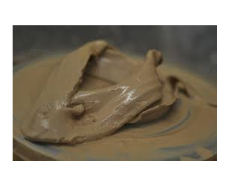
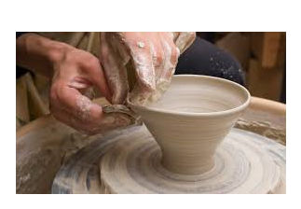
What is a conscience?
The inner voice within a person that moves to do good under any circumstances and to avoid evil at all means. It is the ability to distinguish the one from the other.
Nothing makes a person more human than the gift of being able personally to distinguish good from evil and to choose between them.
How is a conscience formed?
Recognition first that a conscience can be mislead and deadened, we must make purposeful choices to form our conscience well.
1. The first rule of conscience is self -criticism-we must not judge things to our own advantage.
2. The second rule is orientation to
good actions for others.

Slide 6
How does pottery making compare to forming one's conscience?
A potter must continually refine his skills and steady his hands as an
individual must never believe they could know everything regarding right
from wrong.
A pottery bowl is beautiful in its design and purpose just as a human being
is beautiful when they mirror the love of Jesus Christ to the world.

Slide 7
A failed pottery project will not be able to fulfill its intended purpose as a unformed conscience is unable to orientate itself to the good of others.
A potter creates for others to enjoy, when commissioned they create for
the set criteria of the client. A Christian has been commissioned by Jesus
Christ himself-therefore our obligation is to fulfill his expectations not
our own.
What is the intended purpose for a Christian?

Slide 8
To love God with your whole being and to love your neighbour as yourself!
To become holy-to become saints-to draw closer to our creator.

Slide 9
What is the first necessary conditions to gaining an informed conscience for a Christian?
A Choice to acknowledge God as the authority over all that is GOOD.
Some rules apply in every case
1.One should never do evil to achieve a good.
2. Golden Rule-do unto others as you would have them do to you.
3. It is right not to do anything that causes another person to sin.

Slide 10
Rules of Conscience
First rule
Self-criticism- We must be conscious of our inclination to judge things to our own advantage.
Second rule
Conscience is an orientation to the good actions of others.
( If God is love, the imprint of God in us is Love, our choices should be the loving choice to others.)

Slide 11
Be very wise in how you form your conscience-humility leads to God, pride leads you away!
Ezekiel verse 17, “Your heart became proud on account of your beauty, and you corrupted your wisdom because of your splendor.”
Lucifer apparently became so impressed with his own beauty, intelligence, power, and position that he began to desire for himself the honor and glory that belonged to God alone. The sin that corrupted Lucifer was self-generated pride.
Be very wise in how you form your conscience-humility leads to God, pride leads you away!

Slide 12
Is someone who in good
conscience acts wrongly
guilty in God's sight?
No-If one has thoroughly examined
oneself and arrived at certain judgment,
one must follow one's inner voice,
even at the risk of doing something wrong.

Slide 13
There is a natural link between the formation of conscience and moral Principles.
If all people search for the Good than morality can be a cultural experience. Does it seem logical that we look to a higher law to keep harmony/justice in our world?
Natural Law: (The higher law for Catholics)
1. Expresses the original moral sense which enables man to discern by reason the good and the evil, the truth and the lie. CCC #1954
2. The eternal reason that all things tend naturally toward their proper operations and ends, as rational creatures we participate in this law.
3. That which is not just seems to be no law at all. St. Thomas Aquinas

Slide 14
KEY PRINCIPLES OF NATURAL LAW
1. DO GOOD AND AVOID EVIL
2. PRESERVATION OF LIFE
3. PROPAGATION AND EDUCATION OF OFFSPRING
4. THE PURSUIT OF TRUTH AND A PEACEFUL SOCIETY

Slide 15
Examples in Culture
http://www.wingclips.com/movie-clips/most/the-bridge
Life-the bridge
http://www.wingclips.com/movie-clips/gladiator/how-will-the-world-speak-my-name
Peace or war?

