Slide 1
Math for Division 2
November 13, 12:30 – 3:30

Slide 2
1
3
6
The blue numbers are triangular numbers. The purple numbers are square numbers.
Extend both patterns.
Find similarities and relationships between the sets of numbers and within each set of numbers.
1
4
9
Notes:
Extension questions → when a group finds a similarity, or a connection,
first ask them why the relationship exists,
then have them represent it or draw it out so “we can easily explain it later.”

Slide 3
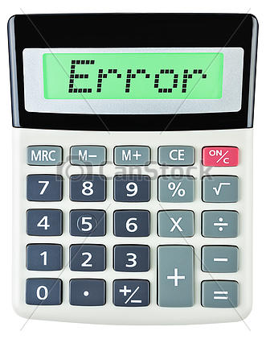
A problem
Notes:
Start with a simple division problem → 8 / 2. Put it in your calc. Tell me what it means.
Go lower → 3 / 1 → same thing
2 / 0 → enter it in, what happens?
Look at google calculator.
Task: Explain why you can’t do this.

Slide 4
Problem debrief
Extensions
Planning
Questioning during the lesson
What is the teacher doing/looking for/assessing

Slide 5
Open with a problem
In a typical math class, the lesson begins with the teacher teaching. What are some advantages of diving right in to a problem?
Notes:
If we deliver first, the students will merely use the strategy we just taught to figure out the

Slide 6
Vertical Surfaces
What are some of the reasons we might opt for vertical surfaces over paper?

Slide 7
Random Groups
What are some of the reasons we might opt for random groups over chosen groups or individual work?
Three is a good number for problem solving. When might partners work better?

Slide 8
break

Slide 9
Another Problem

Slide 10
Resources
Where do we get all these Math problems?
Anywhere! A good problem can come from anywhere.
Textbooks
Math resources in your school
Super source book
Developing Math Fluency + Coming to Know Number
Perfectly Perilous Math
Jayden’s Rescue
Number Devil

Slide 11
Let’s practice
A good problem becomes a great problem through your delivery

Slide 12
Fill in the boxes using each digit from 1 – 9 only once
x
÷
+

