Slide 1
Interactions and Ecosystems
Topic 1
Interactions within an Ecosystem

Slide 2
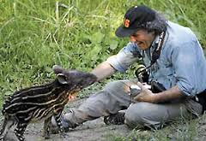
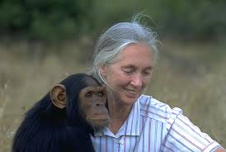
Ecology
Ecology is the study of the relationship between living things and their environment
Ecologists study these relationships and what impacts them

Slide 3
Needs of living things
Living things need:
food
a suitable habitat
water
an exchange of gases
Living things interact with their environment to meet their needs

Slide 4
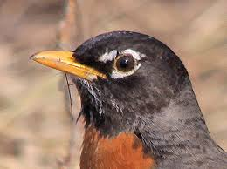
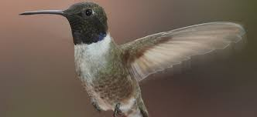
Adaptations
Look at these two beaks? How do they differ? How are they similar? Why? do you think they would have different beaks?

Slide 5
Adaptations
Living things become better suited to fit into their environment
An adaptation is an inherited characteristic that helps an organism reproduce and meet its needs

Slide 6
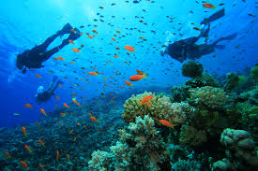
Adaptations
Some adaptations can be
learned!
Humans learn to look both ways before crossing the street in order to help us survive
We also use technology to help us live in extreme environments

Slide 7
Ecosystems
An ecosystem is all of the living and non living things in an environment
Non living things - write down 3 examples
Living things - write down 3 examples

Slide 8
Interactions
Symbiosis occurs when two species live closely together in a relationship that lasts over time
Predator and prey relationships are NOT an example of symbiosis

Slide 9
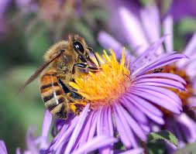
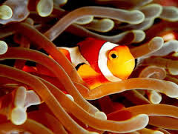
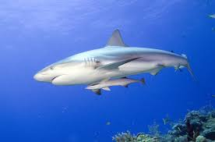
Mutualism
Mutualism is a relationship between two different organisms where both benefit
Ex. Bee and flower

Slide 10
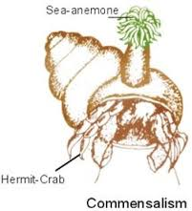
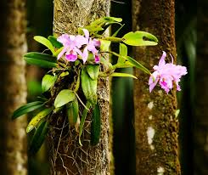
Commensalism
Commensalism is a relationship where one partner benefits and the other is not affected
Ex. Orchid and tree

Slide 11
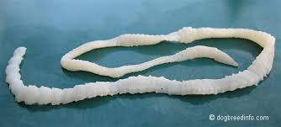
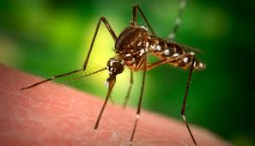
Parasitism
Parasitism is a relationship where one partner benefits and the other is harmed
Ex. Tapeworm and human

Slide 12
Homework
Pg 17
1-4

