Slide 1
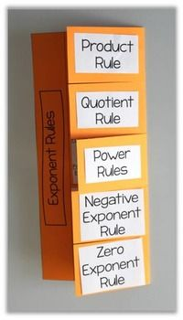
Making a “Foldable” to Remember the Exponent Laws

Slide 2
Foldable
1. Take out a piece of notebook paper and make a hot dog fold over from the right side over to the pink line.

Slide 3
Foldable
The fold crease
2. Now, divide the right hand section into 6 sections by drawing 5 evenly spaced lines.
3. Use scissors to cut along your drawn line, but ONLY to the crease!

Slide 4
Foldable
The fold crease
4. Write EXPONENT LAWS down the left hand side
EXPONENT LAWS

Slide 5
Foldable
The fold crease
5. Fold over the top cut section and write ZERO EXPONENTS on the outside.
ZERO
EXPONENTS
6. Reopen the fold.
EXPONENT LAWS

Slide 6

Foldable
7. On the left hand section, write some examples of zero exponents.
$$5^{0}=1$$
$${\left(−2\right)}^{0}=1$$
$$−4^{0}=−1$$
Any base to the power of zero is always equal to 1.
*Watch out for negatives that are not part of the base!
EXPONENT LAWS
8. On the right hand side, write out the exponent law in words. Add any useful tips to help you.

Slide 7

Foldable
9. Fold over the other five cut sections and write these titles on the outside:
Zero Exponents
Product of Powers
Quotient of Powers
Power of a Power
Power of a Product
Power of a Quotient
Put a couple of examples on the left, and the law written out in words on the right.
$$5^{0}=1$$
$${\left(−2\right)}^{0}=1$$
$$−4^{0}=−1$$
Any base to the power of zero is always equal to 1.
*Watch out for negatives that are not part of the base!
PRODUCT
OF POWERS
QUOTIENT
OF POWERS
EXPONENT LAWS
POWER OF
A POWER
POWER OF
A PRODUCT
POWER OF
A QUOTIENT

