Slide 1
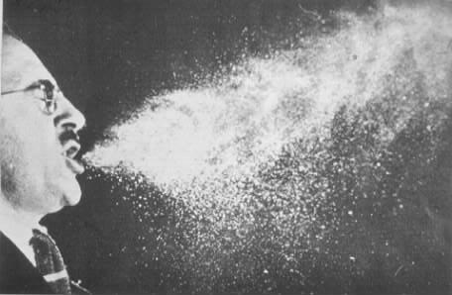
Disease
Causes:
Communicable and
Non-Communicable

Slide 2
Disease, or illness, prevents the normal functioning of the body.
Microbes – micro-organisms
Microbes that cause disease are called pathogens or germs.

Slide 3
Pathogens
Disease-causing microbes (Bacteria, Viruses, Fungi and Protists)

Slide 4
Bacteria:
Streptococcus – causes Strep Throat

Slide 5
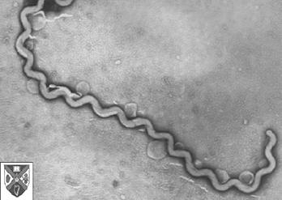
Leptospira - Bacteria

Slide 6
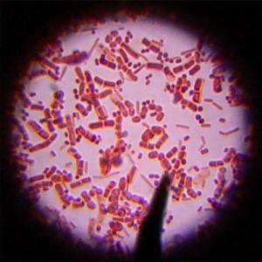
Beneficial Bacteria

Slide 7
Viruses:
Rhinocirusscope:
Common Cold

Slide 8
Protists
Single-celled organisms

Slide 9
Fungi
Includes: Molds, yeasts and mushrooms (some are parasites)

Slide 10
Communicable Diseases:
Causes by Pathogens
Spread from 1 organism to another
Ex. Flu, common cold, and AIDS

Slide 11
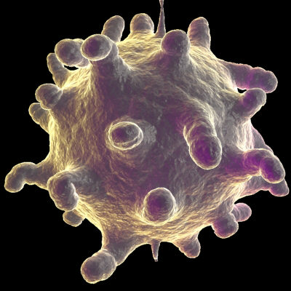
Common Cold

Slide 12
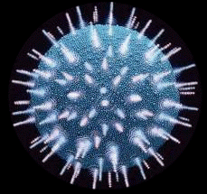
HIV/AIDS

Slide 13
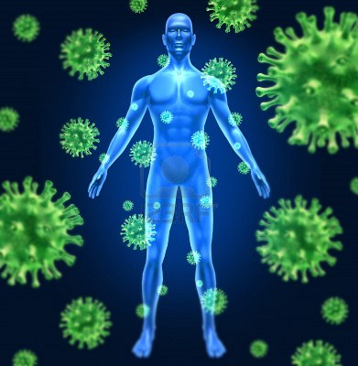
Human Virus

Slide 14
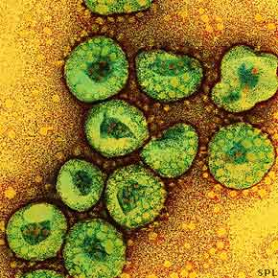
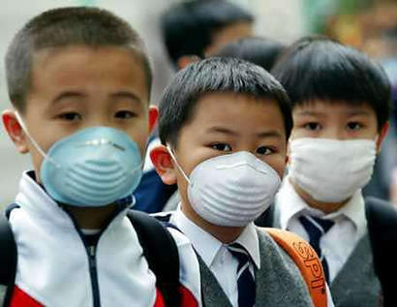
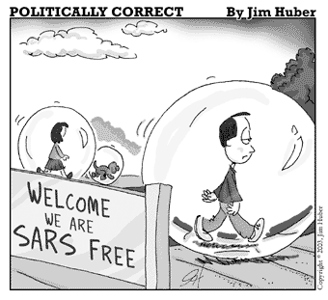

Slide 15
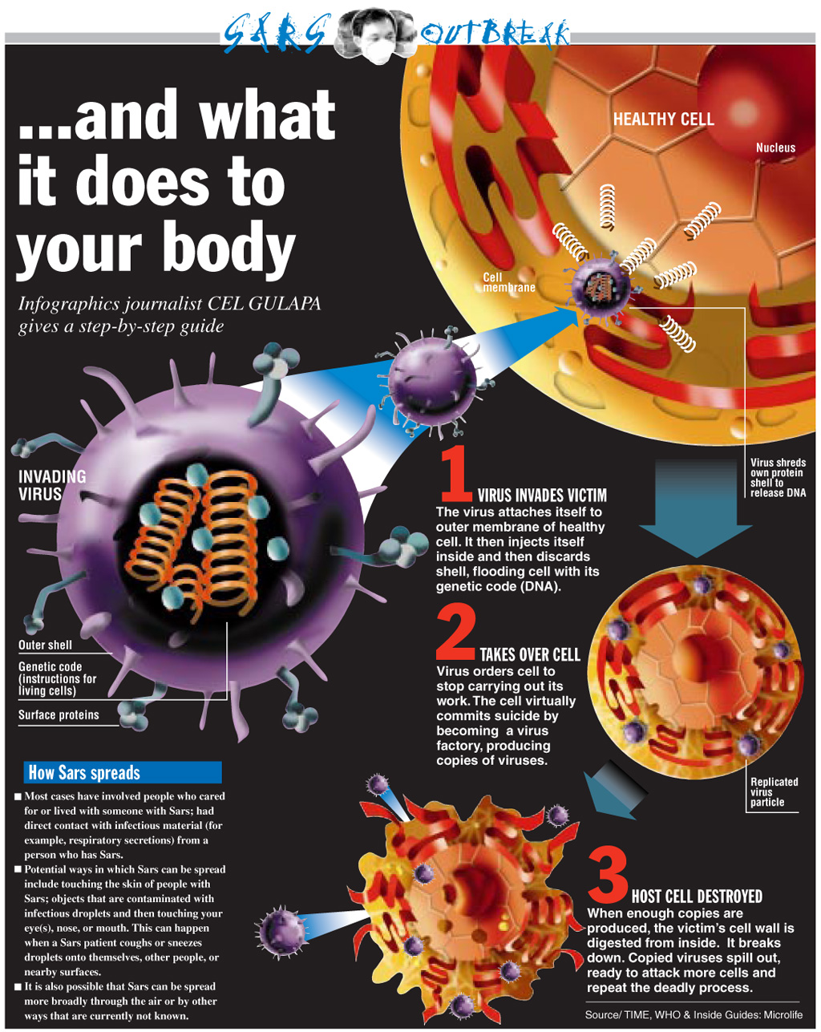

Slide 16
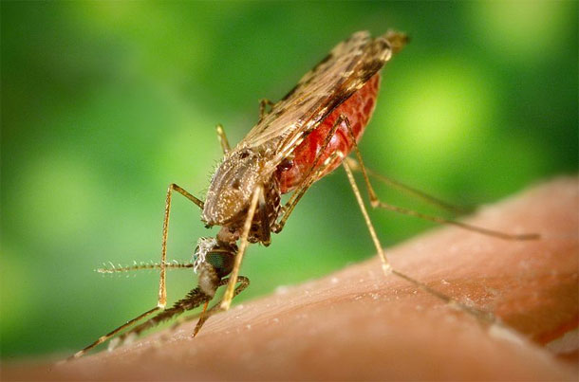
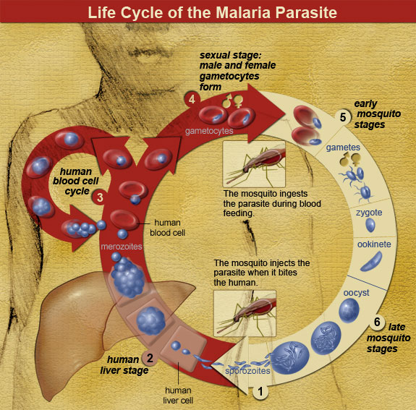
West-Nile Virus
Malaria

Slide 17
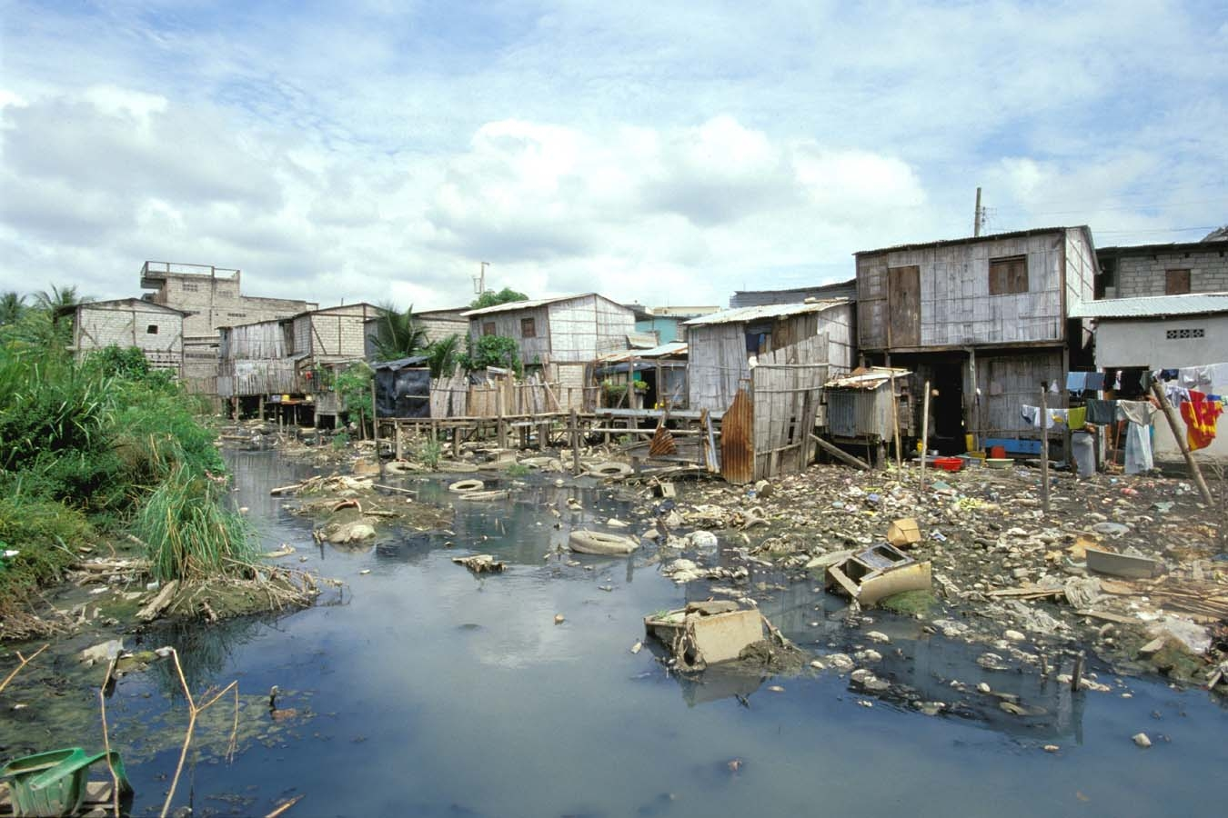

Slide 18
