Slide 1
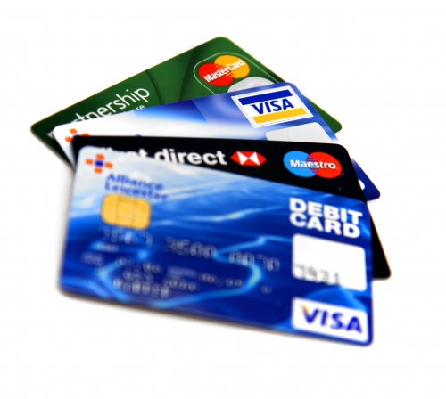
Credit
Buy Now, Pay Later – Where’s the Catch?

Slide 2
What do you think...
If you ever wanted to get a loan or a credit card what would you have to do?
Could you get one right now? Why or why not?
What do you think credit is?

Slide 3
Credit
Money borrowed for a variety of purposes. You, as the borrower, pay interest for the use of the money and are obligated to repay it at a preset date.
It includes such things as: credit cards, bank loans, financing, lines of credit, overdraft protection, leases, student loans and personal loans.
It involves spending future earnings.

Slide 4
Credit (cont’d)
The higher the interest rate or the longer the lending term, the higher the total cost.
Bottom Line: credit is receiving money with a promise to pay later.

Slide 5
Character
Refers to a person’s reputation for honesty and dependability in paying debts.

Slide 6
Capacity
The ability to pay a debt. A lender must consider the borrower’s personal income as well as the expenses he or she may have.

Slide 7
Capital/Collateral
Means wealth or what the borrower owns. The things that make up capital include a house, car, furniture, appliances, savings, investments, insurance policies and other personal effects. Ownership of assets shows that a person manages money wisely and saves a portion of income.

Slide 8
Capital/Collateral (cont’d)
If anything happens to the borrower or their income, these possessions can be used to pay off the debt.
You may be required to name an asset (such as your car) as collateral, which your lender could claim if you fail to make payments on the loan.

Slide 9
Credit Rating/Score
An ongoing record of how well you manage debt. This record is kept on file at the local credit bureau.
Lenders check your credit rating before agreeing to loan you money.

Slide 10
Credit Bureau
Collects information on whether bills and loan payments are paid. Provides a rating of risk, dependent on the person’s “character”.

Slide 11
Co-signer
Any person, with established credit, that is willing to help someone else get credit (a loan or credit card). If the borrower defaults (fails to make payments as described in the loan agreement) on the loan, then it is up to the co-signer to pay.

