Slide 1
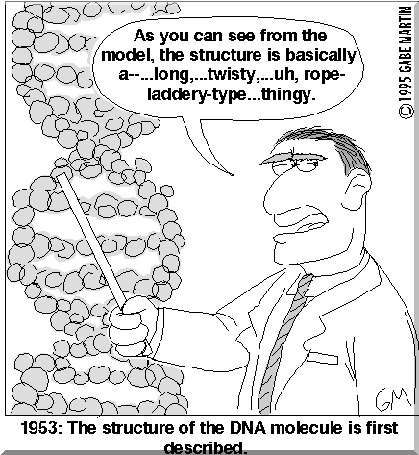
Chapter Twelve
Genetics and Health

Slide 2
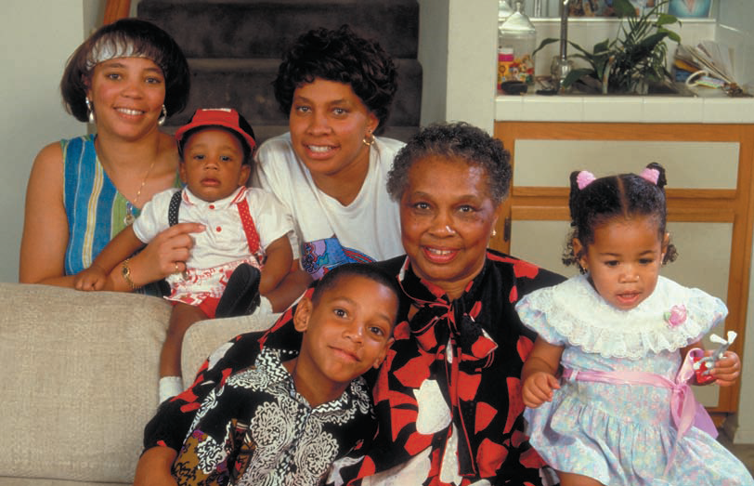
Traits can be passed down from generation to generation.
In the following picture, what traits do you think are inherited?

Slide 3
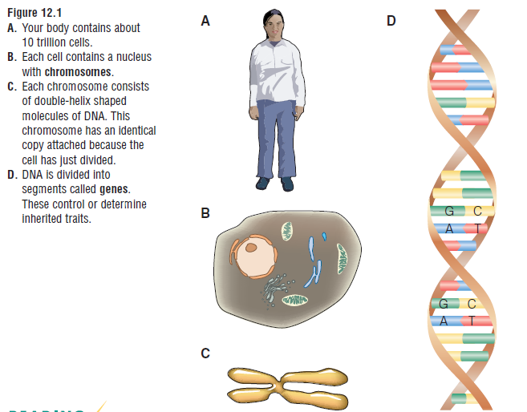
12.1 Structure of DNA
Genetics is the study of how characteristics or traits are passed from parents to offspring.
found in the nucleus of a cell; they contain DNA
basic building blocks of inherited traits that form segments that make up DNA

Slide 4
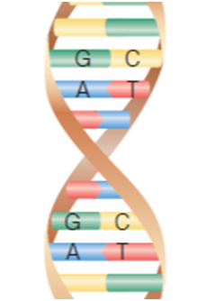
Structure of DNA....
If we take a close-up of DNA what do we notice about the DNA molecule itself?
1) Base Pairs
a) Guanine
b) Cytosine
c) Adenine
d) Thymine
2) Double-Helix Shape
The base pairs will code for a specific trait that you will inherit from your parents.

Slide 5
Chromosomes
Human body contains 46 chromosomes that are arranged in pairs. So, how many pairs of chromosomes will the body have?
_____
Can anyone think to why they might be arranged in pairs?
One chromosome will come from your mother and one from your father.
Mom
Dad
You

Slide 6
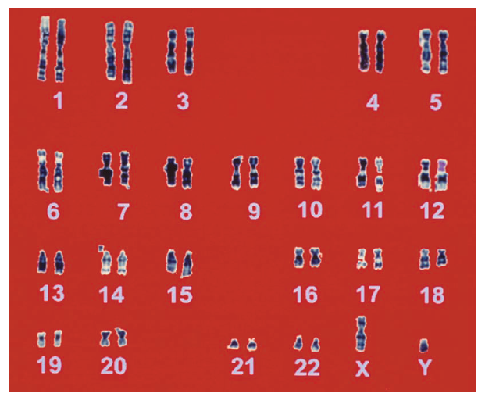
Karyotype of Human Genome
What do you notice about the chromosomes?
Is there anything that doesn't match?
Why do you think that is?

Slide 7
12.2 Inheritance and Genetics
Heredity is the passing of characteristics from parents to offspring.
Gregor Mendel was considered the "father of genetics". He was the one to first look at heredity, specifically with pea plants. Here are his results.

Slide 8
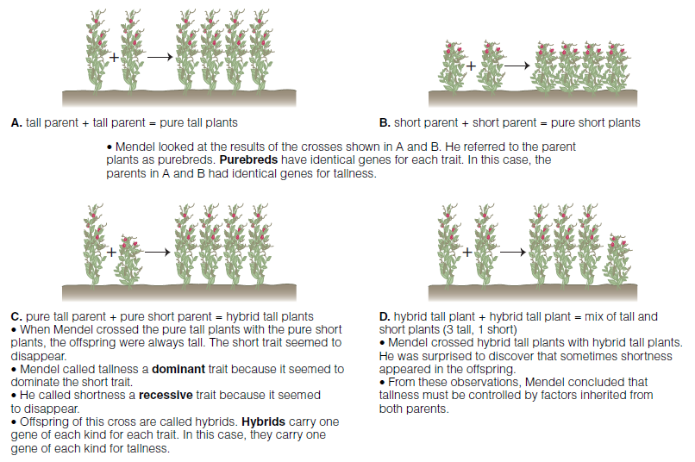
Summary of Terms:
1) Purebred:
2) Dominant Trait:
3) Recessive Trait:
4) Hybrid:

Slide 9
Recording Inherited Traits
Traits are controlled mainly by two genes; some can be more.
We are going to focus on two genes (pair of genes). To represent the genes we use something referred to as genotypes (letter code for the combination of genes that an organism has for each trait).
1) Capital letters represent dominant traits (T)
2) Lower case letters represent recessive traits (t)
Which trait will be expressed: dominant or recessive?
Rr EE tt QQ RR rr

Slide 10
Punnett Squares are used to predict the probability of offspring inheriting specific traits.
1) Eggs with the gene go at the top
2) Sperm with the gene go on the left side
3) Offspring will go in the boxes left over
T = tall
t = short
Punnett Square | Percent Probability Tall | Percent Probability Short
A | 100% | 0%
B
C
D

Slide 11
Examples: Use a punnett square to determine what is the probability of dominant genes and recessive genes.
1) Two pea plants, both have a dominant tall gene and a recessive short gene are crossed.
2) Two pea plants: one with two dominant red flower genes and one with a dominant red gene and a recessive white gene are crossed.

Slide 12
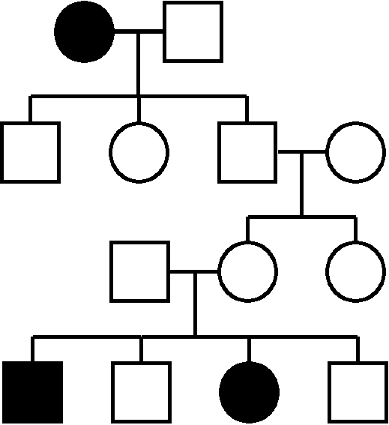
Pedigrees
Pedigrees are diagrams that shows the history of a trait from generation to generation.
This can trace diseases throughout the generations.
**Interpreting a Pedigree**
Page 218
Key:
Male
Female
Mating
Affected
Autosomal Recessive

Slide 13
12.3 Genetic Changes
With copying, mistakes are bound to happen. DNA needs to copy itself in order to reproduce and make new cells; along the way there might be a mutation (change in genetic information that can result in an abnormal gene).
How can mutations happen?
1) Mutagens- environmental factors that increase the chance of a mutation happening. Examples: radiation, ultraviolet light, and chemicals (PCBs, cigarettes, alcohol, drugs).
2) Genetic Disorders- disease or illness caused by alterations to genes that affect their normal functioning. Examples: sickle-cell anemia (abnormal form of hemoglobin...low levels of iron in blood and decreased ability to fight off disease)

Slide 14
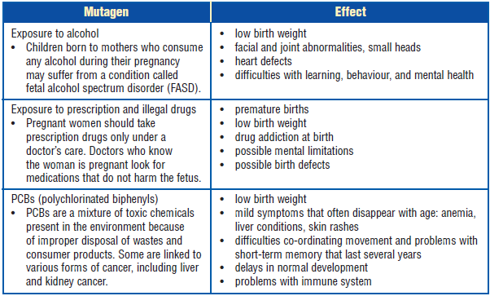
Genetic Disorders Caused by Mutagens
Overdose of radiation/UV radiation can cause: cancer, skin burns and other serious conditions.
Radiation can also be good. By focusing the radiation it can kill cancerous cells.
What are the effects of mutagens on human embryos?

Slide 15
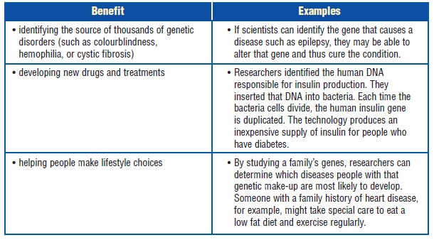
12.4 Issues in Genetic Research
The Human Genome Project was the most important scientific effort that humans attempted. It was what allowed scientists to discover that the body contained 46 chromosomes.
Benefits:
1) Genetic Engineering is transfer genes from one organism to another.
2) Can check if prone to genetic disorders

Slide 16
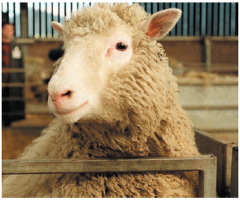
Dolly
Dolly was the world's first cloned sheep. She developed arthritis before she was six years old. They do not know if it was an environmental factor or a genetic factor that caused it.

Slide 17
Ethical Questions that Might Arise from Genetic Research
1) Who has the right to genetic data that provide information about your chances of developing various conditions?
2) What might happen if health insurance companies had access to everyone's genetic make-up? Could they refuse to provide some people with health insurance?
3)What might happen if an employer found out that an employee had genes that often result in substance abuse? Might the employee be fired?
4) Do you want to know genetic information that may tell you of a terrible disease you are likely to develop but unable to do anything about? How might knowing this affect the way you live? Might you suffer from depression or adopt behaviors that put you more at risk?

Slide 18
Section End
Huntington's Disease CBC Video

