Slide 1
Chapter Four
Pages 344-359

Slide 2
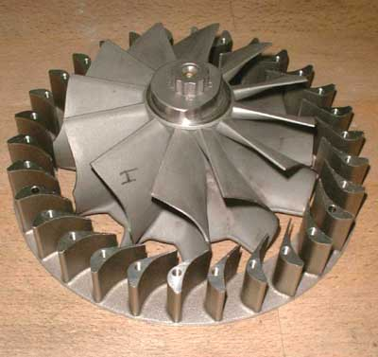
4.1 Electrical Energy Sources and Alternatives
Fossil Fuels- 65% of the Earth uses fossil fuels as an energy source (coal, oil, natural gas)
Turbine- long shaft with many fan blades

Slide 3
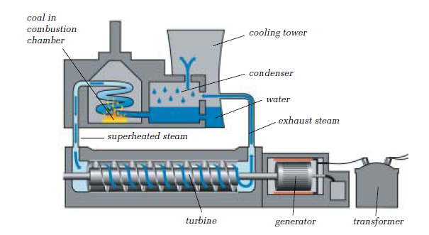

Slide 4
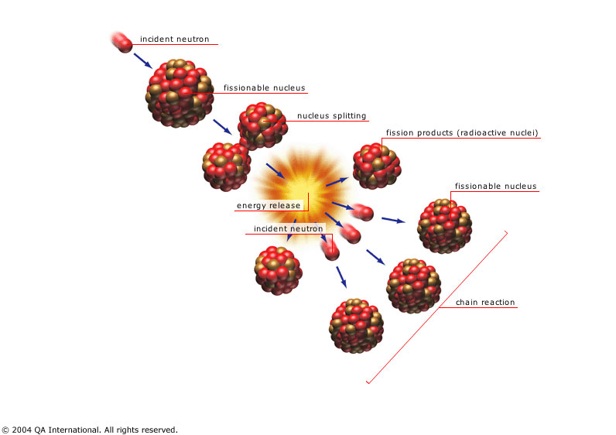
Nuclear Fission
The splitting of atoms of a heavy element into smaller elements
Releases a lot of energy
Usually uses uranium as a starter element

Slide 5
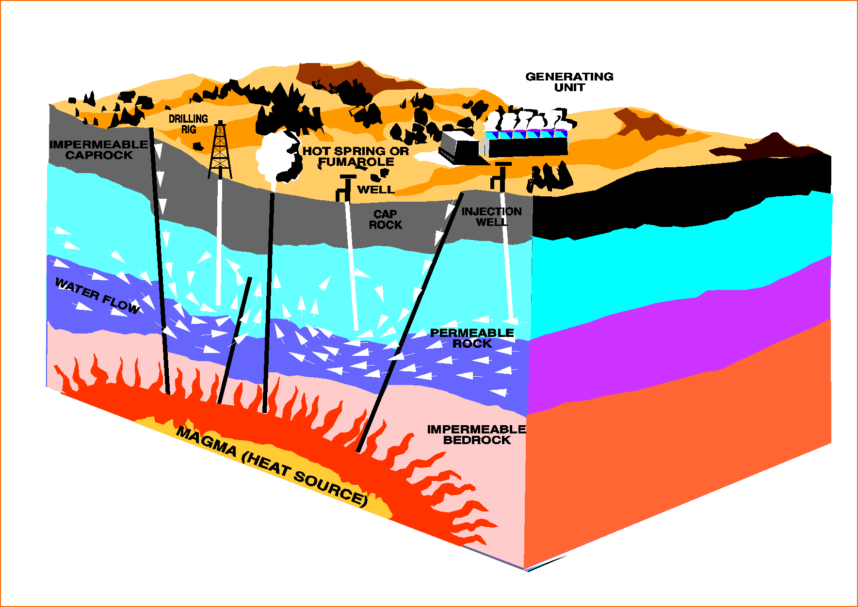
Geothermal Energy
Energy that comes from the earth’s surface.
Pipes are built into the ground, water is pumped down and it will heat up. When it comes back up it will be steam which turns turbines

Slide 6
Biomass
Garbage in landfills gives off combustible gases which are collected and used as fuel for steam driven generators

Slide 7
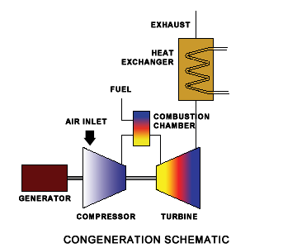
Cogeneration
This is using waste energy from other energy producing plants and uses it to turn turbines

Slide 8
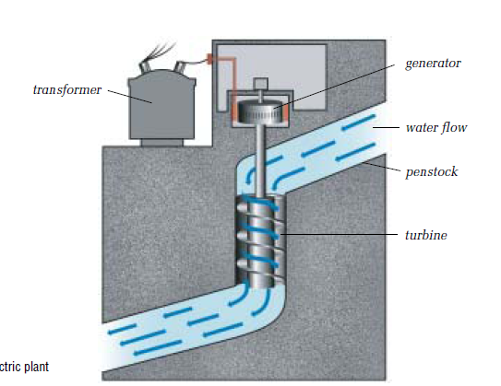
Hydroelectric Power
25% of the world’s energy is made with this

Slide 9
Alternative Energy Sources
Tides- waves will turn a turbine to generate electricity
Wind- wind will turn a turbine to generate electricity
Sunlight- sunlight is converted by a solar cell into electricity
Batteries- chemical energy is converted into electrical energy. Not good for whole cities.
Rechargeable batteries not 100% reliable
Fuel cells- primary cell that generates electricity directly from a chemical reaction with fuel (hydrogen)

Slide 10
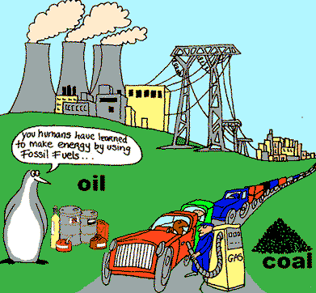
Non-renewable Energy
Def’n- energy source that cannot be replaced after it has been used.
Coal
Oil
Natural Gas

Slide 11
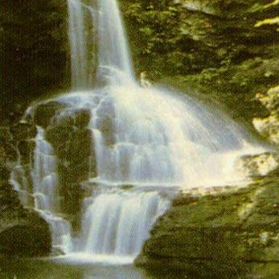
Renewable Energy
Energy sources that can be renewed or replenished naturally in relatively short periods.

Slide 12
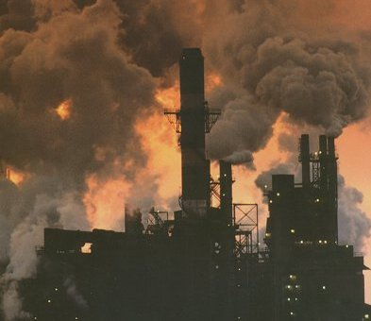
4.2 Electricity and the Environment
Air Pollution
Burning of fossil fuels release pollutants into environment (ash, SO₂, CO₂, NO_{x})
Fly ash- ash that is released when coal is burned\ May contain small amounts of Hg

Slide 13
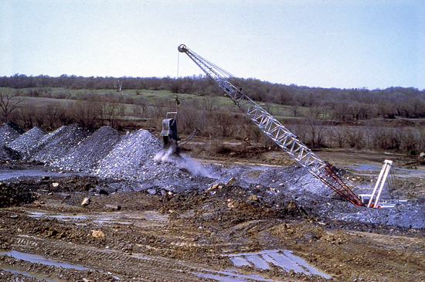
Other Environmental Effects
Strip-mining: removes all plants and animals to large areas of land, restored after they have taken the coal, only bad thing is that it is not restored back to normal.
Releases poisonous gases
Warm water from steam turbines returned to lakes...lakes get warmed, kill fish

Slide 14
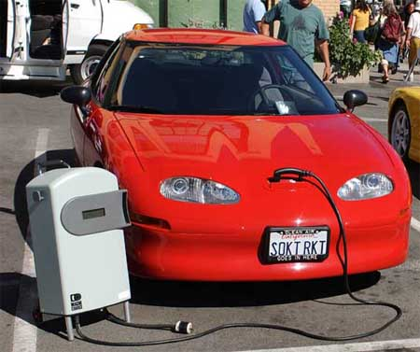
Conserving Non-Renewable Resources
Reserves of non-renewable resources are depleting.
What do we do now?
Electric cars...are they really saving our environment?

Slide 15
Sustainable Future
Sustainability- using resources at a rate that can be maintained indefinitely
We need to use our fossil fuels sustainably, or else they will not last for our future generations.

Slide 16
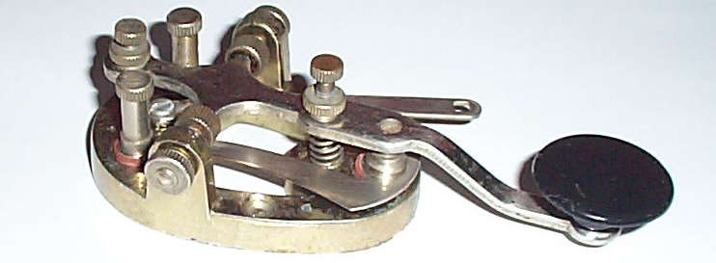
4.3 Electrical Technology and Society
Samuel Morse- invented the first electrical communication system...Morse Code
Today we quicker technology that allows messages to be transferred from one place to another quickly

Slide 17
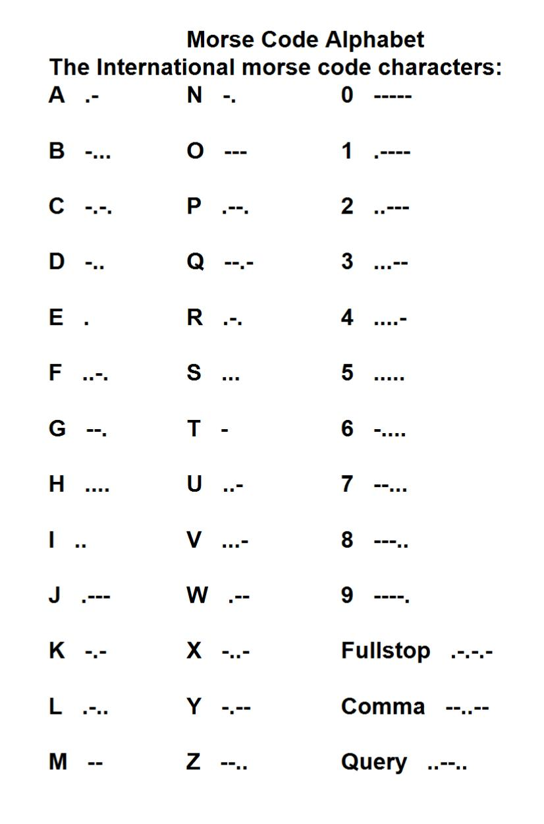

Slide 18
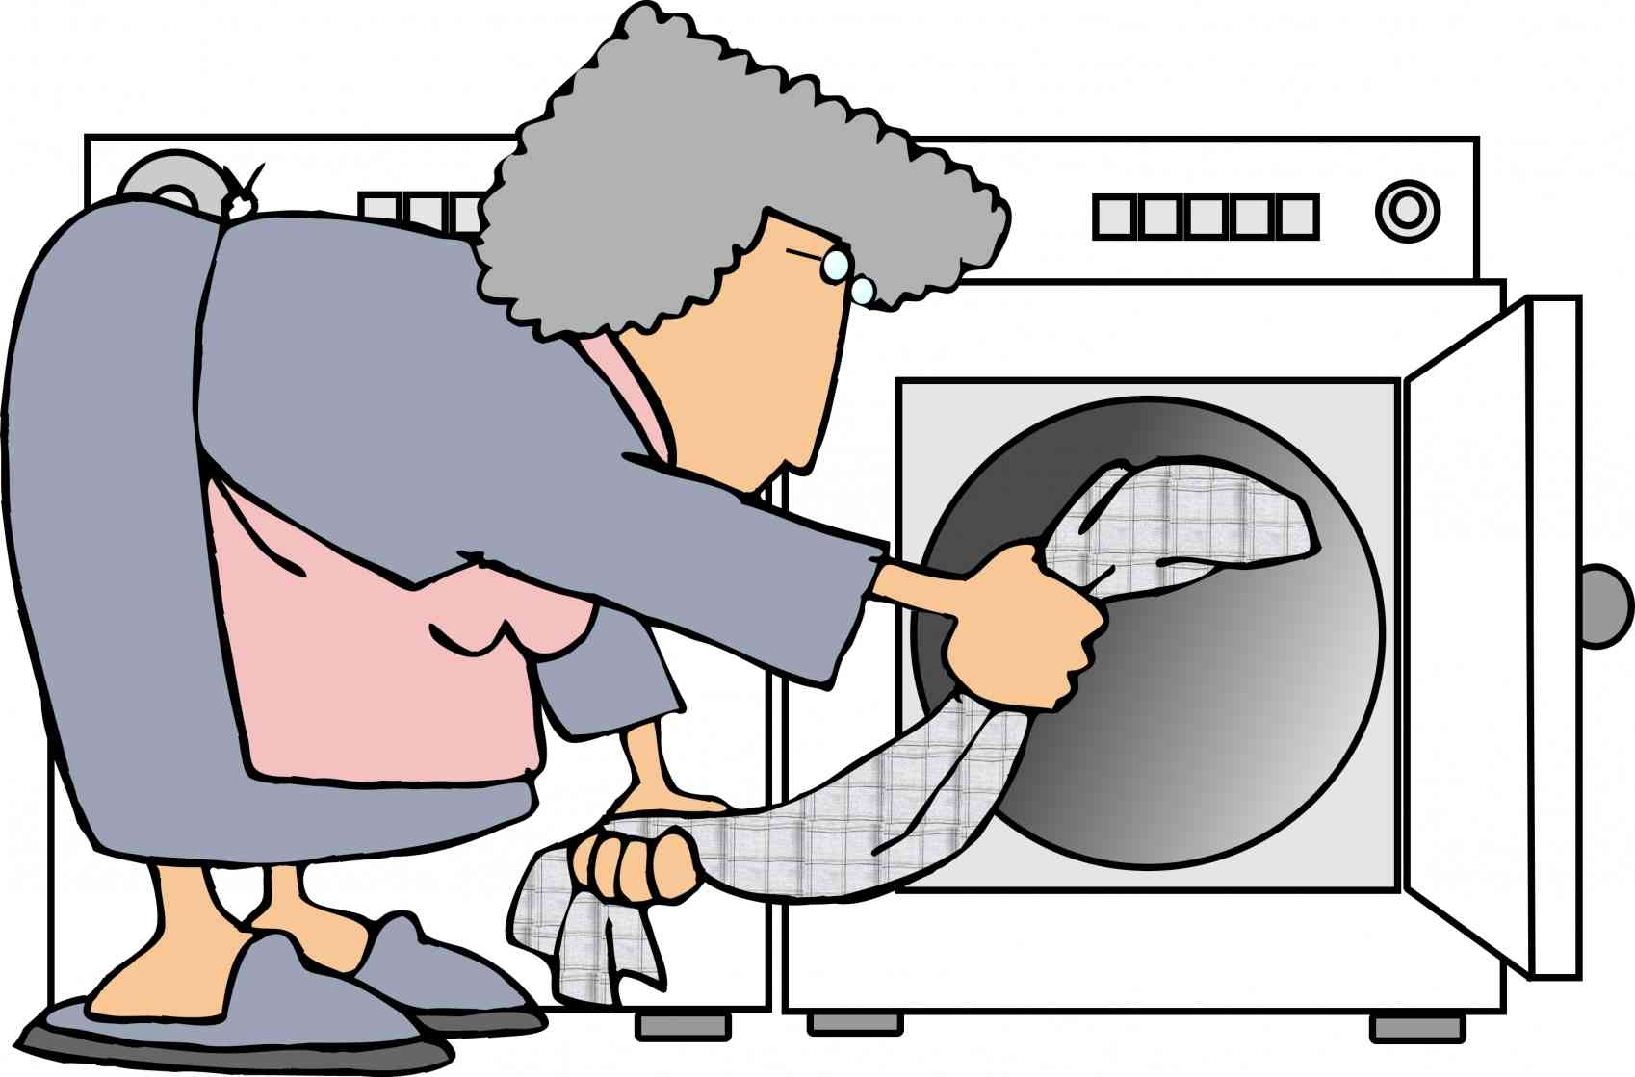
Benefits of Electrical Technology
What do you think?
Gives us more time to do other things, has this made us lazy?

Slide 19
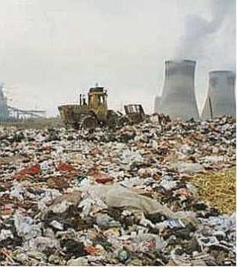
Drawbacks of Electrical Technology
More technology = more resources to keep that technology running
More new technology means old technology is obsolete....what do we do with it?
Solid garbage...hard to decompose...what does this mean?

Slide 20
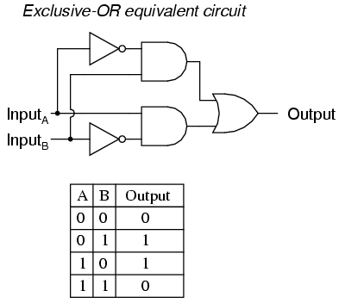
Computers and Information
Computers transpose all information into binary numbers (numbers with just one’s and zero’s)
Binary numbers will turn on and off specific transistors on a microcircuit

Slide 21
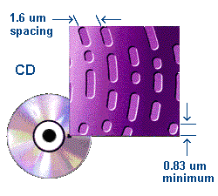
Electricity and Computers
Different techniques are used to store and transmit information but all use electricity in one way or another
CD- pulses occur when the laser is reflected due to the tiny pits stamped on surface of CD. Photodetector converts light pulses to electrical pulses which make our music

Slide 22
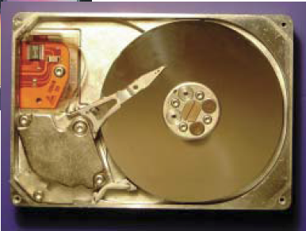
Con’t
Hard Drive on Computer- aluminum is coated with magnetic material which rotates at a speed of 300 km/hr.
Reading- hard drive sends an electrical signal to the processor
Writing- responding to electrical signals from the processor (this will move the head accordingly)

Slide 23
Electrical Transmission of Information
Electronic storage of information is a benefit to society
Information is cheaper to store, easier to find, and much more compact
Internet- allows for a lot of information at your fingertips...downside:
Not all countries can afford it
Privacy: data transmission not always secure

Slide 24
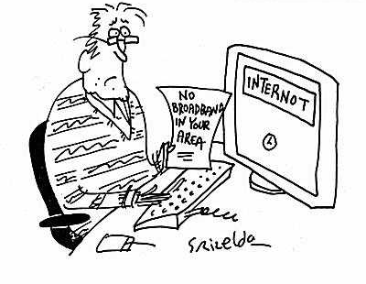
More Concerns With Internet
Trust it?
Information overload?
Search Engines- help with overload

