Slide 1
Career Trends
What jobs are out there for me NOW???

Slide 2
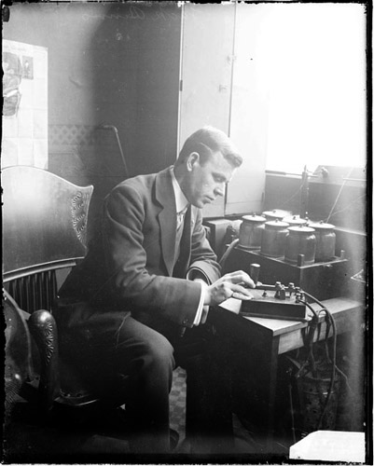
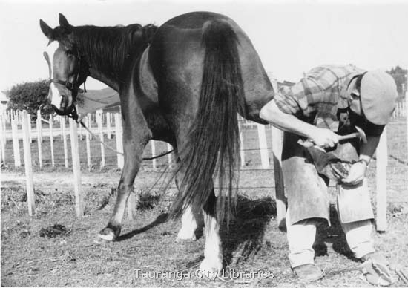
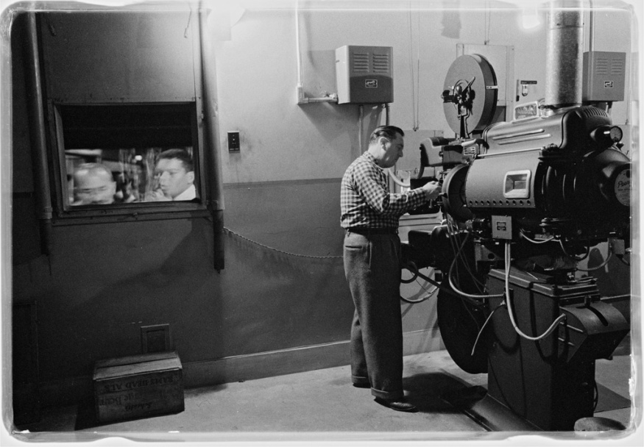
Think of occupations that are extinct!
Blacksmith
Movie Projectionist
Telegraph Operator...

Slide 3
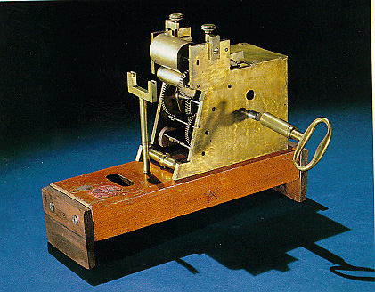
What factors have contributed to the extinction of these occupations?

Slide 4
What current occupations now fill the same need?

Slide 5
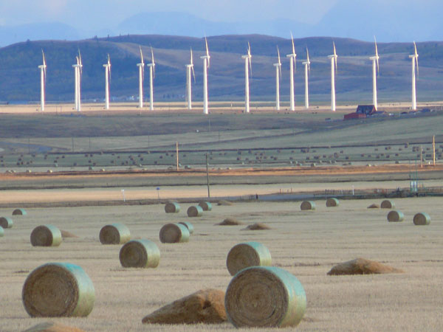
Trends Affecting Alberta’s Occupations and Industries

Slide 6
The Economy
No economy can operate in isolation. Alberta’s economy is influenced by events in other parts of Canada, the US and the world.
Currently, the global recession that began in the US housing market in 2007, has played a huge role in the current economic state of Alberta, Canada and the world.
Demand for everything from resources to workers evaporated and economic growth slowed to a halt, putting us on the verge of a worldwide depression.

Slide 7
Economic Recovery
As the US is our major trading partner, our economy is tied very closely to theirs.
The pace of recovery in the states will strongly influence the pace of recovery in Canada.
Unemployment rates in the US are projected to increase still throughout 2010, but the worst of the recession is believed to be over, taking place in the second half of 2009.
Small signs of recovery have been evident. (eg. slight economic growth)

Slide 8
Asian Ties
Alberta and Canada have economic ties to Asia through immigration, tourism, trade and businesses.
Because of this our recovery is also tied to Asia, who has proved to be more resilient than the US throughout this recession.

Slide 9
The Current Canadian Economy
Canada’s economy shrank in 2009 but is projected to grow slightly in 2010 and 2011.
Global trade has steadied and there are signs of recovery in retail sales, consumer confidence and housing markets.
Employment is slowly rebounding, but their were major job losses in the manufacturing sector, construction industry, natural resources, transportation and warehousing industries.
However, jobs rose in information, culture and recreation, and finance, insurance and real estate.

Slide 10
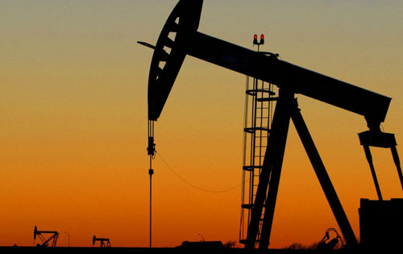
oil
Oil is the world’s #1 energy source, and consumption is expected to grow from 85 million barrels a day (2006) to 91 million barrels a day in 2015, and 107 million barrels a day in 2030.
In August of 2009, 22% of the oil that was imported in the US came from Canada, which was the highest proportion of oil used by states to come from Canada ever.
Although Alberta shipped more oil to the states than ever, the lower price saw the province bring in less money than in 2008. Regardless, oil accounted for 2/3 of Alberta’s exports.

Slide 11
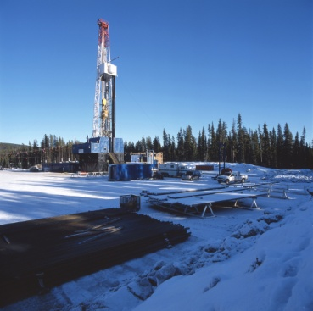
Natural gas
Consumption of natural gas is expected to increase by 50% by 2030.
It is a cheaper source of fuel and is required for electricity.
80% of Canada’s natural gas is produced in Alberta.
Natural gas accounts for 21% of Albertan exports.

Slide 12
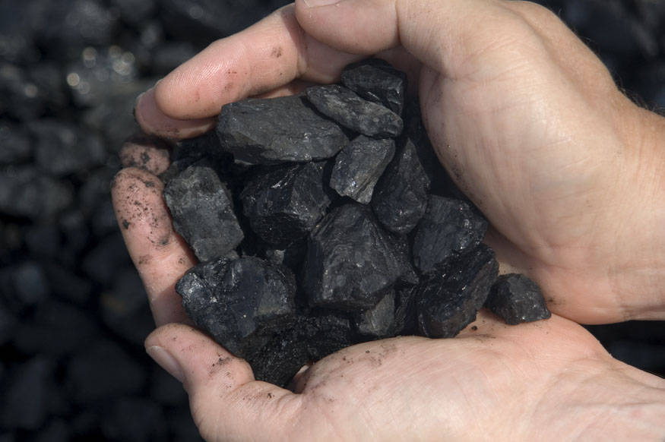
Coal
Coal accounts for about ¼ of the world’s energy consumption.
In Alberta in 2008, coal accounted for 59% of the province’s electricity generation.
Production of coal in Alberta is expected to increase.

Slide 13
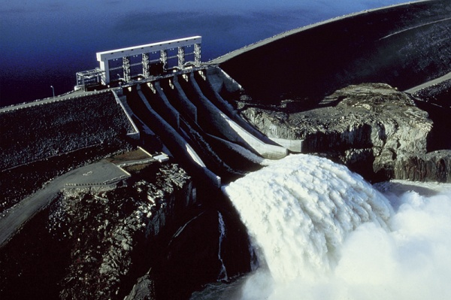
Renewable Energy
The use of renewable energy sources is growing, most of the growth in hydro and wind power.
Most of Alberta’s energy production comes from coal or natural gas (90%), but the rest comes from hydro, wind or biomass (burning biological material to produce energy, eg. Firewood)

Slide 14
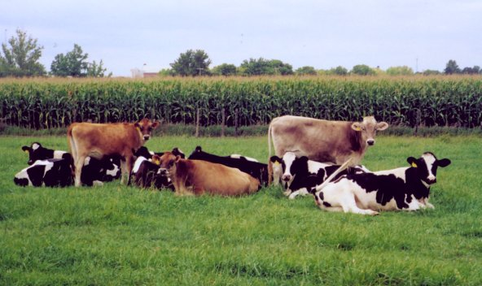
Agriculture
Prices of agricultural products should rise in the next few years, but not back to pre-recession levels.
Because world population growth is expected to be slow in the next 25 years, demand for food is unlikely to skyrocket.
6% of Alberta’s exports is livestock and grain

Slide 15
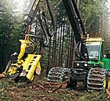
Forestry
The demand for forestry products has shrunk considerably.
Because the US is where most of Alberta’s forestry products go, the industry has not fared well in this province.

Slide 16
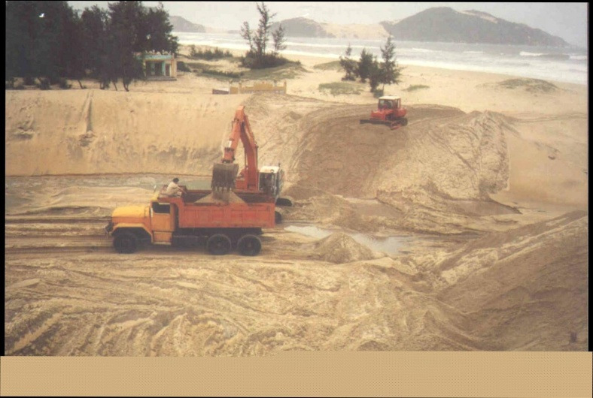
Metal & Minerals
Before the recession lots of money had been going into exploring this industry, and many job opportunities have been created.
Due to the recession, demand for metals and minerals has decreased, and no growth is expected until we have emerged from the recession.

Slide 17
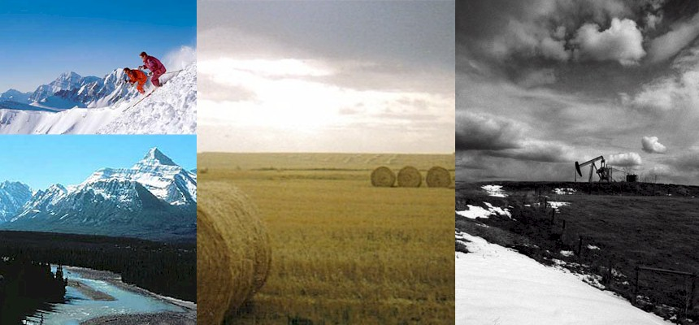
Trends & Challenges in the Alberta Economy

Slide 18
Just some Facts!!
Oil prices increased more than 4 times from 2004-2008
In 2009 however, Alberta spent only half what they did on oil production in 2008
Employment was down 22,000 jobs in Alberta in 2009
Farm income decreased in 2009
Alberta’s exports were down 40% in 2009
Because of this, Albertans shopped less and built less houses
People are still moving to Alberta: there were 70,000 more people here in January 2010 than there were in January 2009

Slide 19
Technological Trends
People, businesses and industries have become more reliant on changing technology.
Employers are looking for a competitive advantage in employees who know how to use or develop the latest programs or systems.
Markets for technologies are growing.
Energy, health care, and resource and land management are areas in the Alberta economy that require high technological competencies and their is room for growth.

Slide 20
Technological Trends
Nanotechnology – The Alberta government has provided funding for nanotechnology research, and NAIT opened a Nanotechnology Systems diploma in September 2010.
Clean technologies – Increasing environmental concioussness has led to a demand for research and development in this area, including technologies that make efficient use of renewable energy sources (wind, solar, etc.) or improve management of Alberta’s land, water and air resources.

Slide 21
Environmental Trends
Economic activity and environmental preservation are competing in Alberta.
Alberta produces 1/3 of Canada’s greenhouse gases.
The Alberta government is encouraging development of energy efficient and environmentally responsible technology, and setting standards and rules for economic activity.

Slide 22
Labor & Skills Shortages
Alberta industries will continue to have trouble finding and retaining skilled workers.
The pool of workers is going to shrink as more baby boomers retire than there are young people entering the job market.
There is also a mismatch between what young people study and what employers are looking for.

Slide 23
More Trends
An aging population (baby boomers) will place strains on the home and health care systems.
The mountain pine beetle infestation could seriously jeopardize the logging, forestry and related industries.
The oilsands are under scrutiny for their effects on the environment, and is proving to be a challenge for the province.

Slide 24
A Changing Workforce
More than 40% of Albertans work more than 40 hours per week
About 25% postpone or cancel vacations due to work
20% still work while on holidays
12% trade their vacation days for money

Slide 25
To be Successful in the 21St century, workers need the following skills and Attitudes...
High level of initiative and imagination
High degree of flexibility
Innovation, ingenuity and a creative approach to problem solving
Inquisitive
Ambitious and an entrepreneurial nature
Loyalty, to an employer or work project
Postsecondary education (jobs for university graduates have doubled in the last 20 years)
Ability to do many tasks at once

Slide 26
...Continued...
Ability to accept responsibility for actions and decisions made on the job
Good communication skills
Computer and technology skills
Team skills
Willingness to continually learn and upgrade skills
Ability to accept constructive feedback and advice for continual improvement
Ability to contribute to a healthy work environment

Slide 27
Characteristics of 21st century workplaces
Integrated learning and training opportunities
Gender, ethnic, generational and cultural diversity
Emphasis on team environments, learning skills from co-workers
Healthy and safe work environments
New organizational structures designed to foster effective operations
More flexible work arrangements, including telecommuting, job sharing, part time work and combination jobs
Focus on knowledge management and enhancement
More sophisticated technology
Focus on customer service
Entrepreneurial focus, with an emphasis on competition and productivity

Slide 28
Prospective and existing Employees want...
The opportunity to engage in challenging work
The ability to make decisions in favor of a work-life balance
Opportunities to learn, grow and advance
Intellectual and emotional connections to co-workers and others in the organization
A commitment to corporate social responsibility on the part of the employer
Fair and adequate compensation, a competitive benefits program, and an attractive retirement package

Slide 29
Current Trends in Alberta’s Major Industries

Slide 30
Accommodation and Food Services
What it is: hotels, resorts and campgrounds, restaurants, lounges and bars
Occupations: bartenders, servers, desk clerks, housekeepers, managers, chefs, etc.
2008 employees: 113, 900
Annual expected growth (2009-2013): 2.8%
Tidbits: Job opportunities in this industry are affected by tourism, which is affected by people’s spending. Above average growth is expected in the food service sector, but below average growth is expected in the accommodations sector.

Slide 31
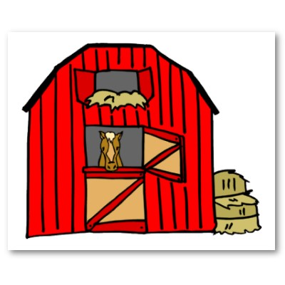
Agriculture
What it is: farms, orchards, greenhouses and feedlots
Occupations: farm workers, dairy producers, animal care attendants, beekeepers, etc.
2008 employees: 61,000
Annual expected growth (2009-2013): 0.9%
Tidbits: This industry is affected by many things: world grain prices, trade barriers, H1N1, and mad cow disease. The US has decreased imports from Alberta, however new trade markets are opening up around the world, and the production of biofuels is opening new job opportunities in Alberta.

Slide 32
Business, Building & other Support Services
What it is: record keeping, employment services, travel agencies, convention and trade show services, investigation and security services, custodial services, cleaning services, waste collection, landscaping services
Occupations: human resource professionals, locksmiths, pest control professionals, travel consultants, etc.
2008 employees: 63, 900
Annual expected growth (2009-2013): 2.7%
Tidbits: Employment in this industry has declined since 1999, and lower than average demand for jobs is expected in the next 5 years.

Slide 33
construction
What it is: construct, repair or renovate residential, commercial and industrial buildings and design and build pipelines, highways and bridges
Occupations: bricklayers, carpenters, electricians, pipefitters, roofers, etc.
2008 employees: 205,300
Annual expected growth (2009-2013): -1.1%
Tidbits: This industry is Alberta’s second largest employer, but it has been hard hit by the recession. However, it faces long term labor shortages as many employees are close to retirement age.

Slide 34
Educational Services
What it is: schools, colleges, universities and training centres, some of which may offer accommodations and food services
Occupations: teachers, professors, educational counsellors, teachers assistants, etc.
2008 employees: 126,800
Annual expected growth (2009-2013): 1.5%
Tidbits: Alberta has a highly educated workforce: over 80% of Albertans have a high school diploma, and in less than 10 years, over half are expected to have some postsecondary education.

Slide 35
Finance, Insurance, Real Estate & Leasing
What it is: banks, credit unions, mortgage and loan brokers, security dealers, insurance agencies, pension fund managers, property managers, auto rental firms
Occupations: financial analysts, insurance adjusters, real estate agents, financial planners, patent and trademark specialists, building superintendents, etc.
2008 employees: 111,700
Annual expected growth (2009-2013): 2.1%
Tidbits: Between 2007 and 2008, this industry grew by 12%! Since then it has slowed due to the recession.

Slide 36
Forestry & Logging
What it is: businesses that produce seedlings, grow and harvest timber, and other support services
Occupations: foresters, forest technicians, logging equipment operators, park wardens, etc.
2008 employees: 3600
Annual expected growth (2009-2013): 0.3%
Tidbits: Most of this industry’s poor performance has been due to the softwood lumber dispute between Canada and the US, decreased demand for building lumber, pine beetle infestations, and the appreciating Canadian dollar.

Slide 37
Health care & Social Assistance
What it is: health care services, home care services, ambulatory services, family services, daycares, vocational rehab services, community food, shelter and emergency relief services
Occupations: physicians, nurses, pharmacists, occupational therapists, dental hygienists, youth and child care workers, emergency medical technicians, etc.
2008 employees: 190,200
Annual expected growth (2009-2013): 2.2%
Tidbits: This industry is Alberta’s third largest employer. It will face many challenges in the near future, as the population ages and the need for health care increases. It is expected that 20% of Albertans will be 65+ in 20 years.

Slide 38
Information, culture & recreation
What it is: publishing, broadcasting, performing arts, film, television and digital media processing and sound recording, telecommunications, data processing and information services, facilities that provide services to meet recreational or cultural needs
Occupations: librarians, cinematographers, professional athletes, reporters, museum curators, etc.
2008 employees: 71,600
Annual expected growth (2009-2013): 2.6%
Tidbits: Above average growth is expected in the information and communications sector, largely due to technology business start-ups in Calgary.

Slide 39
Manufacturing
What it is: businesses involved in manufacturing food, beverages, chemicals, textiles, petroleum and coal products, plastics and electronic equipment
Occupations: meat cutters, machinists, manufacturing engineers, sawmill machine operators, instrument technicians, etc.
2008 employees: 144,100
Annual expected growth (2009-2013): -0.2%
Tidbits: Employment growth has been slow, and many jobs were lost in 2009, as this industry is tied closely to the oil and gas industry. Recovery will depend on the US, and the food and beverage sector is expected to rebound first.

Slide 40
Mining & Oil and Gas Extraction
What it is: companies that explore for and produce crude petroleum and natural gas, drill and equip wells, mine for coal or metal ore and perform other preparation activities associated with mining
Occupations: mining engineers, blasters, drilling and service rig managers, petroleum engineers, drilling floorhands, etc.
2008 employees: 145,500
Annual expected growth (2009-2013): 0.4%
Tidbits: This industry has been the most directly and severely hit industry with the collapse of oil prices in 2008. Many environmental issues are also threatening to hurt this industry. However, oil is going to be a key energy source for years to come, and most of the increase in production will come from the oilsands.

Slide 41
Other Services
What it is: automotive, equipment and electronic repair and maintenance, personal care services, funeral services, pet care, photofinishing, religious, civic and social organizations
Occupations: jewellers, massage therapists, hair stylists, fundraisers, automotive service technicians , etc.
2008 employees: 91,200
Annual expected growth (2009-2013): 2.1%
Tidbits: This industry suffered from rising wage rates prior to the recession.

Slide 42
Professional, Scientific & Technical Services
What it is: legal, accounting, architectural, engineering, surveying and mapping, industrial and computer system design, research and development, scientific and technical consulting, advertising and public relations, translation and veterinary services
Occupations: accountants, architects, civil engineers, graphic designers, lawyers, etc.
2008 employees: 164,200
Annual expected growth (2009-2013): 2.6%
Tidbits: This industry is Alberta’s fourth largest employer.

Slide 43
Public Administration
What it is: government agencies that manage public programs, set policies, create laws, settle civil and legal cases, provide public safety and national defence, organize and finance the production of goods and services
Occupations: correctional officers, firefighters, occupational health and safety inspectors, judges, customs inspectors, etc.
2008 employees: 83,400
Annual expected growth (2009-2013): 1.6%
Tidbits: This industry has had volatile employment, rising and falling with the economy. In 2009, the Alberta government initiated a hiring freeze to help deal with the recession.

Slide 44
Retail Trade
What it is: enterprises involved in the sale of food, beverages, drug products, shoes, clothing, household furniture and appliances, automobiles, and after sales services such as repairs and installation
Occupations: cashiers, direct distributors, opticians, pharmacists, retail store managers, etc.
2008 employees: 229,700
Annual expected growth (2009-2013): 1.9%
Tidbits: This industry is Alberta’s largest. Strong economic growth has created many jobs until recently, and a decrease in demand has occurred, but it is expected to improve through 2010 and beyond.

Slide 45
Transportation & Warehousing
What it is: businesses that transport passengers and cargo, warehouse and store goods, and provide support activities to modes of transportation
Occupations: airline pilots, taxi drivers, warehousing professionals, truck drivers, letter carriers, etc.
2008 employees: 102,200
Annual expected growth (2009-2013): 0.9%
Tidbits: Risks to this industry are an aging workforce, aging infrastructure and the likely resurgence of high fuel and other costs.

Slide 46
Utilities
What it is: electric power generation, transmission and distribution, natural gas distribution, building, operation and maintenance of water, sewer and irrigation systems
Occupations: gas utility operators, utility clerks, water and wastewater operators, plant operators, power linemen, power system electricians, etc.
2008 employees: 17,500
Annual expected growth (2009-2013): 2.0%
Tidbits: Employment growth has been strong in this industry for the last decade, and it will continue to grow as the demand for electricity will not decline.

Slide 47
Wholesale Trade
What it is: wholesale distributers and brokers of goods like farm products, petroleum products, food, beverage and tobacco products, personal and household goods, motor vehicles and parts, building materials and supplies, machinery and equipment
Occupations: shippers and receivers, sales representatives, auctioneers, truck drivers, direct distributors , etc.
2008 employees: 87,300
Annual expected growth (2009-2013): 3.5%
Tidbits: Employment recently spiralled downward but will rebound once consumer confidence returns.

