Slide 1
Canada Wide Science Fair 2015
Fredericton, New Brunswick
My Adventure: One Week of Awesomeness
Rebecca D.

Slide 2
Before…
After regional science fair, the new national team got together one day to discuss our trip and hang out for the day in Peace River. I went with four other finalists (competitors) and two delegates (grown-ups). This was Team Peace Country of Alberta.
Also there was a lot of prep work to do to be ready to go to Nationals. There was lots of stuff to figure out and do before leaving was even possible.

Slide 3
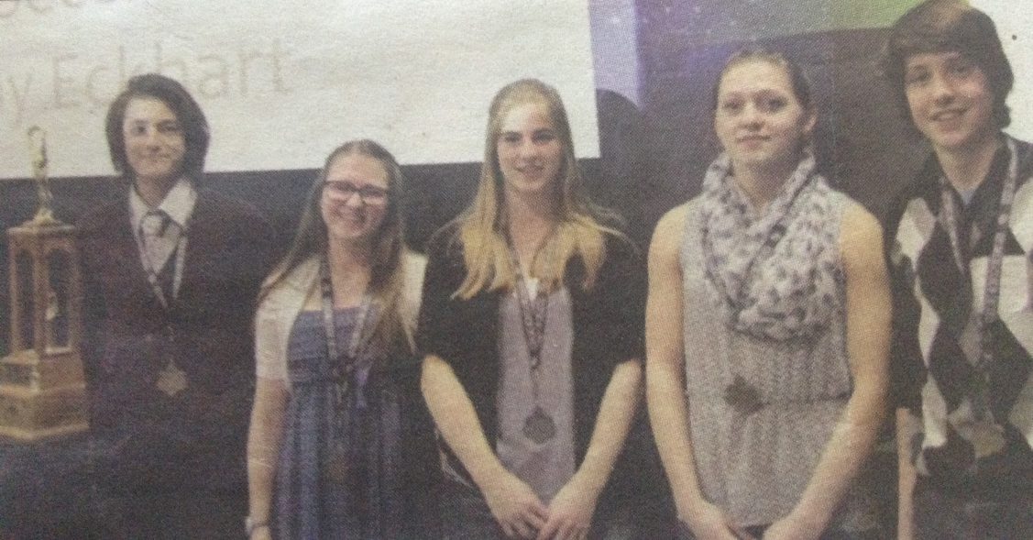
Saturday, May 9th
The three finalists and two delegates from Peace River came down to GP to sleep because our flights were really early Sunday morning. They slept in a hotel. Josh (the other finalist from GP) and I decided not to stay in the hotel. We did all meet for supper at Mr.Mikes. And then we headed home for a good nights sleep and last minute packing.

Slide 4
Flight Day
Sunday, May 10th (Mothers Day)
Get up at 6am
Fly to Calgary, arrive at 10:45
Rush to next connection flight to Toronto
Board plane for Toronto at 10:48
Land in Toronto at 2:59pm
Layover for 6 hours ( so we had supper at a restaurant, toured the airport)
Danced to some fiddlers who were on our flight, and hung out
Finally boarded plane to Fredericton at 10:30
Landed in Fredericton at 12pm, which was 3am Fredericton time
Finally got to the dorms and in bed at 4:30 Fredericton time (we are now on Fredericton time)
THEY LOST MY LUGUAGE!!!!

Slide 5
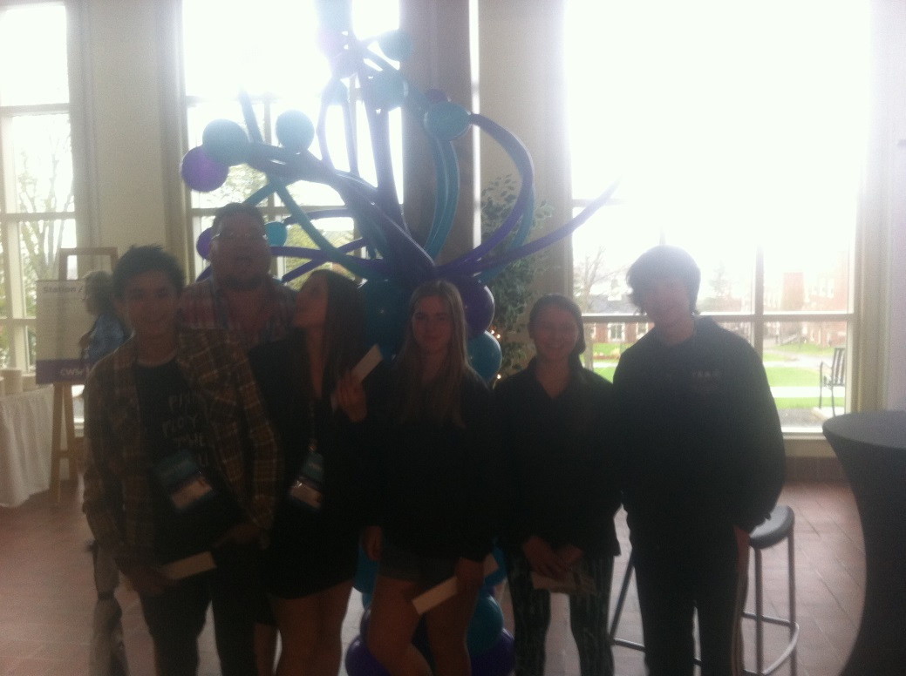
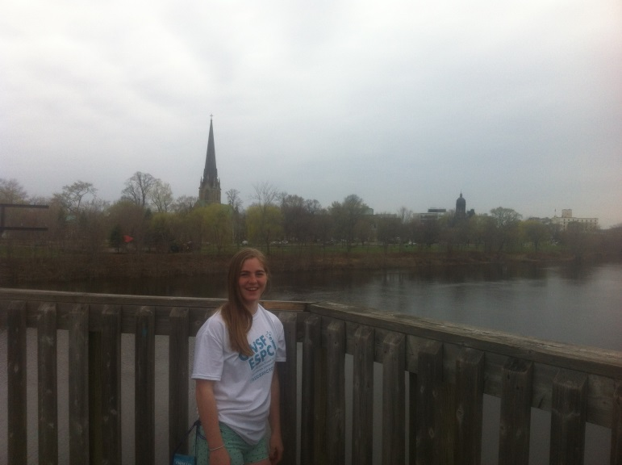
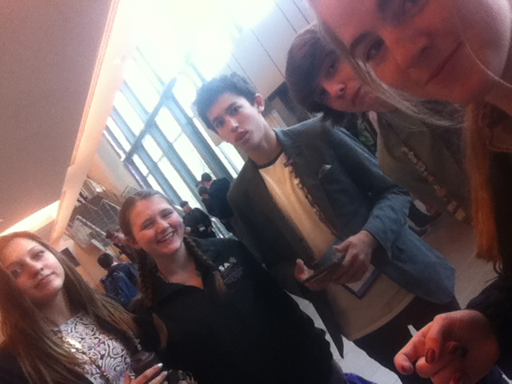
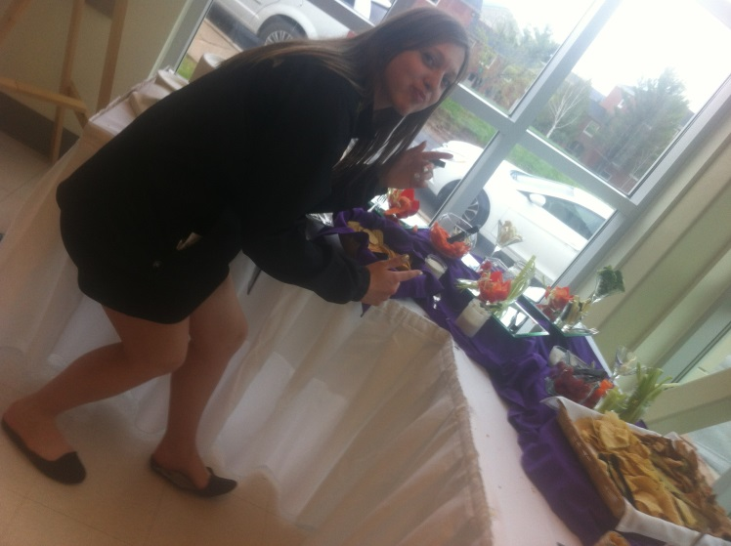
Monday, 11
Chill Day
Slept, Showered, Set up projects
Went for a walk through the town across the bridge
Stand up, Buffet style supper

Slide 6
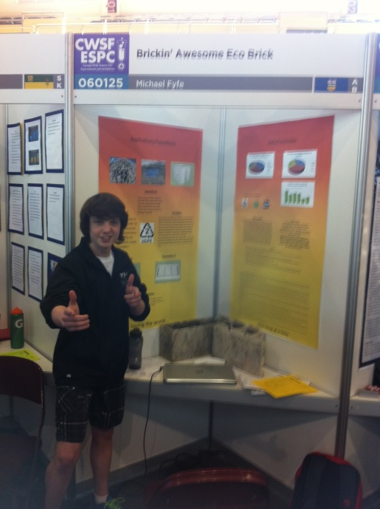
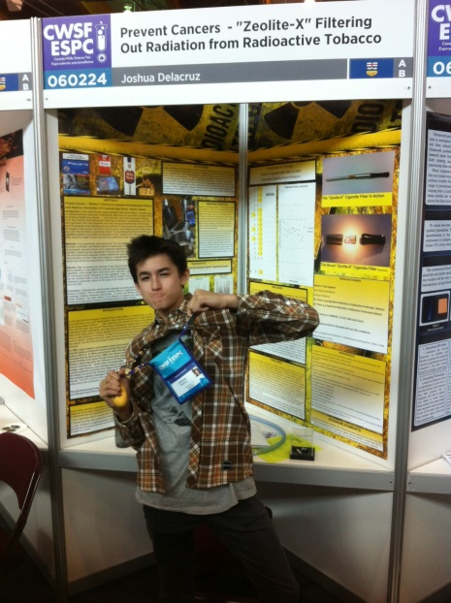
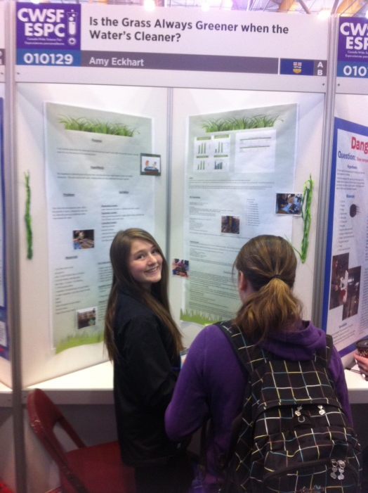
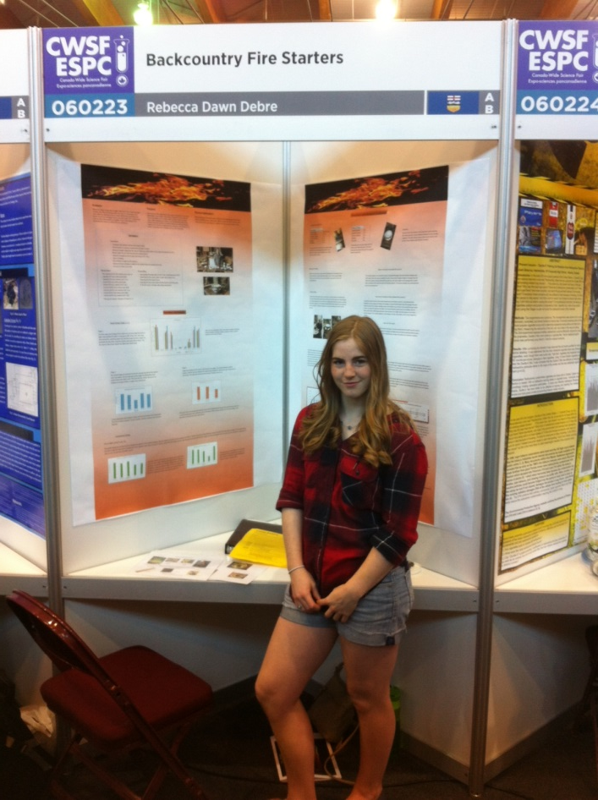
Tuesday, 12
Judging Day
Real early morning
Super organized and strict ( No Delegates)
They were in meetings anyway
Schedueles, Colors, Set Times
Evening: Street Festival
Got money for supper
Storytelling through the town
Music
Carnival stuff
Raining

Slide 7
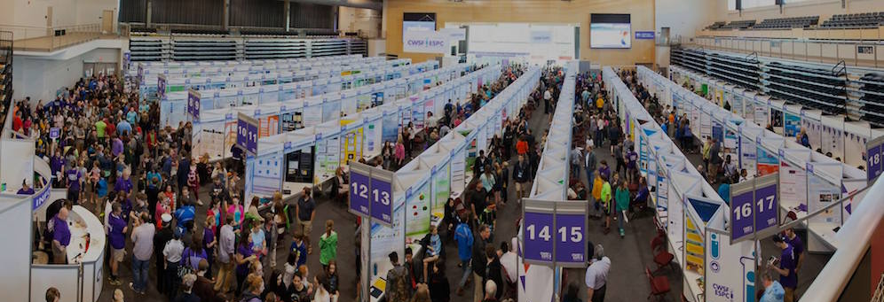

Slide 8
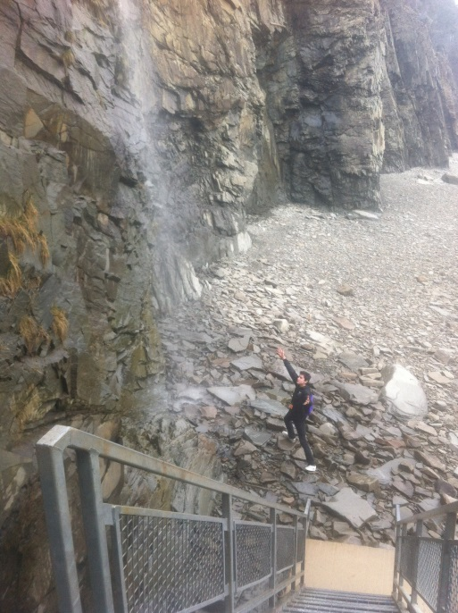
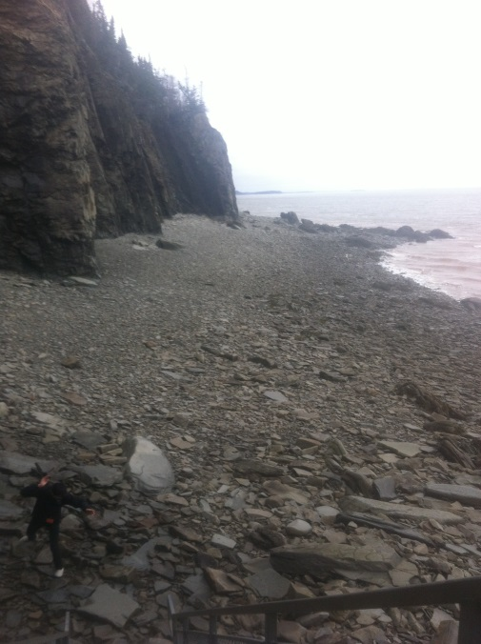
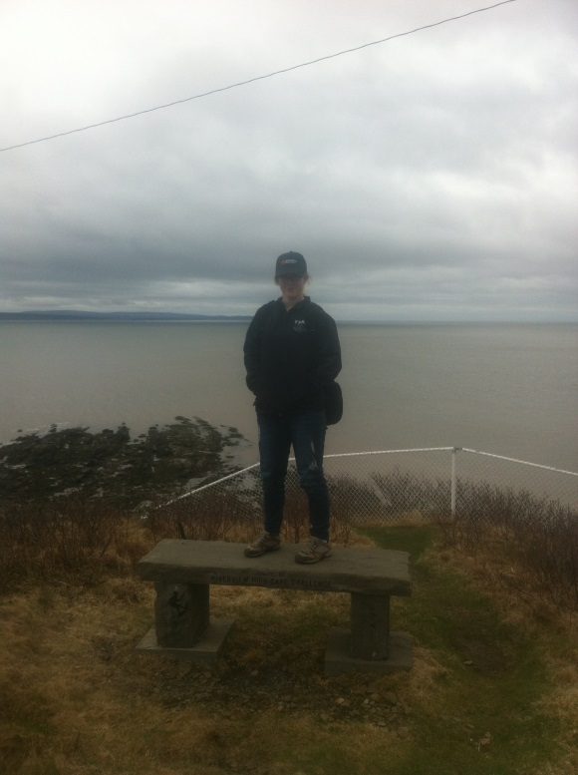
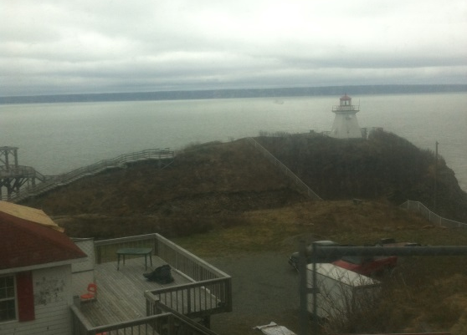
Wednesday, 13
We got to pick from 4 trips
Josh and I were on one
Chaya, Mike and Amy were on another
Rainy and Cool
Part 1:
2 hour bus ride to the Bay of Fundy
Then we went to this quaint, but large, ranch house for lunch
Tour Day

Slide 9
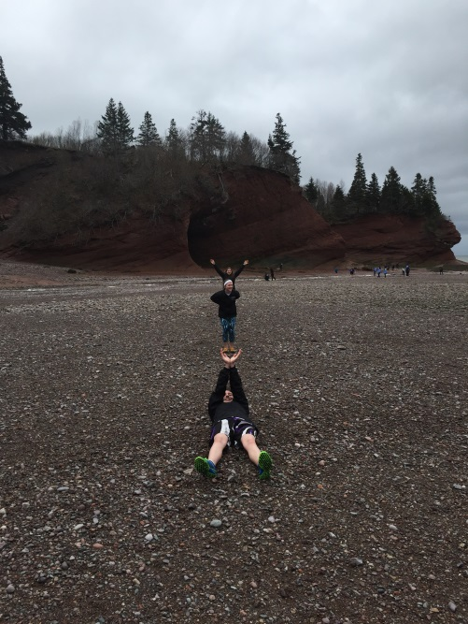
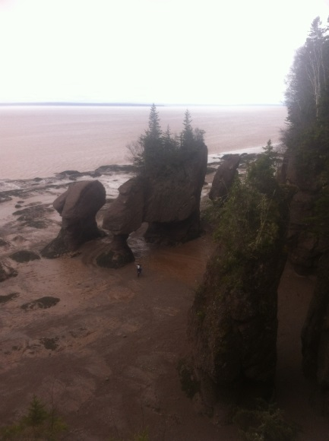
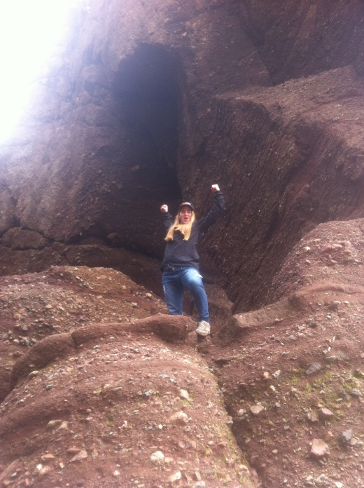
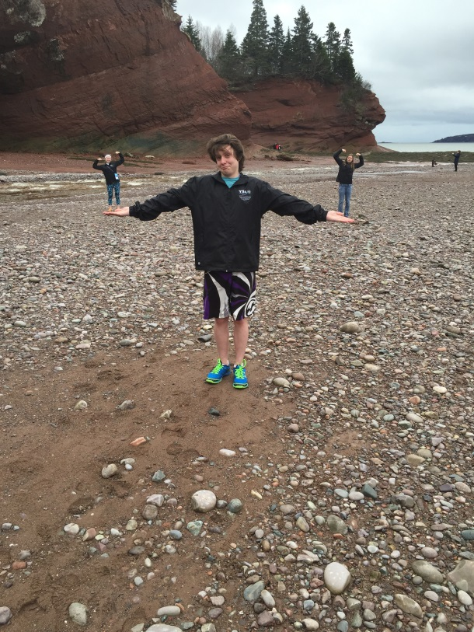
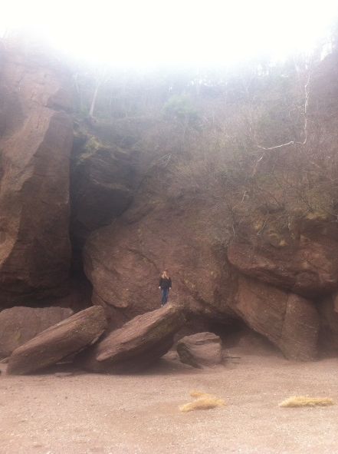
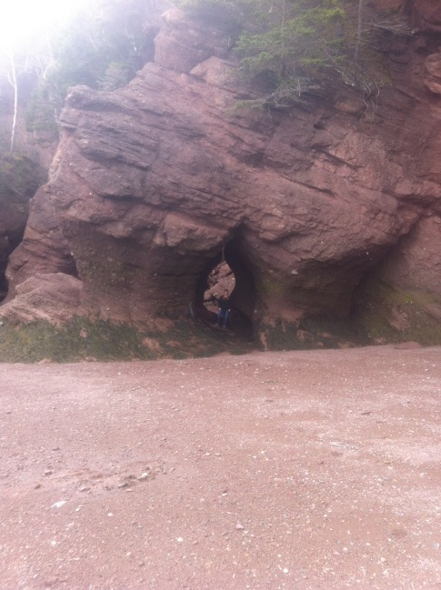
Part 2: Ionic Hopewell Rocks
Meanwhile, the other group….
The sun came out for the first time for like 20 min
All the groups headed back to campus for supper
Walking on the ocean floor
I slept on the way back

Slide 10
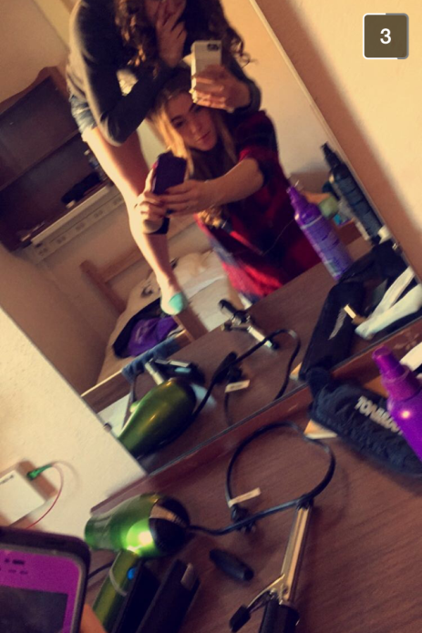
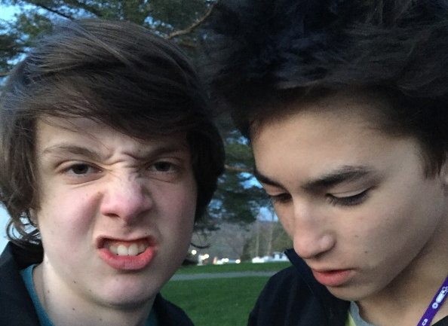
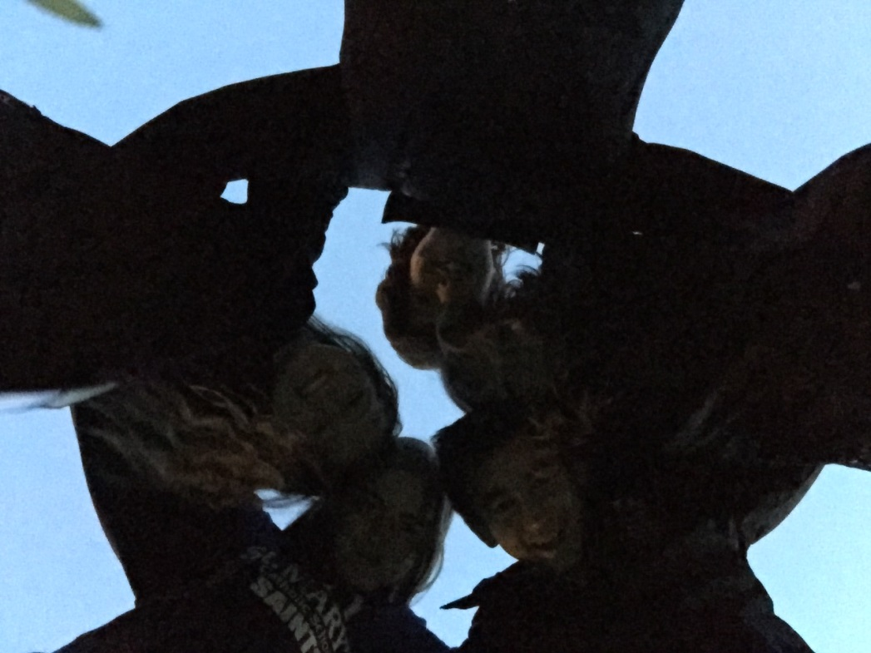
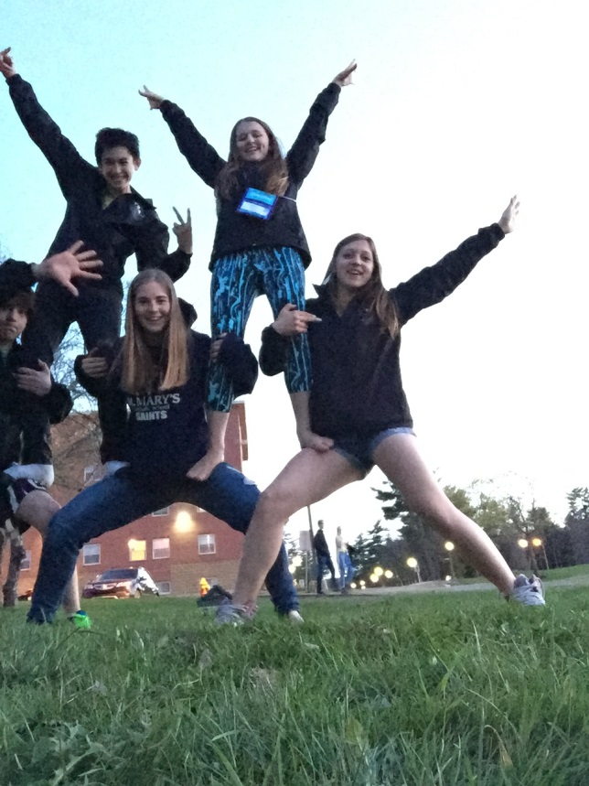
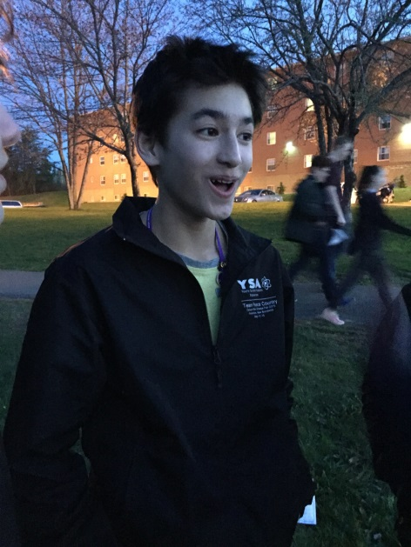
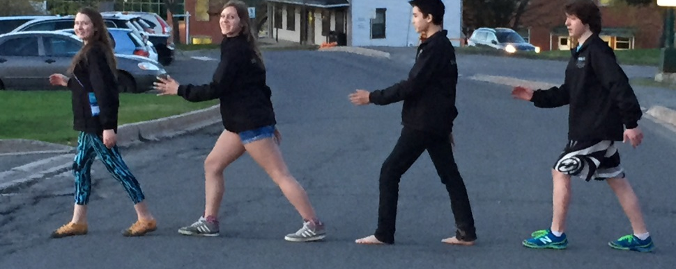
Wednesday Evening
Pretty much we goofed off, there was a photo challenge going on, but we decided to just take whatever pictures we wanted and hang out

Slide 11
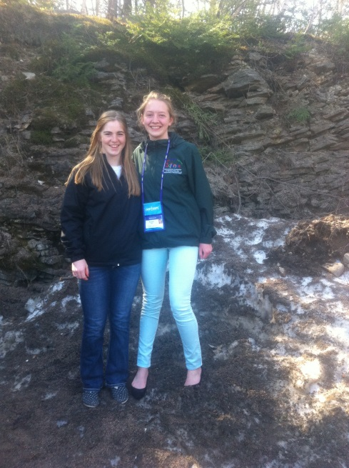
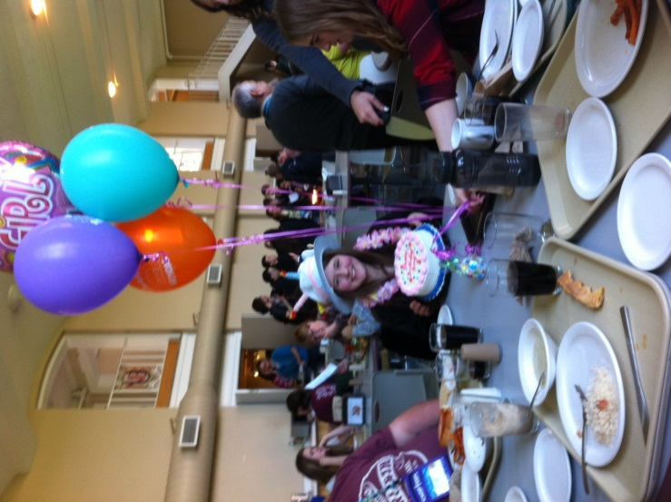
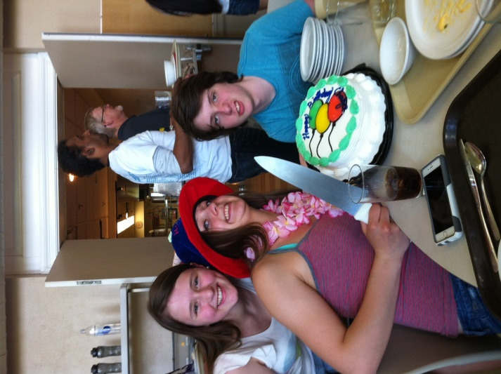
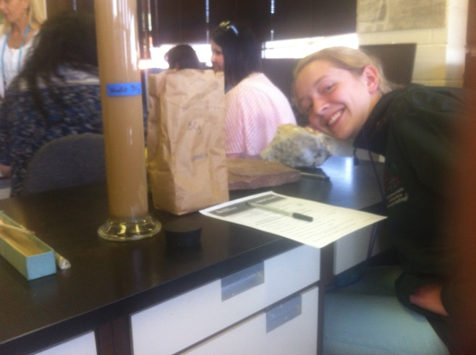
Thursday, 14
Morning:
Experiment Day
Afternoon:
Public Viewing
Evening:
Show
Also , while we were they both Amy and Chaya had birthdays

Slide 12
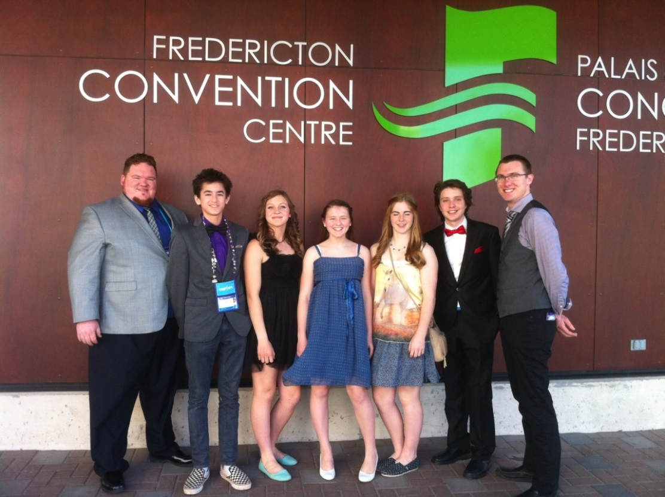
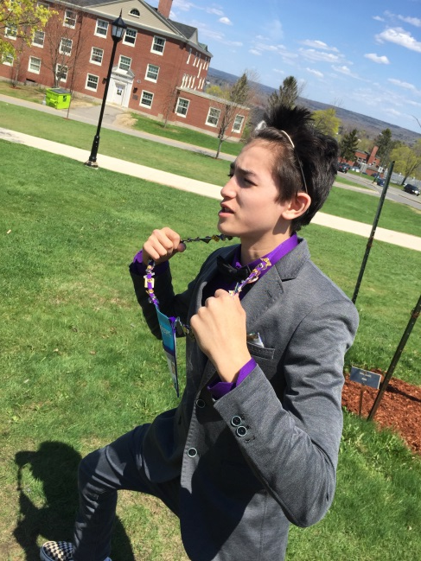
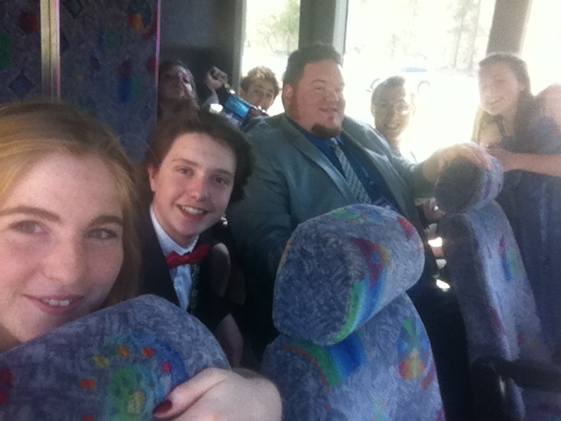
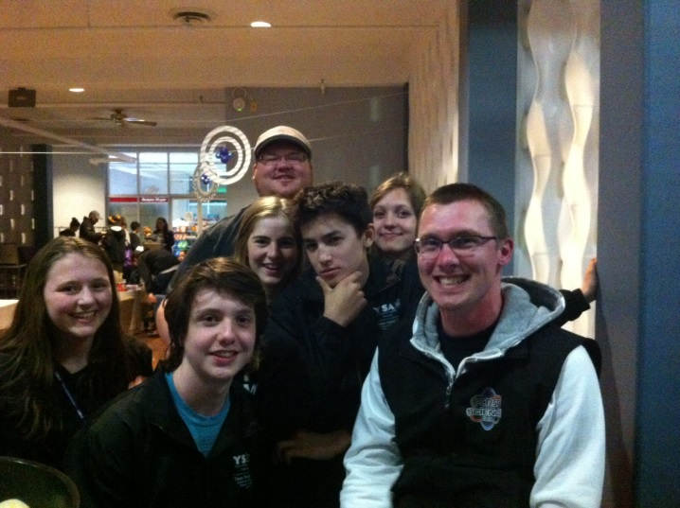
Friday, 15
More Public Viewing, in the morning
Awards Night
Lounge

Slide 13
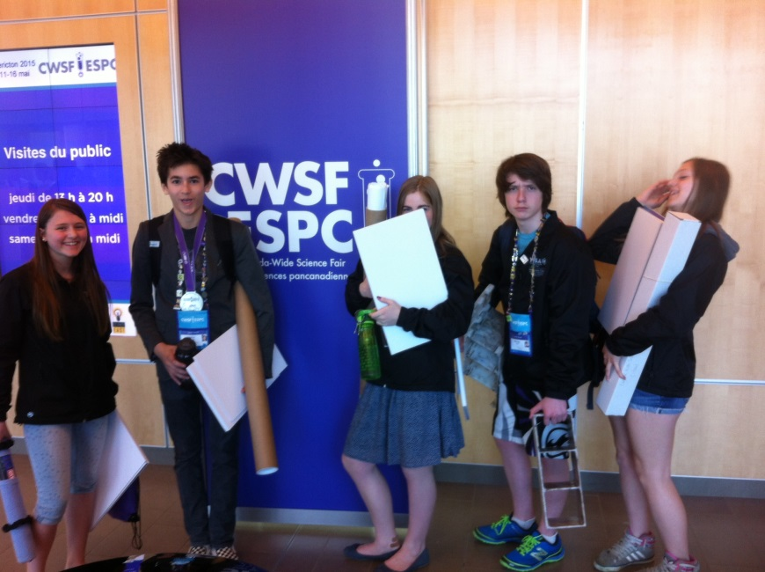
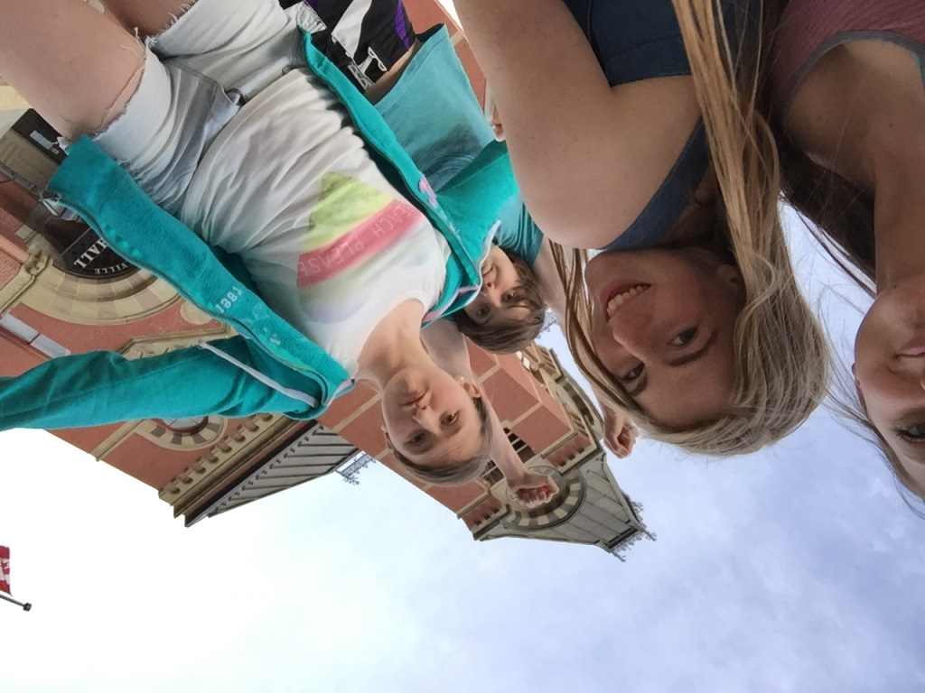
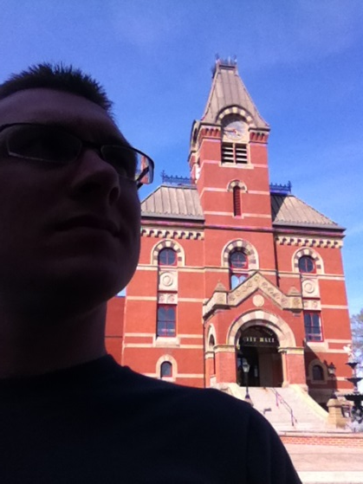
Saturday, 16
- We played a lot of frisbee that afternoon
-some teams that didn’t live so far away left in the middle of the afternoon
Getting Ready to Come Home
-take down our projects
We browsed through the downtown shops, went to a music store, then headed to a fancy restaurant for supper. After supper we went for a walk along the river
-we decided to go out on the town for the evening

Slide 14
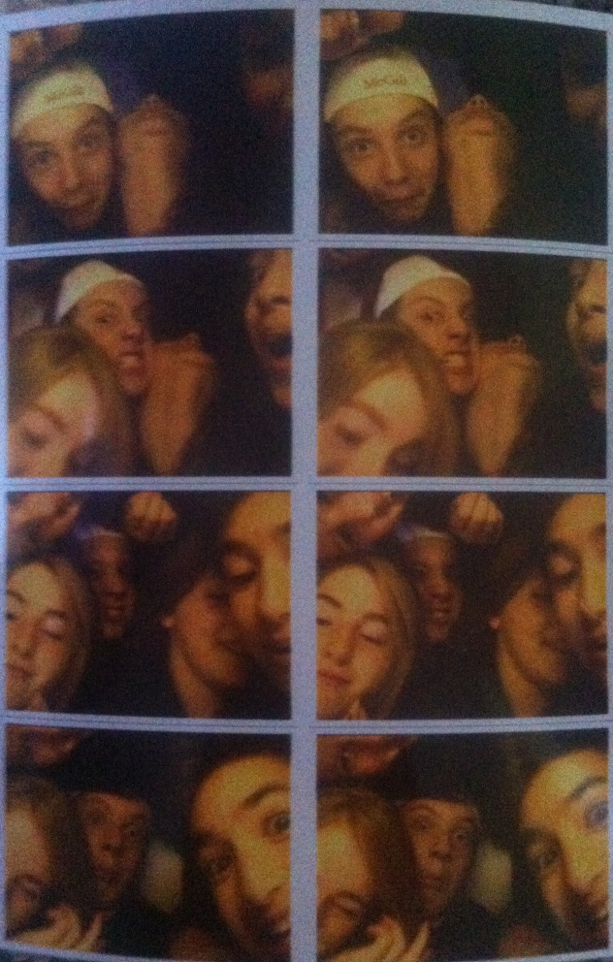
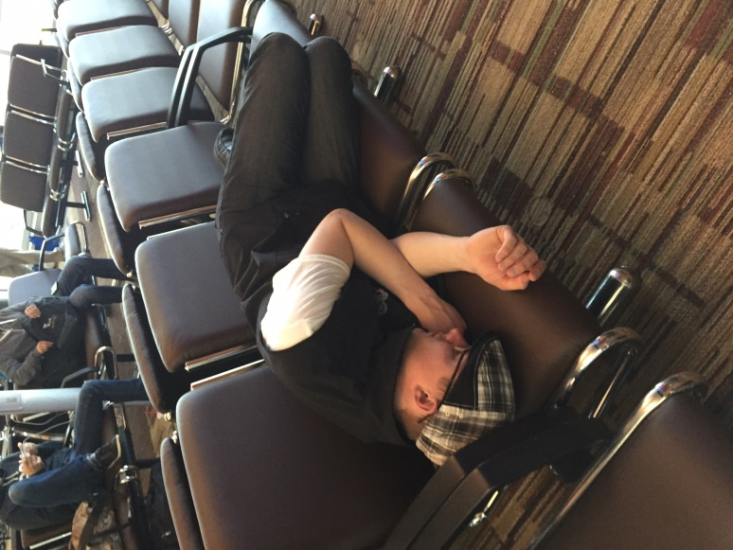
Sunday, 16 Flying Home
We had to get up at 4:30 in the morning to catch the bus to take us to the airport. Us girls were up until 12:00 packing so were did not want to get up.
We flew from Fredericton to Toronto to Edmonton to Grande Prairie
Out whole team had a habit of taking videos and pictures of our team sleeping
Out flight was delayed in Edmonton so we took photos in a photo booth, everyone was overtired!
Arrived in GP at 2:30 because we gained 3 hours.

Slide 15
This Year: Montreal, May 2016

