Slide 1
3.3 Patterns of Inheritance
Pgs. 50-54

Slide 2
3.3 Patterns of Inheritance
Traits: desirable characteristics in organisms. We will uses animal fur color to focus on patterns of inheritance in this section.
Purebred: organisms whose ancestors have only produced white fur offspring for several generations (either BB or bb)
Hybrid: an individual produced by crossing two purebred parents that differ in a trait such as fur color (always Bb)

Slide 3
Dominant Traits
If we cross a purebred white female (bb) with a purebred black male (BB), we notice the result is that all offspring have the same black coat (Bb).
 |  | b | b
 | B | Bb | Bb
 | B | Bb | Bb
F E M A L E
M A L E
Black fur is dominant because all offspring have black coats.

Slide 4
Recessive Traits
Has the white coat allele in the hybrid offspring disappeared?
No, to find out, we need to cross the hybrid female offspring with the hybrid male offspring.
The result is that ¾ of the offspring are black, and ¼ is white.
 |  | B | b
 | B | BB | Bb
 | b | Bb | bb
F E M A L E
M A L E
The white fur kitten is and example of a recessive trait.

Slide 5
How to know what color, or what trait will show…
If it is a purebred, then it will have the trait of the purebred.
BB – black cat.
bb – white cat
If it is a hybrid, it will always show the dominant trait.
Bb - black
Question: If we are talking about eye color, and I tell you brown eyes(E) are dominant over blue (e) what eye color will the following people have?
EE - Ee - ee-

Slide 6
Homozygous vs. heterozygous
If the organism has two of the same alleles, (BB or bb) it is considered homozygous!
If the organism has different alleles, (Bb) it is considered heterozygous!

Slide 7
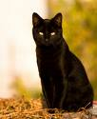
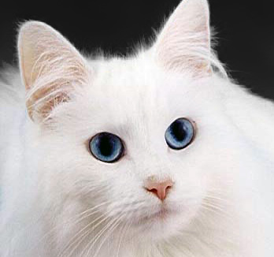
Genotype vs. phenotype
Genotype is the genetic information. (BB, Bb, bb).
Genotype = genes!
Phenotype is what it will look like. (black, white)
Phenotype = looks!

Slide 8
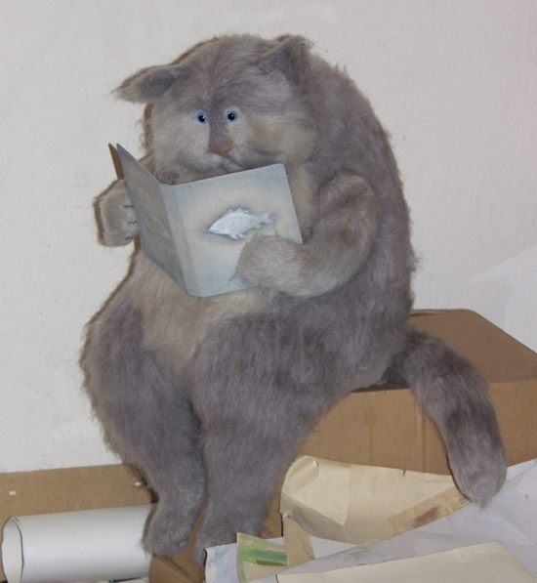
Incomplete Dominance
Sometimes the dominant-recessive pattern does not always work.
When a purebred black cat and a purebred white cat are crossed its offspring can be grey.
Neither of the parents’ alleles are dominant or recessive.

Slide 9
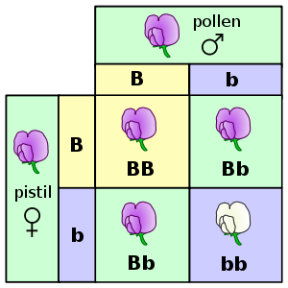
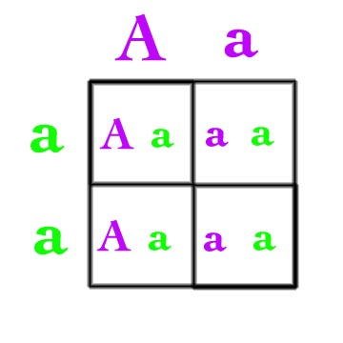
Punnett square
An easy method to figure out what the off spring will look like!

