Slide 1
Organizing the Elements & The periodic table today
Sec. 2.2 and 2.3
p. 122-133

Slide 2
Elements
All the compounds that compose our life are a combination of 115 basic building blocks called elements.
Elements: A substance that cannot be broken down into different kinds of matter.
There are 90 naturally occurring elements (such as gold, iron, calcium, hydrogen, etc.) and 25 synthetic elements (man made: such as hasium, califorium, nobelium, etc.)

Slide 3
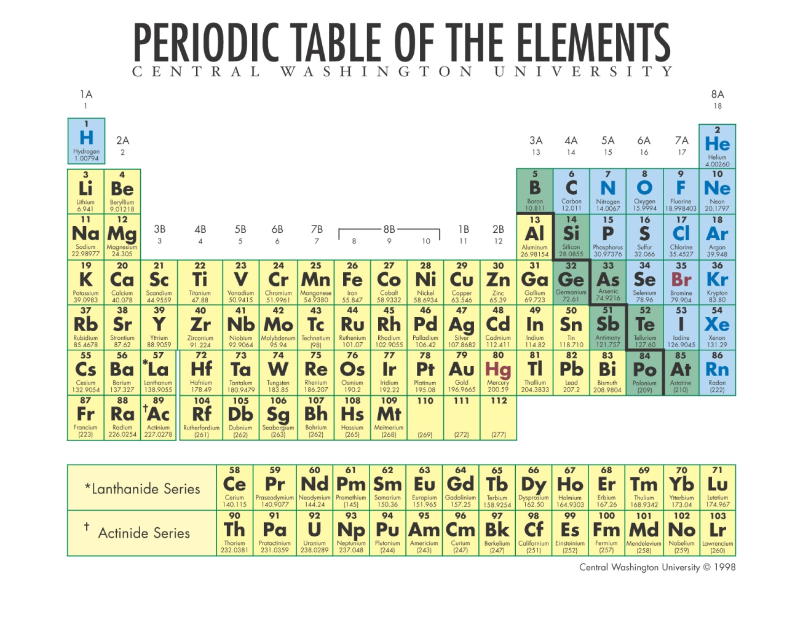
The periodic table is divided into three main sections:
The metals
The non metals
And the metalloids
Each one of these groups contains elements with similar chemical and physical properties.

Slide 4
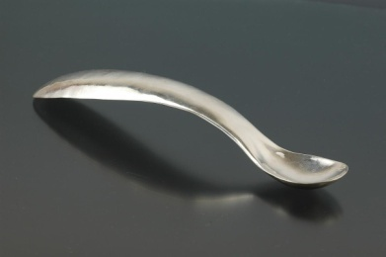
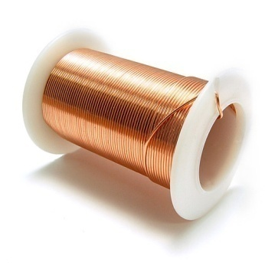
Metals
Metals make up more than 75% of the elements in the periodic table
Metals.asf
They are characterized by the following physical properties:
shiny (high luster)
Usually solids at room temp
Malleable (can be hammered, pounded, or pressed into different shapes without breaking.
Ductile (can be drawn into thin sheets or wires without breaking)
Good conductors of heat and electricity

Slide 5
Metals can be both reactive or inert
Reactive: is normally unstable and readily undergoes violent changes
Reactive Metals web link
Inert: A substance that does not react with another substance

Slide 6
Non metals
Nonmetals.asf
There are 17 non metals in the periodic table
In general, they can be categorized by 3 major physical properties:
They DO NOT have luster
Usually gases at room temperature
Poor conductors of heat and electricity

Slide 7
Metalloids
The metalloids are B, Si, Ge, As, Sb, Te, Po and At
The members of this group are the least uniform in character.
Many of them are known as semiconductors.
Semiconductors- are NOT as good at conducting as the metals, but they are better conductors than the nonmetals

Slide 8
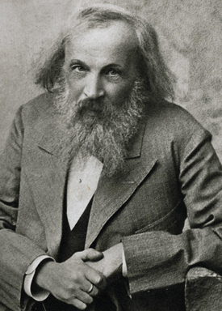
The Periodic Table
Groups or Families
Demitri Mendeleev came up with the first version of the periodic table in 1864
The periodic table is organized by listing elements in order of increasing atomic number
It is divided into
vertical columns called groups or families
horizontal rows called periods
P E R I O D S

Slide 9
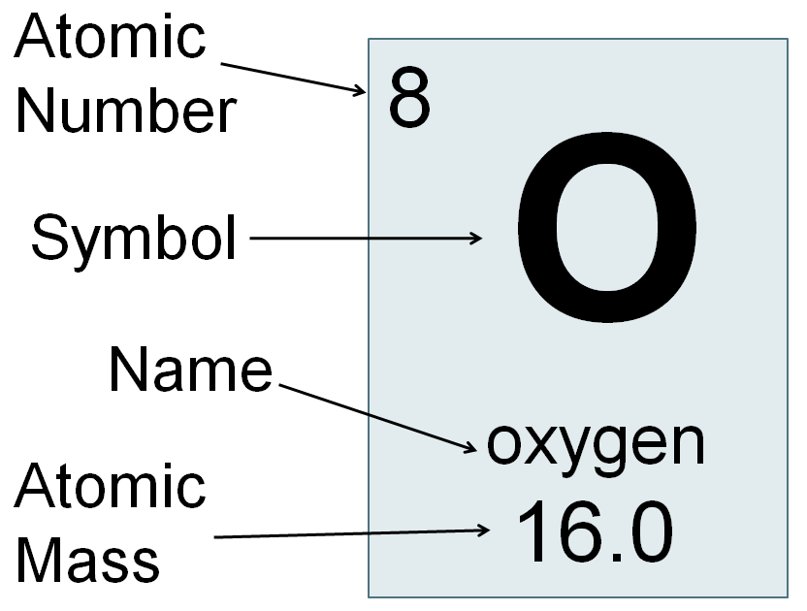
Every element on the periodic table is in it’s own box
Each box has the same information on it.

Slide 10
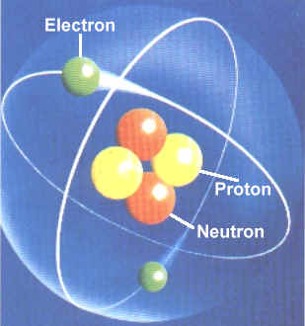
Every element is made up of three parts
Protons (positive)
Electrons (negative)
Neutrons (no charge)
Protons and neutrons are in the nucleus in the middle of the element
Electrons orbit the outside like the rings of Saturn

Slide 11
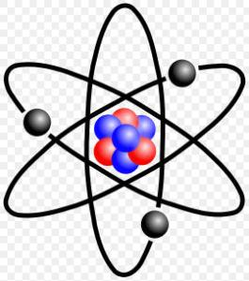
Atomic mass vs. Mass number
Atomic mass is the mass of the whole element
You add together ALL of its components:
Protons + neutrons + electrons = atomic mass
This give you a number with digits to the 10 000th place
Example:
Carbon
Atomic mass: 12.0107
To make it simpler we use Mass Number
Protons + Neutrons = Mass Number

Slide 12
How to solve number of protons, neutrons, electrons
To make it simpler we use Mass Number
Protons + Neutrons = Mass Number
Or… Neutrons = Mass number – protons
Atomic Number = number of protons
Atomic Number = number of electrons
That means…
Electrons = protons
Build an Atom SMARTboard

Slide 13
Practice
How many electrons does an atom of Oxygen have?
How many protons?
How many neutrons?
Atomic number = 8, that means it has 8 electrons
8 electrons, that means there must be 8 protons
Atomic mass – atomic number
16.0 – 8 = 8
8 neutrons

Slide 14
More Practice! ☺ yay!
On the front page: “Unit B Matter and chemical change”
Do the first three elements of each question
HINT: ion charge…
Complete the back in full
2.3 using periodic table.notebook

Slide 15
Periodic Properties
The periodic table also has certain characteristics in different regions of the periodic table.
Alkali Metals (group 1)
Alkaline Earth Metals (group 2)
Halogens (group 17)
Noble Gases (group 18)
Transition Metals

Slide 16
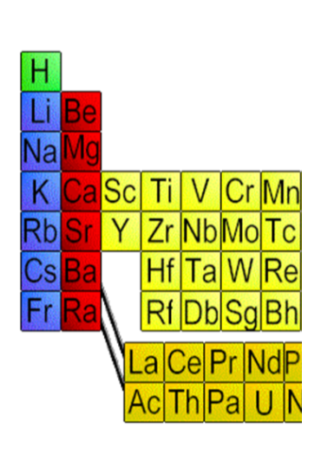
Alkali Metals (Group 1)
These are the metals in the first column of the periodic table
MOST REACTIVE OF THE METALS
They are so reactive, that they react with air if they are exposed to it
They are soft shiny metals that usually combine with nonmetals in chemical compounds
Brainiac Alkali Metals.wmv

Slide 17
Alkaline Earth Metals (Group 2)
These are the elements in the second column of the periodic table, and they are similar to the alkali metals, just not quite as reactive
They will react actively with water

Slide 18
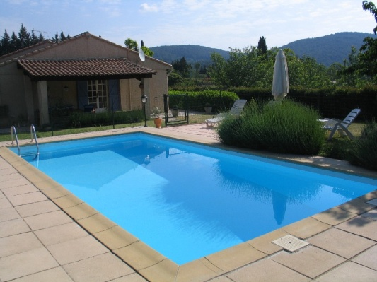
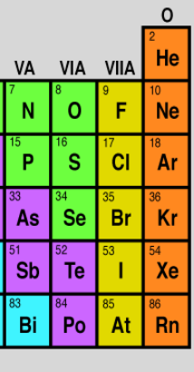
Halogens (Group 17)
The Halogens are found in the second last column.
They are generally a nasty bunch, most of them form toxic choking fumes.
None of the Halogens can be found in nature in their elemental form. They are always found as “salts”
MOST REACTIVE OF NON-METALS
Chlorine to sterilize a pool
Sodium fluoride in toothpaste

Slide 19
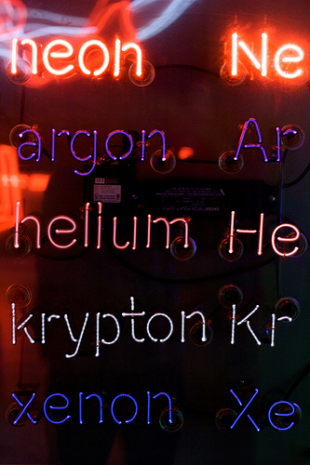
Noble Gases (Group 18)
The noble gases make up the last column in the periodic table.
The noble gases are also called rare gas elements, and they all occur in nature as gases.
MOST STABLE AND UNREACTIVE OF ALL ELEMENTS.
They do not undergo chemical reactions.
(See SMARTboard build an atom)

Slide 20
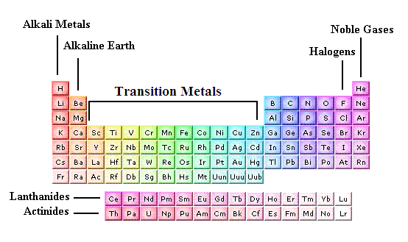
Transition Metals
The transition metals are the metals located in the middle of the periodic table
They are generally multivalent
Interactive Periodic Table

