Slide 1
Section 2.1
Ozone: protects Earth’s surface from the Sun’s ultraviolet
radiation
Monitoring water quality
Monitoring: Keeping track of something for a special
purpose. In this unit it pertains to protecting water and
air quality.

Slide 2
2.1 Monitoring Water Quality
Water quality is determined according to what the water is used
for. Both provincial and federal governments set guidelines for
water quality.
human drinking water
recreation such as swimming
livestock drinking water
irrigation
protection of aquatic life
Scientists and technicians make sure that these guidelines are
being met by monitoring water quality, using both biological
and chemical indicators.

Slide 3
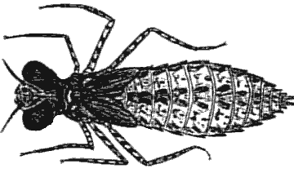
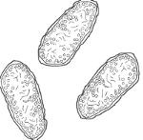
Biological Indicators
Scientists use organisms that live in water to help determine
water quality. These indicators include fish, plants, worms,
insects, plankton (microscopic algae and tiny animals),
protozoa, bacteria, and viruses.
Microbiological Indicators
Microscopic organisms such as bacteria can cause serious
health problems if they are present in large enough numbers.
One type is Escherichia coli or E. Coli.

Slide 4
Aquatic Invertebrates
Invertebrates: animals without backbones. They are used for
monitoring because different invertebrates prefer different
living conditions. For example, the organisms living in a
stagnant pond are different from those living in a pond with a
higher concentration of dissolved oxygen. Water temperature
and pH can also affect the types of organisms found in an area.
A lot of variety in aquatic invertebrates usually means
the water is healthy.
Many leeches and bottom feeders indicates a problem.
They survive on decaying material.

Slide 5
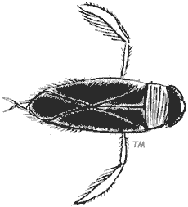
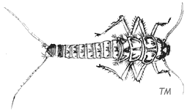
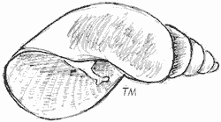
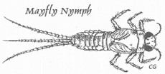
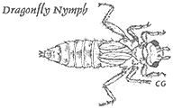
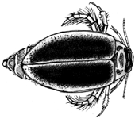
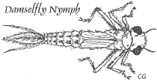
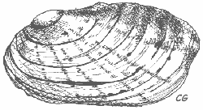
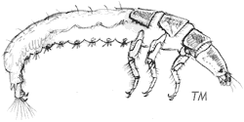
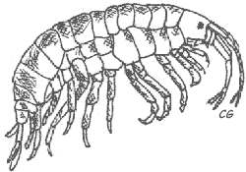
Midge larva
Water boatman
Stonefly nymph
Snail
Leech
Flatworm
Cranefly larva
Mayfly nymph
Damselfly nymph
Clam
Dragonfly nymph
Diving beetle
Caddisfly larva
Bristleworm
Amphipod
Blackfly larva

Slide 6
Most Commonly Monitored Indicators of Water Quality
dissolved oxygen
acidity
heavy metals
plant nutrients such as nitrogen and phosphorous
pesticides
salts such as sodium chloride and magnesium sulfate

Slide 7
Measuring Chemicals in the Environment
The concentration of chemicals in the environment is usually
measured in parts per million (ppm) of milligrams per litre (mg/L).
1 ppm = 1 mg/L
One part per million means that one unit of an element or
chemical can be found in one million units of solution.
Calculate the concentration in ppm:
2 mL of solute in a solution with a final volume of 1000mL
2ml = x .
1000ml 1 000 000 ml
Simply cross multiply to get your answer:
2ml x 1 000 000 ml = 2000 ppm
1000 ml

Slide 8
Dissolved Oxygen
The level of dissolved oxygen in water depends on:
temperature
turbulence due to wind or the speed of moving water
the amount of photosynthesis by plants and algae in the water
the number of organisms using up the oxygen
Dissolved oxygen (ppm or mg/L) | Invertebrates
8 | Large numbers of diverse invertebrates
6 | Mayflies, stoneflies, and beetles begin to disappear
4 | Freshwater shrimp, midge larvae, and worms can survive
2 | Midge larvae and some worms can survive

Slide 9
Phosphorus and Nitrogen Content
One factor that can affect dissolved oxygen is an increase
in phosphorous and nitrogen in the water.
Large amounts of phosphorus and nitrogen can enter water systems
in different ways. Sewage outfalls and runoff from fertilized fields are
two possible sources.
Higher concentrations of these nutrients in water cause increased
growth of algae and green plants. As more algae and plants grow,
more die. This dead organic matter becomes food for bacteria that
decompose it.
With more food available, the bacteria increase in number and use
up the dissolved oxygen in the water. When the dissolved oxygen
content decreases, many fish and aquatic insects cannot survive.

Slide 10
Acidity
As the acidity increases, the diversity of plants and animals that
live in this water decreases. Most fish disappear if the water’s
pH falls to 4.5.
Acidic deposition is a major problem wherever the soil and water
lack natural bases to neutralize acidic precipitation. As a result,
forests and lakes have been damaged.
Spring Acid Shock: Concentration of acid that can dramatically
lower the pH of the water in a pond, slough, lake, or river for a
short period of time; occurs in areas where acid precipitation is a
problem and acidic deposits build up in ice and snow in the winter; in
spring, when the ice and snow melt, the acid melt water flows into
aquatic systems.

Slide 11
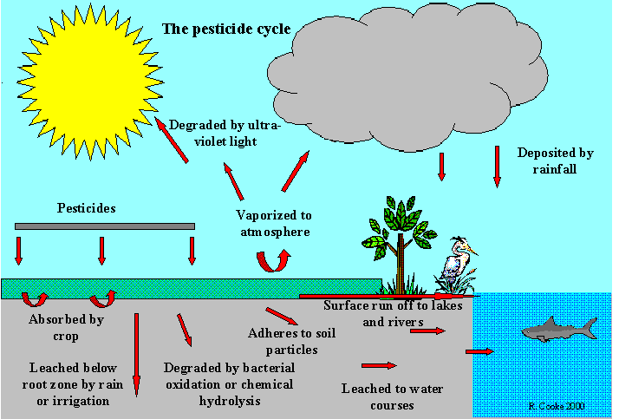
Pesticides

Slide 12
Pesticides
The problem arises when insects produce more than one
generation in a season. One of those generations may become
immune to a pesticide and the following season a stronger poison
must be created.
In other instances, the poison, even though it lasts a short time in
the environment, remains in the tissues of organisms, causing harm.
Another problems occurs when pesticides combine in water
creating a new toxin, poison. Toxicity describes how poisonous
a substance is.

Slide 13
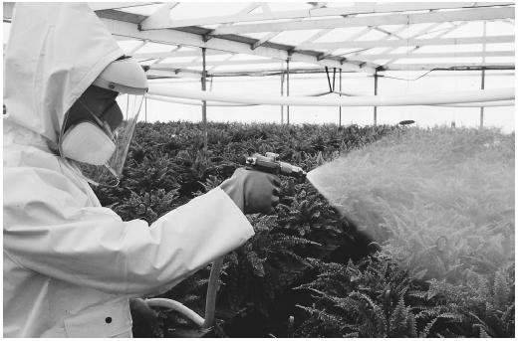
Pesticides
In the past many pesticides remained in the environment longer
than they were needed. Today most pesticides last only a growing
season and then are broken down.

Slide 14
Measuring Toxicity
Toxins or poisons are substances that produce serious health
problems or death when introduced into an organism.
LD50: is the amount of a substance that
causes 50% of a group of test animals
to die if they are given a specified dose of
the substance all at once.
LD 50 testing allows scientists to compare toxicity because they
are comparing the dosage that will produce the same outcome:
Death.

Slide 15
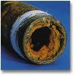
Heavy Metals
Heavy metals: metals that have a density of 5 g/cm³ or higher (e.g.,
copper, zinc, lead, mercury, cadmium, nickel); heavy metals are
one type if substance monitored to determine water quality.
Many of these metals occur naturally in rocks, soil and sometimes
in water. Other times they are taken from the environment from
fertilizers, lead in pipes, paint, etc.

Slide 16
Practice
Page 224
Numbers 1-8

