Slide 1
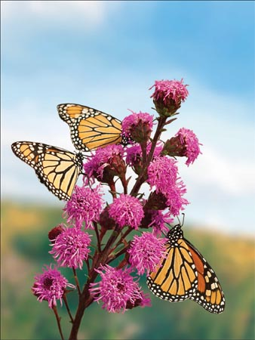
1.4: How Organisms Take in Substances
In plants:
Diffusion
Osmosis
Active Transport

Slide 2
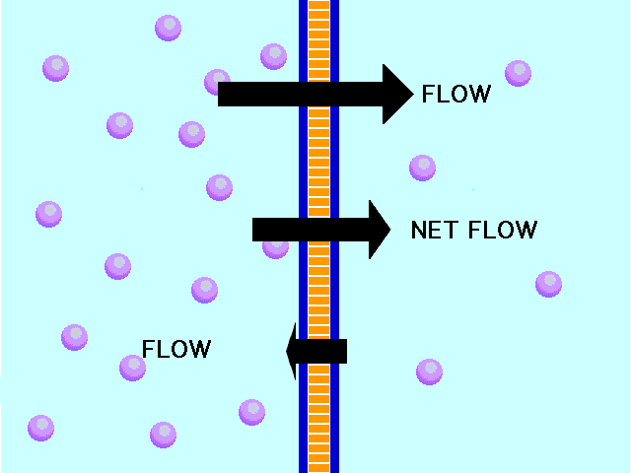
Diffusion
Def’n- movement of molecules from an area of higher concentration to one of lower concentration.
Plant nutrients move this way thru the roots of the plant

Slide 3
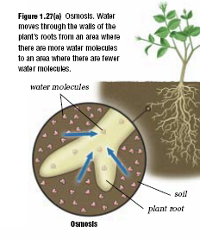
Osmosis
Def’n- the movement of water molecules from an area of high concentration to low concentration.
Occurs in the roots

Slide 4
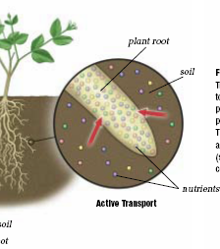
Active Transport
Def’n- energy is used to move nutrients from an area of low concentration to high concentration

Slide 5
In Animals:
Ingestion- process of taking food/drinks into the body. We get about 25 nutrients this way. Food is broken down two ways:
Chemically- occurs in the stomach, intestine, and mouth
Physically- occurs in the mouth
Hydrolysis- breakdown of large organic molecules by water
The nutrients are then transported via bloodstream

Slide 6
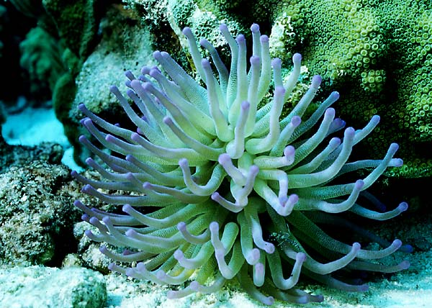
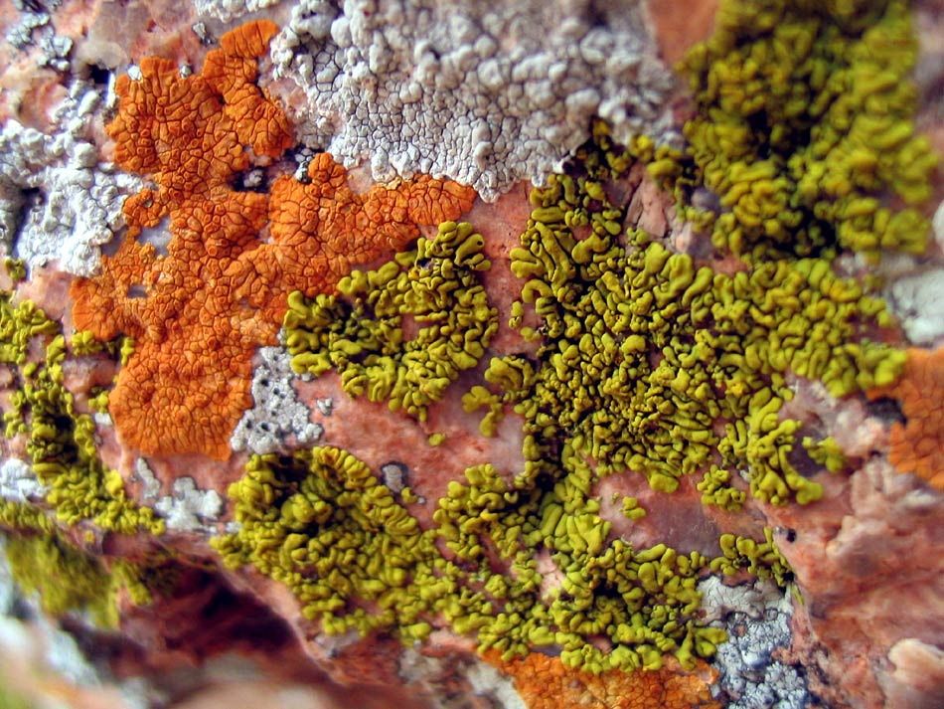
Nutrient accumulation in other plants
Anemones- capture food with tentacles
Lichens- fungi and algae
Bread mould- eats the bread with enzymes
Desert plants- need to be able to survive drought

Slide 7
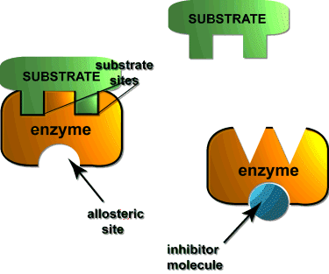
Substrates
Def’n- material on which an organism moves or lives. They can be attached straight to their substrate or not.

