Slide 1
1.3 Common Substances Essential to Living Things

Slide 2
1.3 Common Substances Essential to Living Things
25 essential compounds needed in human body.
Sugar, starch, fat, oil, wax, and proteins (C, H, O)
Organic Compounds- any compound that contains carbon.
Examples: hydrocarbons.
Inorganic compounds- compounds that do not contain carbon.
Examples: baking soda

Slide 3
Nutrients
Nutrients: elements and compounds that organisms need for living, growing, and reproducing.
Two types of nutrients:
Macronutrients- organisms need in large amounts.
Micronutrients- organisms need in small or trace amounts

Slide 4
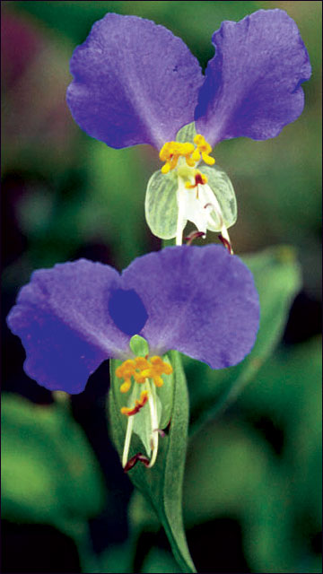
Six Common Macronutrients
Nitrogen
Plants: leaf/stem growth, chlorophyll
and protein composition
Animals: protein and nucleic acid composition, growth and repair of
tissues
Phosphorous
Plants: root/flower growth, cellular respiration and photosynthesis
Animals: bone, teeth, and DNA composition

Slide 5
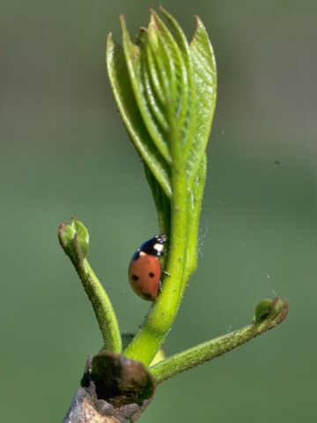
3) Potassium
a) Plants: early growth, starch/protein production, sugar movement
b) Animals: muscle contraction and nerve impulses
4) Magnesium
a) Plants: chlorophyll structure and photosynthesis
b) Animals: bones, teeth composition; absorption of calcium and potassium

Slide 6
5) Calcium
a) Plants: cell wall structure and cell division
b) Animals: composition of teeth, bones; helps blood clotting; muscle and nerve function.
6) Sulfur
a) Plants: production of fruits and grains
b) Animals: protein synthesis, enzyme activation, and detoxification.

Slide 7
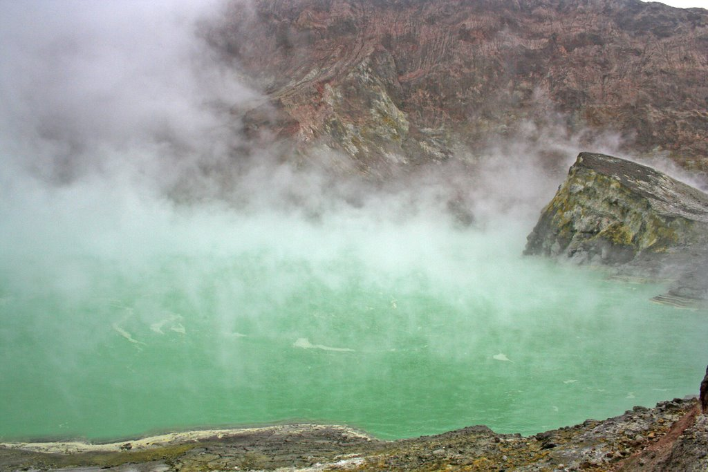
Levels of nutrients- has to be right on
Optimum amounts- amount that provides an organism with the best health.

Slide 8
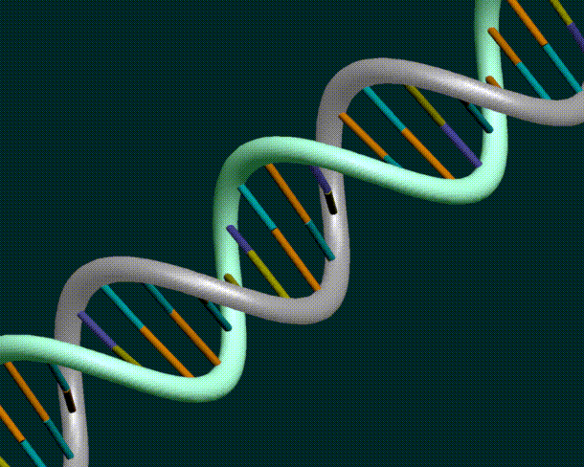
Organic Molecules:
Carbohydrates- made up of C, H, and O.
Lipids- large compounds of C, H, and O.
A) Proteins- contain atoms of C, H, O, and N
B) Amino Acids- building blocks of protein
4. Nucleic Acids- large complicated molecules found in living things; DNA and RNA (phosphates, ribose, nitrogen-containing bases); contribute to heredity and cell’s activities

Slide 9
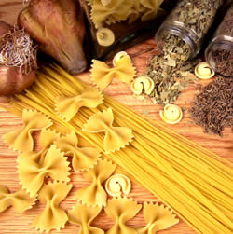
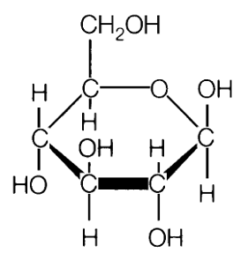
Carbohydrates
Found in: rice, potatoes, fruits, bread, pasta
Examples: glucose (made by plants during photosynthesis); starch, cellulose, glycogen (made by the combination of glucose molecules)

Slide 10
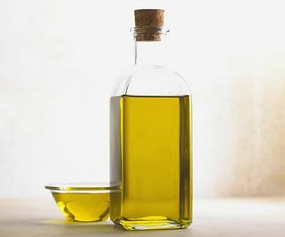
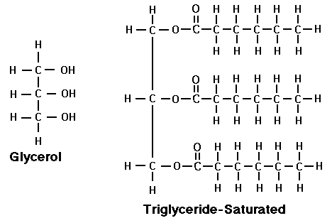
Lipids
Examples: fats, oils, waxes
Plants produce large amounts of oils→ canola seeds, corn, peanuts, soybeans, walnuts, etc
Animals produce oils on skin.

Slide 11
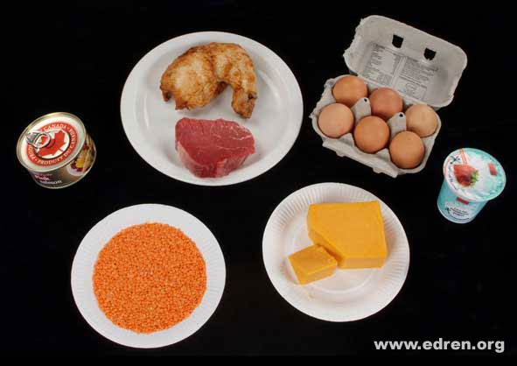
Proteins and Amino Acids
Found in: meats, fish, eggs, dairy
Used for: growth, repair, and energy
Enzymes- made of proteins, catalysts
Amino acids- basic amino acids join together to form proteins.
Each protein has between 40-500 amino acids

Slide 12
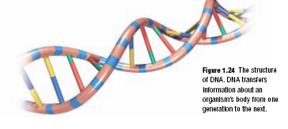
Nucleic Acids
What were the nitrogen bases that we learned in the first unit?

