Slide 1
Sec 1.3 and 1.4
p. 284 - 294

Slide 2
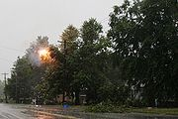
Section 1.3 Electrical Safety
Short Circuit – an accidental low-resistance connection between two points in a circuit, often causing excess current flow.
- current travels along a different path than originally intended.
Short circuits may cause: circuit damage, overheating, fire or explosion.
In electrical devices, unintentional short circuits are usually caused when a wire's insulation breaks down, or when another conducting material is introduced, allowing charge to flow along a different path than the one intended.
Tree limbs cause a short circuit during a storm

Slide 3
Electrical Shock
When wondering how dangerous a current flowing through your body may be, you have to consider 2 aspects of electricity:
Voltage
Amperage
High voltage is more dangerous than low voltage
Number of Amps is more important when assess for potential danger. Too much electricity flowing through a persons body can cause burns, damage to the heart, and can be fatal. Current as low as 0.1 A can be fatal.

Slide 4
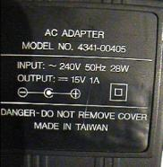
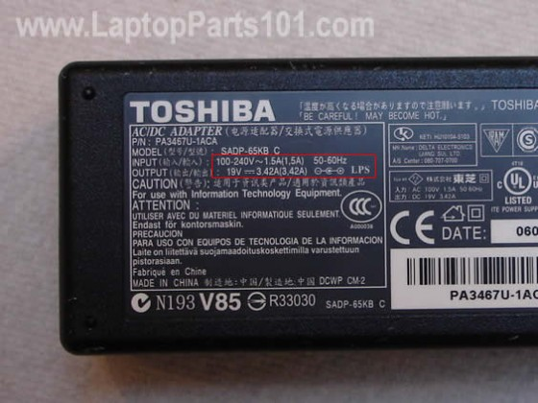
Electrical Shock Con’t
The danger of electrical shock varies, depending on the situation.
Insulator – current does not flow through easily. Such as wood, rubber, and air
Every plug-in device sold in Canada must have a label listing what voltage it requires and the maximum current it uses.
Why would the Canadian government make this a regulation? ________________________________________________
The Amp rating does not have to be high for you to get a shock. If there is a short circuit, or if the insulation is damaged, you can get a shock before the electricity goes though the device.

Slide 5
Electrical Safety pointers
See page 285
Read together

Slide 6
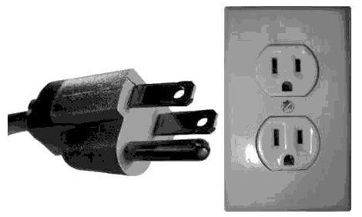
Plugs, Fuses and Breakers
A grounded three-prong plug has an extra wire that connects the device to the ground wire of the building.
Why would we want a plug to have this third prong?
It provides another pathway for the electricity, just incase there is a short circuit.

Slide 7
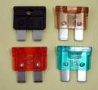
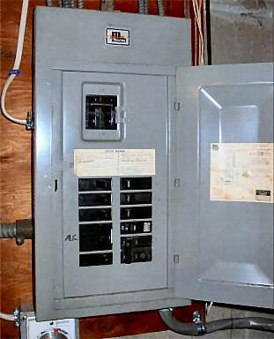
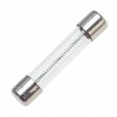
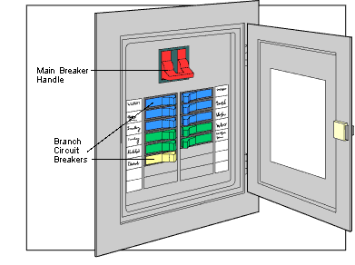
Fuses and circuit breakers interrupt a circuit when too much current is flowing through it.
Fuses have a thin piece of metal that is made to melt if too much current passing through it.
Household breakers also have a special wire that heats up if there is too much current. In a breaker however, instead of melting, the hot wire triggers a spring mechanism to turn off the switch inside the circuit breaker. Once the wire is cooled, the switch can be turned back on.

Slide 8
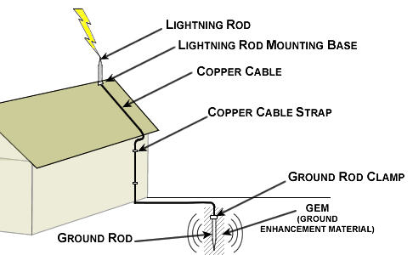
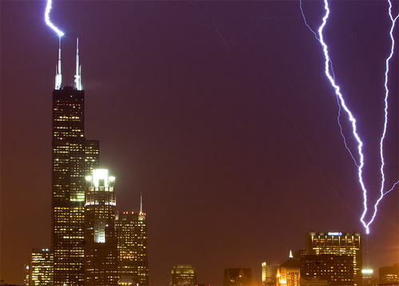
Danger of lightning
Lightning can strike up to 30 000 A, definitely enough to kill a person.
You can survive if: the full current travels through only part or over the surface of your body.
Tall buildings are a natural target for strikes. Why?
Therefore they have lightning rods that are connected to the ground with a wire. This shifts the electrical discharge away from the building, harmlessly to the ground.

Slide 9
☺ Check and Reflect ☺
Page 287
Numbers 1-7

Slide 10
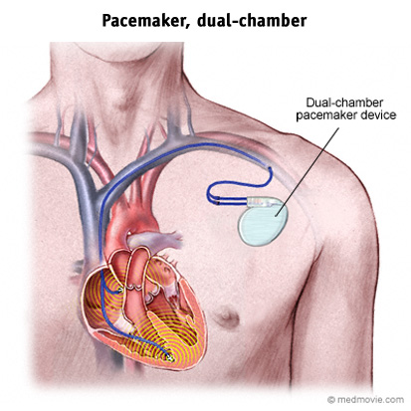
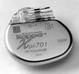
Section 1.4 Cells and Batteries
Electrochemical Cell – is a package of chemicals designed to produce small amounts of electricity. The electricity comes from chemical reactions.
There are two main types of cells:
Dry cells
Wet cells
A pacemaker uses an electrochemical cell to deliver small amount of current at a regular interval to keep the heart beating normally.

Slide 11
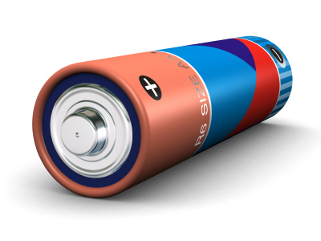
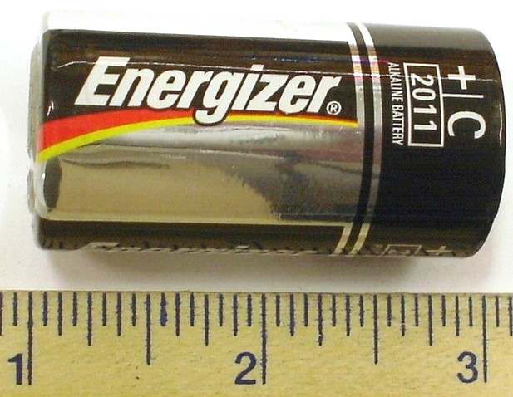
Dry Cells
The electricity-producing cells that we use everyday in flashlights and T.V. remotes are dry cells.
They are called “dry” because the chemicals are in a paste
They are sealed so they can be used in any position without the chemicals leaking out.

Slide 12
Dry Cells con’t
Dry cells work by a chemical reaction in the cell releasing free electrons.
Electrodes – a conductor through which electric current enters or leaves a device or material
Electrolyte – a paste or liquid that conducts electricity because it contains chemicals that form ions.
Ion – an atom or group of atoms that has become electrically charged through the loss or gain of electrons.

Slide 13
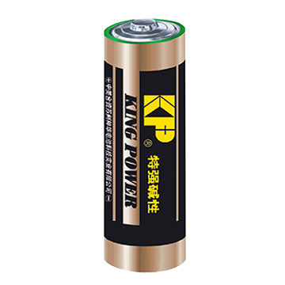
The electrolyte conducts electricity, and it reacts with the two metals (electrodes). One electrode becomes positively charged, and the other becomes negatively charged.
In a dry cell, electrons leave from the negative electrode, and return in through the positive electrode.
Positive terminal: electrons return
Negative terminal: electrons leave

Slide 14
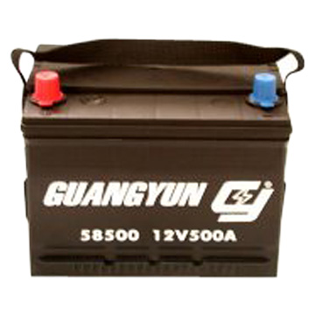
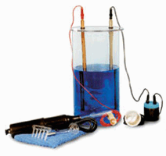
Wet Cells
A wet cell uses a liquid electrolyte that is usually an acid (such as sulfuric acid).
Early cells were wet
Cars and trucks use wet cells
Wet cells are generally cheaper to make
Must be careful however, the electrolyte is highly corrosive.

Slide 15
Wet Cells con’t
Each electrode in the wet cell reacts differently with the electrolyte.
The acid eats away at the zinc.
This leaves behind electrons, that gives the disappearing electrode a negative charge.
Zinc electrodes must eventually be replaced.
The reaction between the copper and acid leaves a positive charge, but does not eat away the copper.
Electrons move from the neg. zinc to the pos. copper. Creating a flow of electrons – electricity!

Slide 16
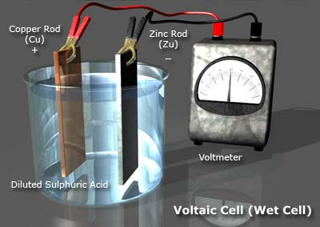
3) Electrons flow from the negative zinc to the positive copper.
2) Acid reacts with the copper leaving positive charge.
1) Acid eats away at the zinc. Leaves electrons behind. Becomes negative

Slide 17
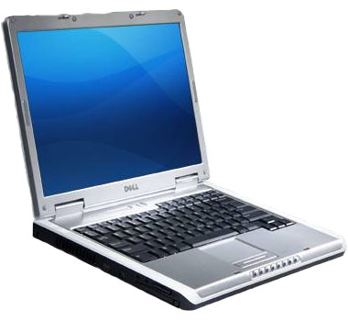
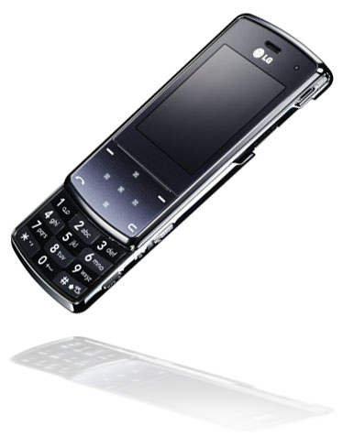
Primary Cells
Dry and wet cells
The chemical reaction cannot be reversed
Secondary Cells
Chemical reactions can be reversed
Also known as rechargeable cells
The reversed flow of electrons restores the reactants that are used up.
Used to start cars, in laptops, cell phones
Can still wear out with time.

Slide 18
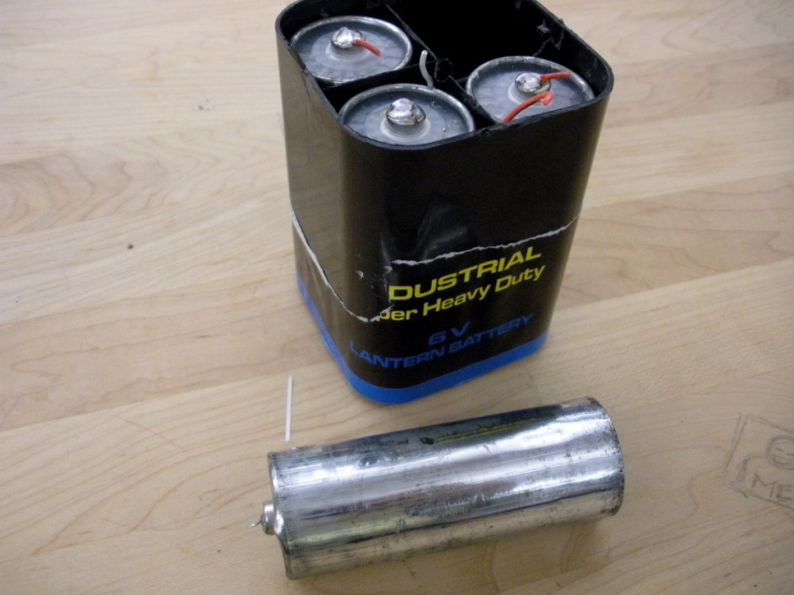
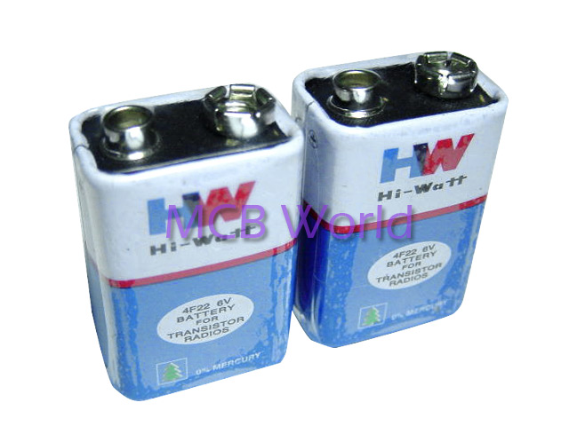
Batteries
Battery – cells connected together
Most are sealed into a case with only two terminals, so you can’t tell that it contains more than one cell

Slide 19
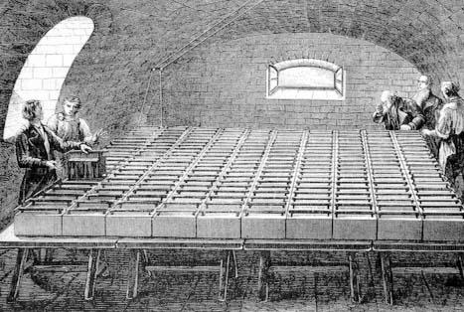
Electrochemistry
Electrochemistry is the study of chemical reactions involving electricity.
Alessandro Volta made the first practical battery around 1800. He used copper and zinc discs separated by electrolyte soaked discs.
In 1807, Humphry Davy connected 2000 cells together in a room to make one massive battery

Slide 20
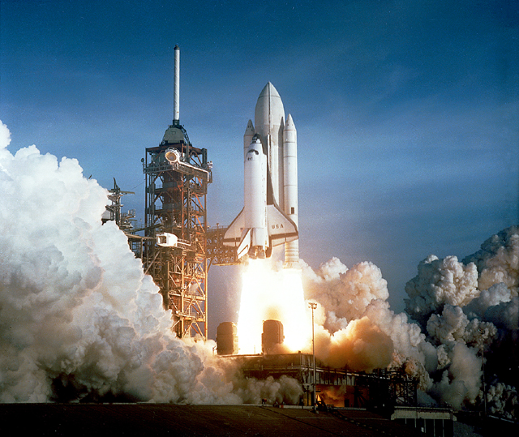
Electrolysis
Splitting molecules into their elements
For example: H₂O split into H₂ and O
Davy’s battery was so powerful it separated pure metals out of compounds.
He discovered potassium, sodium and other elements this way.
Electrolysis of water is used to fuel a space shuttle.
Water is separated into pure oxygen and hydrogen, and when they are mixed together and ignited, it releases a huge amount of energy.

Slide 21
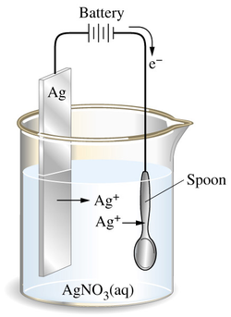
Electroplating
Gold and silver are very popular but also very expensive
Because of this, less expensive products can be coated with a thin layer of silver or gold – called electroplating
Cheap metal is also usually stronger than silver and gold.

Slide 22
☺ Assess your Learning ☺
Page 295
Numbers 1-9 and 11

