Slide 1
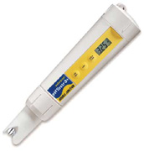
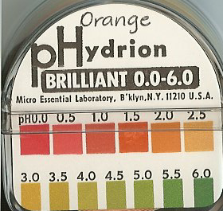
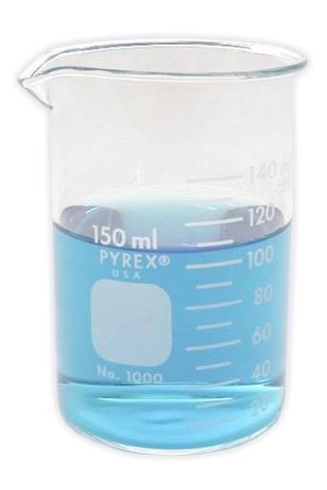
1.2 Acids and Bases
p. 191-195

Slide 2
Anything about the pH scale?
What can you tell me about acids and bases?
Alkaline is another name for a base.
acid/base intro video

Slide 3
1.2 Acids and Bases
pH scale- indicates the acidity of a solution
Acid- is a compound dissolved in a solution that has a pH lower than 7
Base- is a compound dissolved in a solution that has a pH higher than 7
0--------------7---------------14
Acid Neutral Base

Slide 4
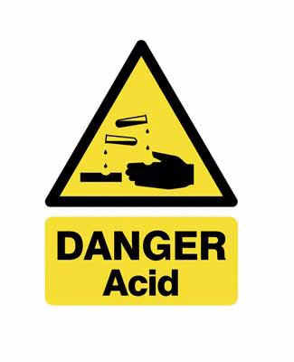
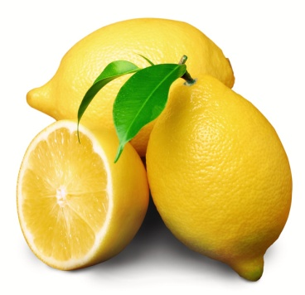
ACIDS
Often taste sour *
Is a measure of the concentration of hydrogen ions in a solution
Strong acids can burn skin & eyes
Strong acids can dissolve metals
Examples:
Lemon juice
Vinegar
Car battery acid (dangerous!)
*Never test an unknown acid by tasting it!
0--------------7---------------14
Acid Neutral Base

Slide 5
BASES
Can taste bitter, sweetish, or salty *
Often feel slippery or “soapy” *
Strong bases can burn skin & eyes
Bases react more easily with protein than with metal; they are often used for cleaning
Examples:
Milk
Baking soda
Soap
Drain cleaner (dangerous!)
*Never test an unknown base by touching or tasting it!
0--------------7---------------14
Acid Neutral Base

Slide 6
pH scale
Examples:
pH 0.5 is battery acid
pH 12.6 is ammonia
pH 7 is neutral (distilled neutral)
HOW TO TEST:
Acid base indicators- they are substances that change color in the presence (you need to use a color chart to indicate the correct pH)
Can be a universal indicator, or a red/blue pH strip
pH meter- digital indicator
0--------------7---------------14
Acid Neutral Base

Slide 7
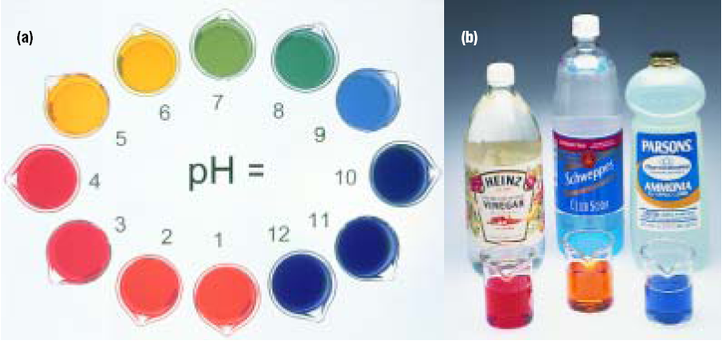
What is the pH of the household
chemicals in picture b?

Slide 8
We will also be using LITMUS PAPER
Litmus paper is blue or red paper that will test the pH of a substance.
Red litmus paper will turn blue in a base and STAY RED in an acid
Blue litmus paper will turn red in an acid and STAY BLUE in a base
In other words,
RED BLUE
ACID BASE

Slide 9
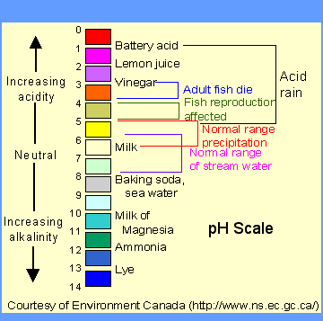

Slide 10
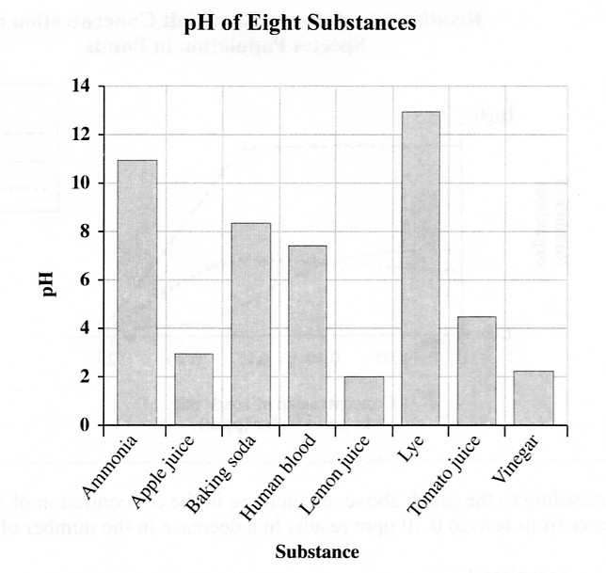
Practice PAT question!
23.Which of the following conclusions can be made from the graph above?
A. Vinegar is more basic than lye.
B. Ammonia is more acidic than apple juice.
C. Baking soda is more basic than human blood.
D. Tomato juice is more acidic than lemon juice.

Slide 11
The pH scale
Careful measurement is important
A mistake of one pH unit means 10 times too much or too little!
x10
x100

Slide 12
ACID/BASE mini lab!
Make a work space for your group
Everyone needs goggles
Each group needs:
Spot plate and spot plate paper
pH paper
Universal Indicator
Everyone needs to record the results
1.2 Measuring Acids and Bases Lab.doc
P:\Sci 9 lab groups.notebook
ph online activity

Slide 13
Universal Indicator
See p. 193 in textbook for same pic!!

Slide 14
Neutralization
Neutralization- where the acid is neutralized by the base creating a pH of 7
The process produces a salt and water always (not always NaCl).
HCl + NaOH → NaCl + H₂O
Acid + base → salt + water

Slide 15
Acid Rain
Central Canada gets acid rain in a pH of 3.
Lakes become acidic therefore killing the organisms within the lake.
Lakes treated with lime in order to neutralize it.
Ca(OH)₂ + H₂SO₄ → CaSO₄ + 2 H₂O
Calcium hydroxide + sulfuric acid → calcium sulfate + water

Slide 16
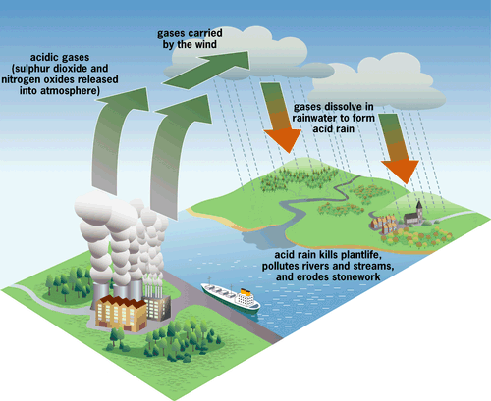

Slide 17
Vinegar has a pH value of 2.2 and lemon juice has a value of pH2.3. Even the strongest recorded acid rain is only about as acidic as lemon juice or vinegar and we know that these don't harm us
So why should we care about acid rain??

Slide 18
Acid and Bases review song…
1.2 Acids_And_Bases_Have_Two_Different_Faces.flv

