Slide 1
Chapter One: Harmful and useful chemicals in the environment
Section 1.1
p.182-190

Slide 2
1.1 Chemicals in the Environment
Everything contains chemicals: environment and living things
Oxygen: animals need oxygen in order to survive. Plants make oxygen.
Carbon Dioxide: plants need carbon dioxide to survive. Animals make carbon dioxide.

Slide 3
Harmful Chemicals
Forest fires and volcanoes- release carbon dioxide (too much?)
Gasoline, electricity and pesticides- produce toxins that affect our environment (how?)

Slide 4
Nitrogen Cycle
Nitrogen cycle: what do you think it might mean?
Nitrogen cycle is a cycle that involves the use and deposition of nitrogen in the earth. Like recycling.
Nitrogen fixation- process in which nitrogen is “fixed” so it can be used
Fixed = combine with other elements.

Slide 5
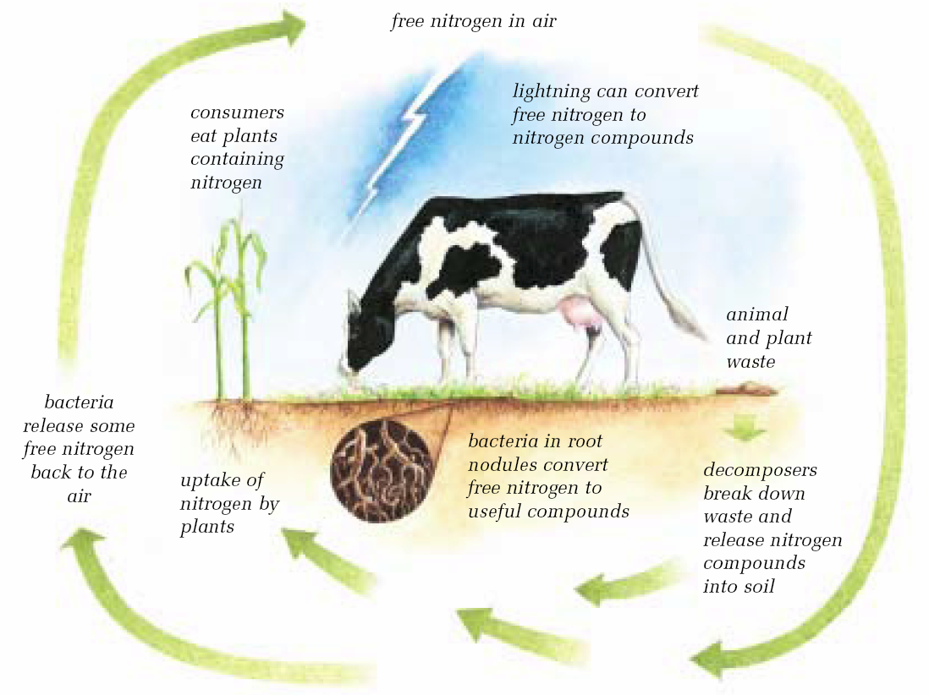

Slide 6
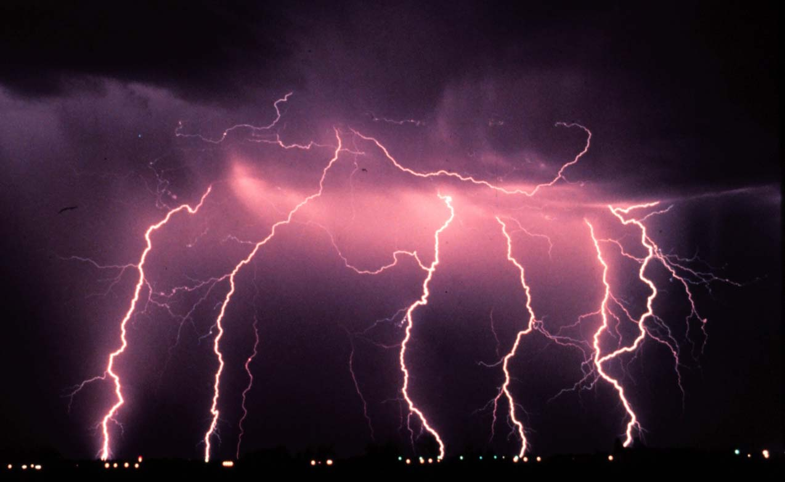
What happens during nitrogen fixation?
Free nitrogen (N₂) is absorbed into the ground where bacteria, in root nodules, will separate N₂ so that it can combine with other elements.
Lightning does this also

Slide 7
Nitrogen Cycle Steps:
Nitrogen fixation
Plants use product of nitrogen fixation
Animals eat plants- animals make more complex nitrogen compounds (proteins)
Decomposers- break down complex N.C. making simpler N.C. in the soil.
Bacteria- break down simpler N.C. into free nitrogen which is released back into the air

Slide 8
Concentration of Nitrogen
Varies from place to place
Some nitrogen is not available because it is found very deep in the soil so that plants and animals cannot reach it.
Nitrogen is needed by plants; therefore, fertilizers are added or clover and alfalfa to fix more nitrogen
Video

Slide 9
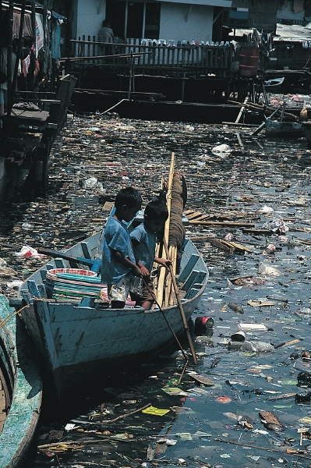
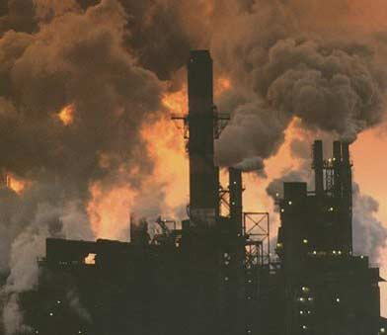
Pollution
Definition- any change in the environment that produces a condition that is harmful to living things.
Examples:
Car exhaust
Forest Fires
Anything else?

Slide 10
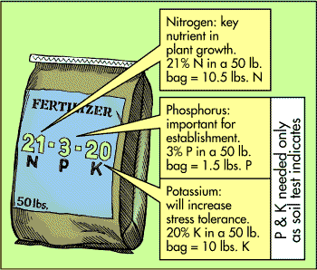
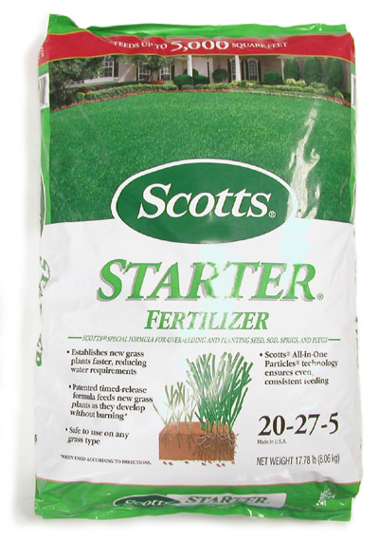
Agriculture Activities
Fertilizers- substance that enriches the soil…makes plants grow better.
Contain: N, P, K (and sometimes S)
Numbers just shown on bag mean the percent found in the fertilizer.
Example: 15, 15, 20, 25
Meaning 15% N, 15% P, 20% K, 25% S
Fertilizers can be harmful and must be applied carefully

Slide 11
Agriculture Activities con’t
Pesticides- chemicals that kill pests (pest = organisms that harm people, crops, or structures).
Herbicides- kill or control weeds
Insecticides- kill or control insects
Fungicides- kill fungi
Pesticides kill all pests as well, even good ones...

Slide 12
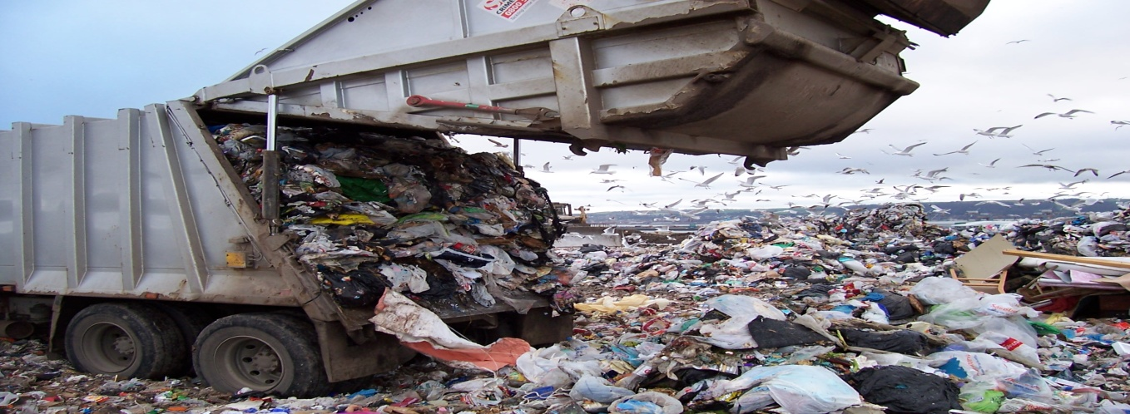
Solid Wastes
Garbage (includes everything from machinery to bottle caps)
Some solid wastes can be reused or recycled but most are placed in landfills
Hazardous wastes- incinerated (burn them at very high temperatures)
Sanitary landfills- plastic liners and compact clay to prevent solutions from entering soil

Slide 13
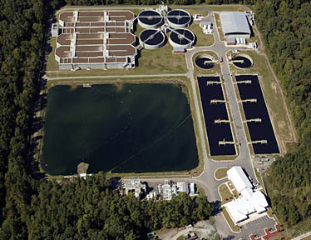
Wastewater
Sewage- dissolved and undissolved materials from kitchen, bathroom, and laundry
Septic tank- underground container where bacteria break down organic materials before moved to the soil
Sewage treatment plant- treats the wastewater and releases the effluent back into the river.
Effluent – Treated wastewater that has been released
Storm Sewers - not all water can be treated; therefore, storm water may be released straight back into the river

Slide 14
Fuel Combustion
Fossil fuels- coal, natural gas, oil formed from dead plants and animals. They are also called hydrocarbons…why?
They also contain S, N, O, Hg, Pb
Combustion Reaction:
Word Equation:
Hydrocarbon + oxygen → carbon dioxide + water + energy
Sometimes, SO₂, NO, Hg, Pb are let into the environment….dangerous!

Slide 15
Industrial Processes
Read p. 190
“sour gas” – natural gas that contains hydrogen sulfide

Slide 16
C & R p. 190
Numbers
1, 3-7

